Slide 1
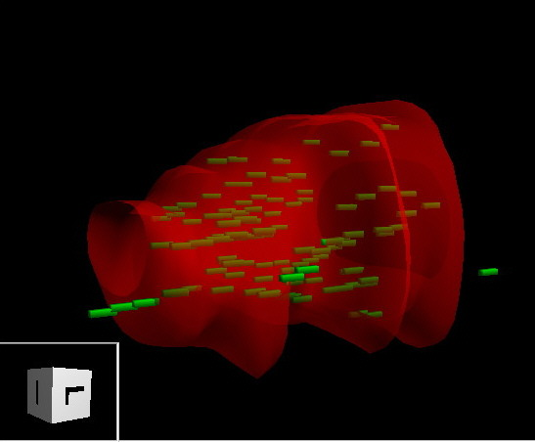
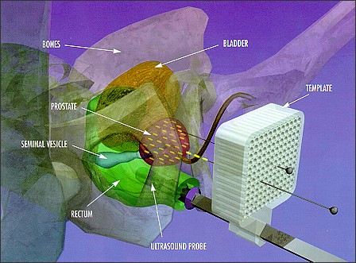
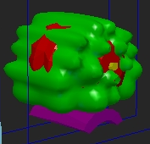
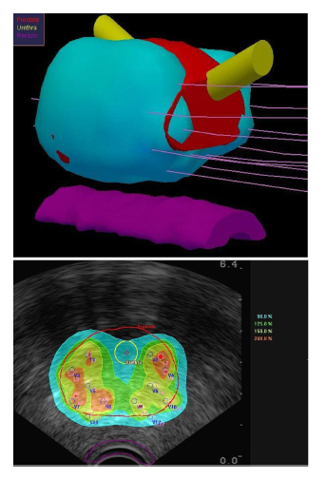
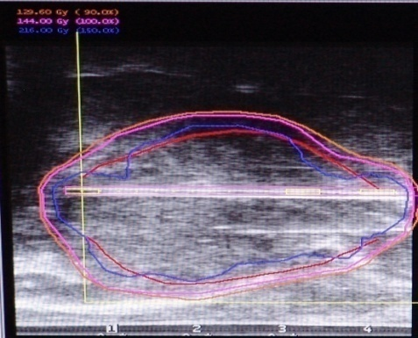
Prostate Cancer
Advancing Cure with Modern Technology and Research
Dr Siraj Husain MD

Slide 2
Outline
Introduction to Prostate Cancer
  Basic Background / Anatomy
Treatment Options
  Surgery, Radiation, Cryotherapy, HIFU
Recurrence after Treatment:
  What can we do?
  Surgery: -> Radiation Treatment, Hormones, Chemotherapy
  Radiation: -> Surgery, Salvage Brachytherapy, Hormones, Chemotherapy, Cryotherapy

Slide 3
How Bad is It??
Prostate cancer stats
Prostate cancer is the most common cancer among Canadian men.
In 2008, an estimated 24,500 men will be diagnosed with prostate cancer
and 4,800 will die of it.
On average, 471 Canadian men will be diagnosed with prostate
cancer every week.
On average, 92 Canadian men will die of prostate
cancer every week.
One in 8 men will develop prostate cancer during his lifetime,
mostly after age 60. One in 27 will die of it.

Slide 4
Prostate Cancer Problem
84% increase in diagnosed cases since 1987
    Aging population
    Earlier diagnosis (PSA, screening)
    Increasing awareness by patients
    Canadian Cancer Statistics 1998, 2001 and 2007 (NCI of Canada)

Slide 5
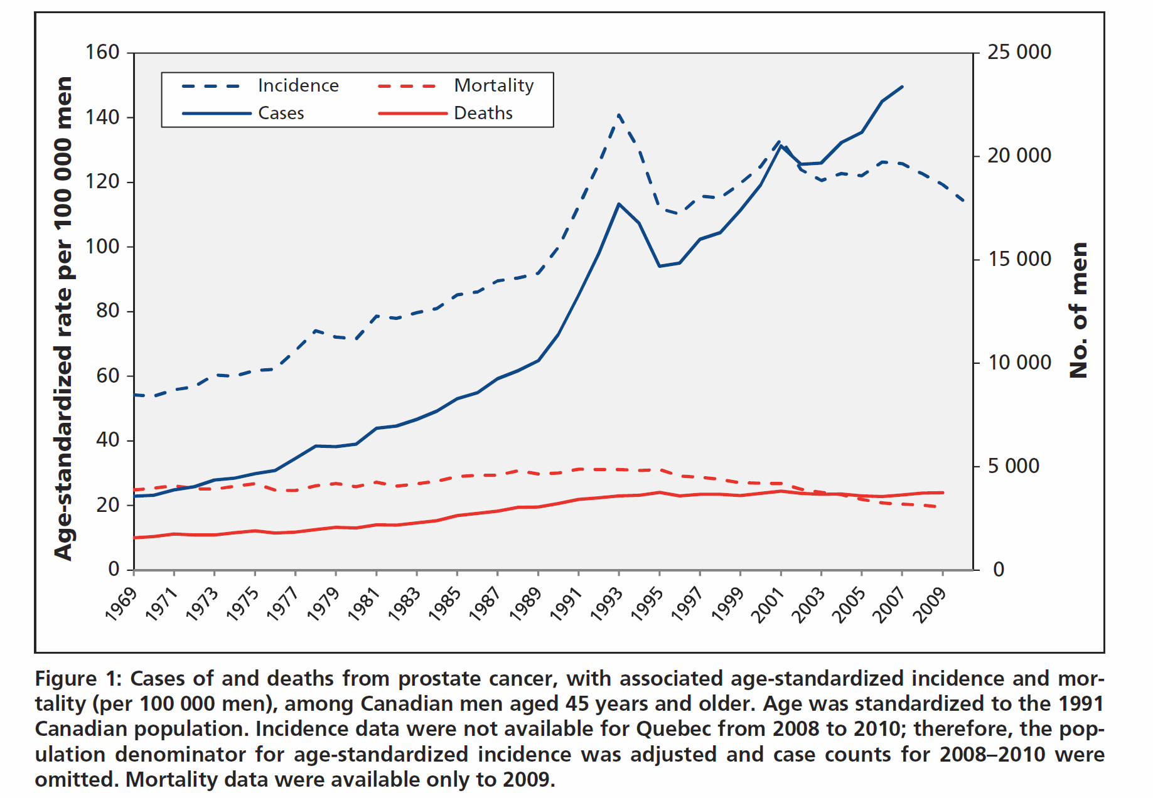

Slide 6
Prostate Anatomy and Function

Slide 7
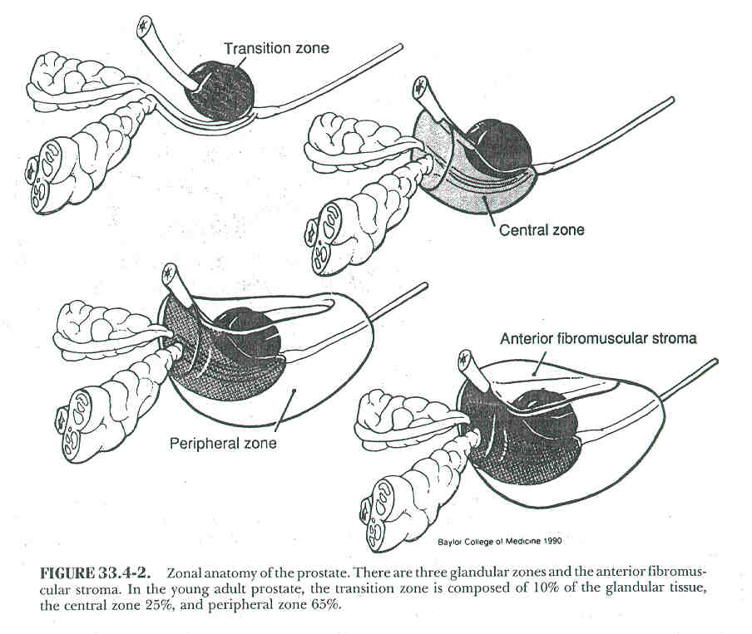
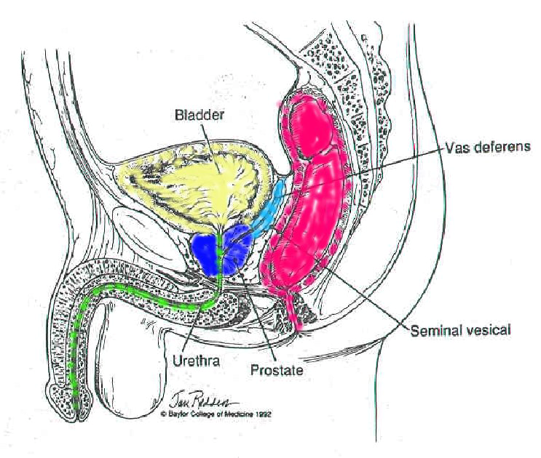
Prostate Anatomy:
Location:
  Between bladder
  Rectum & Penile bulb
The prostate is
  divided into 3 zones:
    Transitional
    Central
    Peripheral

Slide 8
Prostate Function (What does it do?)
Not clearly understood.
  Main 3 functions produces fluid for semen, which helps move sperm during orgasm; it makes PSA and it controls urine flow.
  Produces 20-50% of seminal fluids that may help sperm motility and penetrability.
    The functional unit is the glandular acinus that consists of both epithelial and stromal elements
    The epithelial component includes secretory epithelial cells (the major cell type), basal epithelial cells, neuroendocrine cells, as well as macrophages and lymphocytes.
    It produces clear fluid for semen. (The seminal vesicles, attached to the prostate, also contribute fluid and nutrients to the seminal fluid.) During orgasm, muscular contractions cause semen to be ejaculated through the urethra and from there out of the penis.

Slide 9
Functions of the Prostate
PSA Production :The prostate also makes prostate specific antigen (PSA). PSA is added into semen and turns it into liquid after ejaculation.
In healthy prostates, a small amount of PSA leaks out into the blood. However, prostate cancer cells leak more PSA, so early-stage prostate cancer can often be caught by a blood test that measures PSA levels.
Urine Flow Control: The prostate also plays a part in controlling the flow of urine. The urethra, the tube that carries urine from the bladder through the penis, passes through the prostate gland. Muscle fibers in the prostate contract to slow the flow of urine.

Slide 10
What Predicts Outcome of Prostate Cancer?
Personal Risk Factors (Risk of getting prostate cancer)
    Age
    Race
    Family History / Genetics
    Diet
Clinical Factors (Risk factors that affect prognosis and assist in treatment decisions)
    Gleason Score
    PSA
    Clinical Stage

Slide 11
Risk Factors
Host Related (Age):
  Age at diagnosis: <50 yrs – worse prognosis
  1 in 55 men between the ages of 40 and 59 will develop clinically apparent disease.
  1 in 7 men between 60 and 79.
  75% of men older than 80 will have some form of latent disease (Autopsy series)
  80% of clinically apparent disease occurs in men older than 65 years.

Slide 12
Risk Factors
Risk Group | RR for Prostate Cancer (95% CI)
Brother(s) with prostate cancer diagnosed at any age | 3.14 (2.37–4.15)
Father with prostate cancer diagnosed at any age | 2.35 (2.02–2.72)
One affected FDR diagnosed at any age | 2.48 (2.25–2.74)
Affected FDRs diagnosed <65 y | 2.87 (2.21–3.74)
Affected FDRs diagnosed ≥65 y | 1.92 (1.49–2.47)
Second-degree relatives diagnosed at any age | 2.52 (0.99–6.46)
Two or more affected FDRs diagnosed at any age | 4.39 (2.61–7.39)
CI = confidence interval; FDR = first-degree relative. Adapted from Kiciński et al, An epidemiological reappraisal of the familial aggregation of prostate cancer: a meta-analysis. PLoS One 6 (10): e27130, 2011.

Slide 13
Clinical Factors:
(Factors that affect outcome)
Gleason Score / PSA / Stage

Slide 14
Gleason Score
Graded 1 to 5: on the most common and the second most common type of abnormal cells that are seen in the Biopsy sample.
By adding the two grades a “Gleason Score” is obtained.
  Score 1 to 6: Low Grade
  Score 7: Intermediate Grade
  Score 8 to 10: High Grade

Slide 15
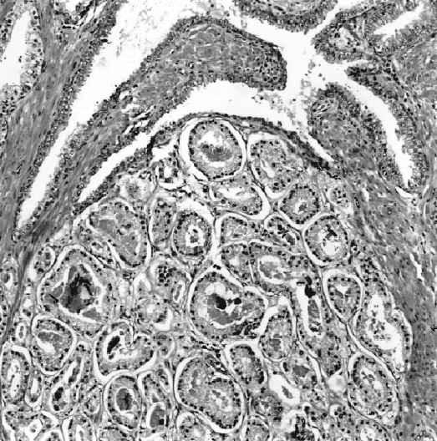
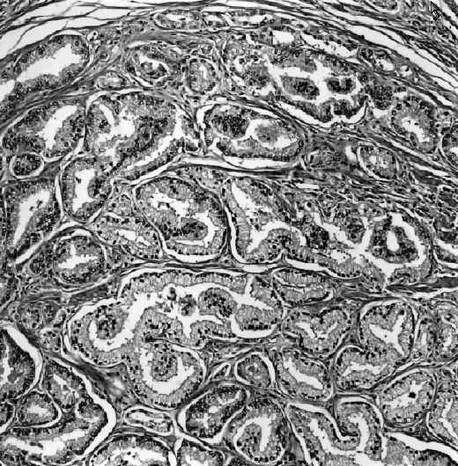
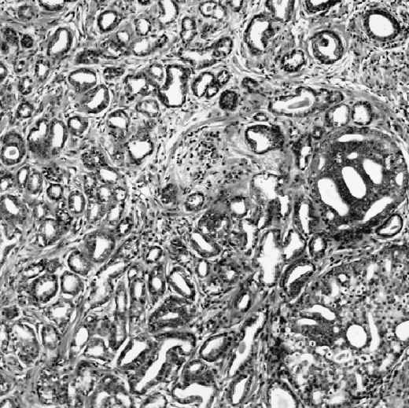
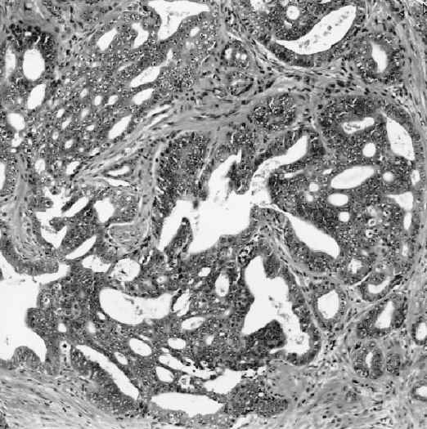
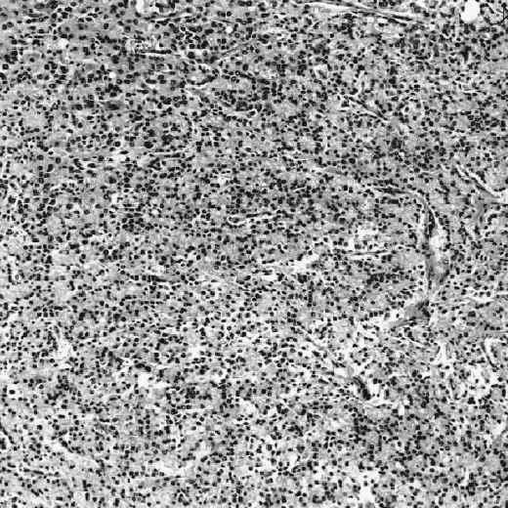
Gleason Grade 1
Gleason Grade 2
Gleason Grades
1 through 5
Gleason Grade 3
Gleason Grade 4
Gleason Grade 5

Slide 16
Prostate Specific Antigen (PSA)
This is the real revolutionary change in the last 25 years
Old serum tumor marker .. acid phosphatase first described in 1938
PSA isolated in semen 1971
Currently perhaps the best tumor marker in all of oncology

Slide 17
PSA
PSA circulates in the serum in uncomplexed (free or unbound) or complexed (bound) forms.
Serum PSA is largely complexed by endogenous protease inhibitors, the most common being alpha(1)-antichymotrypsin.
Elevates due to prostate disease, prostate manipulation, medication such as:
  Prostatitis
  Endoscopic urethral manipulation
  Prostatic Biopsy
  Ejaculation
  ?? DRE
Decreases due to:
  Meds that lower serum testosterone (LHRH agonists / antiandrogens, 5alpha-reductase inhibitors (Finasteride)
Used for staging, monitoring, and prognosis
Notes:
Prostate Cancer Early Detection
Prostate cancer screening or early detection has been accomplished
using DRE, measurement of serum PSA (and its various forms),
transrectal ultrasonography (TRUS), and combinations of these tests.
Although DRE can detect prostate cancer, it detects fewer cancers than
does PSA testing and, unfortunately, many cancers detected using DRE
are either locally or regionally advanced. [ref: 169] Although serum
PSA is a better screening test than DRE, DRE should not be abandoned,
as it may detect some cancers associated with a normal serum PSA level.
Therefore, DRE should be combined with serum PSA testing. TRUS should
not be used a first-line screening study as it lacks high specificity,
is relatively expensive, and adds little information to that already
gained by the use of serum PSA testing and DRE.[ref: 170] TRUS is used
to guide prostate biopsy in those patients who have an elevated serum
PSA level, an abnormal DRE, or both (Fig. 34.4_3).
PSA is a serine protease produced by benign and malignant prostate
tissues. Although it is produced in small amounts elsewhere, including
breast tissue, endometrium, and in a few malignancies other than
prostatic cancer, it should be considered to be organ-specific
clinically.[ref: 171-175] PSA circulates in the serum as uncomplexed
(free or unbound) or complexed (bound) forms.[ref: 176-178] Serum PSA
is largely complexed by endogenous protease inhibitors, the most common
being alpha(1)-antichymotrypsin. Other proteins bind a smaller
fraction.
Serum PSA may be elevated transiently in cases of prostatitis and
after endoscopic urethral manipulation, prostatic biopsy and, to a more
limited extent, ejaculation. [ref: 179,180] Routine DRE actually has
little effect on serum PSA, but most physicians defer PSA testing after
such an examination.[ref: 181] The half-life of serum PSA is 2.2 to 3.2
days. [ref: 182,183] Therefore, one should wait approximately 4 to 8
weeks after significant prostate manipulation, such as that which
occurs with prostatitis or prostate biopsy, before obtaining serum PSA.
It should be emphasized that the most common cause for an elevated
serum PSA level is BPH, the incidence of which increases with age, as
does the incidence of prostate cancer.
Serum PSA concentrations can be decreased by treatment with agents
that lower serum testosterone, such as luteinizing hormone-releasing
hormone (LHRH) agonists and antagonists, antiandrogens such as
flutamide, and the 5alpha-reductase inhibitor finasteride, which is
used for the management of presumed BPH and male-pattern baldness.
Finasteride also lowers PSA levels by an average of 50%. [ref: 184]
Therefore, one can correct for the effect of finasteride on PSA by
doubling the PSA level.[ref: 185] Use of alpha-adrenergic antagonists
such as terazosin (also used to manage obstructive voiding symptoms)
has no appreciable effect on serum PSA levels.[ref: 186]
Use of Total Serum Prostate-Specific Antigen Level and Digital Rectal
Examination for Prostate Cancer Early Detection
The risk of prostate cancer correlates with serum PSA concentrations
and DRE findings. The positive predictive value of a serum PSA level
between 4.0 ng/mL and 10 ng/mL is approximately 20% to 30%. [ref: 187-
191] For levels in excess of 10 ng/mL, the positive predictive value
increases to 42% to 71.4%. The use of DRE complements serum PSA testing
(Table 34.4_3).
The majority of cancers (>80%) detected by serum PSA are clinically
significant as defined by cancer grade and volume.[ref: 192] In
contrast to the use of DRE alone for early detection of prostate
cancer, the majority of PSA-detected cancers are confined clinically.
However, as many as 40% of cancers detected by the use of serum PSA and
DRE may have evidence of ECE, usually capsular penetration, if the
prostate is removed surgically and examined pathologically. [ref: 192]
The frequency of PSA testing remains a matter of some debate. In men
with a normal DRE and a PSA level in excess of 2.5 ng/mL, PSA testing
should be performed annually, as approximately 50% of these patients
may convert to having a PSA level exceeding 4.0 ng/mL. [ref: 193,194]
The test can be performed biannually in those with a normal DRE and
serum PSA level lower than 2.5 ng/mL, as conversion in this group is
much less likely. The likelihood of curable prostate cancer, either
organ-confined or with ECE associated with low to intermediate cancer
grade, is similar in men who have prostate cancer associated with serum
PSA levels lower than 4.0 ng/mL and in those with levels of 4.0 to 5.0
ng/mL. Therefore, cure is not likely to be compromised in those with
very low serum PSA levels initially who experience a limited rise in
the PSA level over time.
Enhancing Prostate-Specific Antigen Test Performance
A number of different strategies have been developed to enhance PSA
test performance, by increasing sensitivity in certain populations or
specificity in others. These strategies include use of age-specific
reference ranges, PSA velocity, PSA density, and the molecular forms of
PSA (free or complexed PSA).
PSA density is a measurement that attempts to correct for elevated
PSA levels due to BPH. PSA density is defined as the total serum PSA
level divided by the prostate gland volume (in milliliters) measured by
TRUS. [ref: 195] As prostate gland volume increases with increasing
amounts of BPH, PSA should rise as well. Prostate cancer releases more
PSA into the serum than does BPH.[ref: 196] The use of PSA density is
limited by the need to perform TRUS, variations in the accuracy of TRUS
to measure volume, and the fact that PSA levels due to BPH are a
product of the ratios of both the stromal and epithelial components of
BPH, which vary from patient to patient. Some have suggested that a PSA
density cutoff of 0.15 may better discriminate between patients with
elevated serum PSA levels due to BPH and those with elevated levels due
to cancer. [ref: 197] Catalona et al.[ref: 198] showed that as many as
50% of prostate cancers may be missed if one uses this PSA density
cutoff to determine the need for prostate biopsy. Still others have
failed to show any utility for the use of PSA density in men with a
normal DRE and PSA levels between 4.0 and 10.0 ng/mL.[ref: 199] As BPH
tends to occur in the transitional zone of the prostate and not in the
central or peripheral zones, attempts to improve prostate cancer
detection using transitional zone PSA density have been developed.
[ref: 200,201] However, like PSA density, these calculations are
subject to error, require TRUS, and do not seem to be superior to the
use of PSA testing alone in most patients. In addition, the failure to
identify prostate cancer in those with larger prostate glands may
simply be a product of biopsy sampling errors rather than true absence
of the disease.
Age-specific PSA reference ranges are an attempt to compensate for
the fact that the standard reference range of 0.0 to 4.0 ng/mL does not
reflect age-related volume changes in the prostate due to BPH. A single
cutoff may, therefore, be inappropriate for all ages. Many
investigators have proposed age-related reference ranges to improve
test sensitivity in younger men (who have less BPH and, therefore,
would be expected to have lower levels of PSA) and to improve test
specificity in older men (who are more likely to have BPH and higher
PSA values that accompany it).[ref: 202] Race may also have an impact
on PSA levels, an issue that has been addressed by several authors
(Table 34.4_4). Using age-specific reference ranges, cancer detection
rates will increase 8% to 18% in men younger than 60 years and will
decrease 4% to 22% in older men. Use of age-specific reference ranges
decreases the overall biopsy rate in men undergoing screening. The
biopsy rate has been shown to decrease approximately 21% in older men
undergoing screening if age-specific reference ranges are used.
However, the overall cancer detection rate will also decrease, as fewer
elderly men, the group most likely to have prostate cancer, will
undergo prostate biopsy. In one series, the overall cancer detection
rate fell from 5.7% using the standard PSA cutoff point of 4.0 ng/mL to
3.8% using age-specific reference ranges. Of the T1c or nonpalpable
cancers missed in the older patient population, the vast majority have
favorable pathologic features suggesting that they may be of low
biologic potential in this age group and that failure to detect them
may have little impact on patient mortality or morbidity. Use of age-
specific reference ranges remains controversial: Some investigators
have shown no benefit to their use as compared to use of the standard
cutoff point of 4.0 ng/mL. Others have also argued cogently the
likelihood that organ-confined cancers are similar in men with serum
PSA values between 2.5 and 6.0 ng/mL, suggesting that any lead time
gained by use of age-specific reference ranges will not likely
translate into improved outcomes and that the increased costs--
monetary, physical, and psychological--associated with the increased
biopsy rates in men younger than 60 years may not be justified.
PSA velocity refers to the rate of changes in serum PSA over time.
PSA velocity is calculated using the following equation: 1/2 (PSA2 -
PSA1/time 1) + (PSA3 - PSA2/time 2), where PSA1 is the first, PSA2 the
second, and PSA3 the third PSA measurement. Time represents the
interval (in years) between PSA measurements. At least three PSA
measurements obtained over 24 months or at least 12 to 18 months apart
are required for maximal accuracy. In the initial study, significant
differences in PSA velocity were noted in patients found to have cancer
and BPH many years before cancer diagnosis. Carter et al.[ref: 203,204]
found that a PSA velocity exceeding 0.75 ng/mL was highly predictive of
prostate cancer using one assay (sensitivity 72% and specificity 95%).
The use of PSA velocity is limited by the fact that multiple
measurements using the same assay over a relatively long period are
necessary for accuracy. In addition, there is substantial biologic and
laboratory variability in serum PSA testing, and some suggest that only
increases in serum PSA greater than 25% are likely to represent changes
due to prostatic disease (BPH or cancer).
Perhaps the greatest enhancement of PSA testing has been based on the
knowledge that PSA exists in the serum in both free (or unbound) and
complexed forms (bound to serum proteins). Stenman et al.[ref: 176]
made the observation that the free form of serum PSA exists in a higher
fraction in men without prostate cancer than in those with the disease.
Others observed that the specificity of PSA testing for the detection
of prostate cancer could be enhanced by calculating the free-to-total
PSA ratio as compared to using total PSA alone. [ref: 205] Partin et
al.[ref: 206] conducted a multiinstitutional trial evaluating the
performance of both total and free-to-total PSA for the detection of
prostate cancer in men with serum PSA levels between 4.0 and 10.0 ng/mL
using the Hybritech assay (Hybritech, Inc., San Diego, CA). All men had
a normal DRE and underwent systematic TRUS-guided prostate biopsy. Of
773 men, 379 (49%) were ultimately found to have prostate cancer. As
expected, the total PSA was higher and free fraction was lower in those
with prostate cancer as compared to those without the disease. Using a
free PSA cutoff of 20% to provide 95% sensitivity, these researchers
could achieve a specificity of 20%, eliminating 20% of unnecessary
biopsies. For patients who had a normal DRE and total PSA concentration
between 4.0 and 10.0 ng/mL, the probability of prostate cancer was 56%,
20%, and 8% for those with free PSA fractions of 0% to 10%, 15% to 20%,
and more than 25%, respectively. Catalona et al. [ref: 206] also
demonstrated that the use of the percentage of free PSA in men with
total serum PSA concentrations between 4.0 and 10 ng/mL could eliminate
29% of unnecessary biopsies, if a cutoff of 20% free PSA was used as an
indicator for prostate biopsy. Others have performed similar studies
using the same or different assays and patient populations (i.e.,
ranges of total PSA). [ref: 205,207-213] In these studies, the
sensitivity and specificity for cancer detection varied from 71% to
100% and 24% to 95%, respectively, using cutoff points ranging from 14%
to 28%.
As 13% to 20% of men with serum PSA concentrations between 2.6 and
4.0 ng/mL (upper limit of normal) will be found to have prostate cancer
within 5 years, some have examined the usefulness of percentage of free
PSA for the early detection of prostate cancer in these men. [ref:
171,176,214] Catalona et al.[ref: 208] used percentage of free PSA to
screen 914 men aged 50 years or older who had normal DREs and total PSA
concentrations between 2.6 and 4.0 ng/mL. Using a cutoff point of 27%
free PSA, 90% of cancers were detected and 18% of unnecessary biopsies
were eliminated. The positive predictive value of percentage of free
PSA at this cutoff point was 24%, and 81% of 52 men who underwent
radical prostatectomy were found to have organ-confined cancers. Of
these cancers, 83% were considered to be clinically significant based
on cancer volume, stage, and grade. Others have shown similar findings
using a different PSA cutoff point. [ref: 215]
The percentage of free PSA may also be of value in predicting cancer
aggressiveness. Carter et al. [ref: 216] measured both total and
percentage of free PSA serially in men from whom serum had been stored
before the diagnosis of prostate cancer. Stored sera from men with
aggressive cancers as defined by stage (T3, nodal or bone metastases),
grade (7), or positive margins at the time of radical prostatectomy
were compared to sera from men with less aggressive cancers (none of
the previously mentioned features). Although total PSA levels were not
different between both groups measured serially before the diagnosis, a
statistically significant difference between the two groups with
respect to percentage of free PSA was noted. All eight patients with
aggressive cancers from whom serum was available for testing 10 years
before diagnosis had free PSA fractions of 14% or less.
Clinicians should be aware of several issues when determining whether
to use percentage of free PSA and in interpreting results of the assay.
Age, prostate volume, and method of serum storage before processing may
influence PSA ratios. Samples should be processed within 3 hours or
stored at -70C if processing is delayed; otherwise, the free PSA
fraction may be degraded. [ref: 217] Lower free PSA cutoff points may
be possible in smaller gland volumes (i.e., <40 cm**3) while still
maintaining an acceptable detection sensitivity of 90%. [ref: 207]
Several analytical issues must be understood. Assays performed by
different methods may yield different results. [ref: 191,218,219] The
percentage of free PSA cutoff point advised by manufacturers of these
assays varies. Therefore, clinicians must be well acquainted with the
methods used for free PSA testing before interpreting the results.
Finally, it must be emphasized that use of percentage free PSA improves
specificity of detection; some cancers will be missed. Both physicians
and patients must be aware of this, as some will find any decrement in
sensitivity unacceptable. Percentage of free PSA testing may be used
best when determining the need for a second prostate biopsy in patients
with a normal DRE, a total serum PSA between 4.0 and 10 ng/mL, and a
previously negative biopsy.
Future Refinements
Similar to use of percentage of free PSA, several investigators have
assessed the measurement of complexed PSA (PSA bound to alpha(1)-
antichymotrypsin) for the detection of prostate cancer. Brawer et al.
[ref: 220] measured total, complexed, and free PSA in 75 men with
prostate cancer and in 225 who had benign findings on prostate biopsy.
At 95% sensitivity, the specificities of total, free, and complexed PSA
were 21.8%, 15.4%, and 26.5%, respectively. Sokoll et al. [ref: 221]
reported similar findings and improved specificity for complexed PSA as
compared to total PSA in men with total serum PSA concentrations
between 4.0 and 10.0 ng/mL.
The ProstAsure Index (Horus Global HealthNet, Hilton Head Island, SC)
examines the relationships between several variables, such as PSA, age,
and prostatic acid phosphatase, using an artificial neural network to
predict the risk of prostate cancer. Babaian et al.[ref: 222] compared
the ProstAsure Index with percentage of free PSA for prostate cancer
detection in 54 men with prostate cancer, 77 with BPH, and 94 with no
evidence of either. A comparison of the receiver operating
characteristics curves for both tests demonstrated that the area under
the curve for the ProstAsure Index was higher than that for percentage
of free PSA (0.95 vs. 0.86, respectively), suggesting a small but
significant advantage for the index.
Other serum proteins have been identified that may, in the future,
play a role in prostate cancer detection and evaluation. Prostate-
specific membrane antigen (PSMA) is a 750-amino acid type 2
transmembrane glycoprotein distinct from PSA. Serum levels of PSMA are
increased in patients with prostate cancer. Human kallikrein-2 is a
serum protease that bears considerable homology to PSA. Neither PSMA
nor human kallikrein-2 currently is being used routinely for prostate
cancer early detection, but refinements in development of serum assays,
as well as novel imaging and treatment techniques targeting these and
yet-to-be discovered proteins, may have a significant impact on
prostate cancer early detection, staging, and treatment.
Prostate Biopsy and Its Impact on Risk Assessment
Prostate biopsy is indicated in men with an elevated serum PSA level,
an abnormal DRE, or a combination of the two. Prostate biopsy is best
performed under TRUS guidance using a spring-loaded biopsy device
coupled to the transrectal probe. [ref: 223,224] Although prostate
biopsy can be done using a transperineal approach, the transrectal
approach facilitates more accurate needle placement and tissue
sampling. Rather than just sampling an area abnormal on the basis of
DRE or TRUS imaging, systematic biopsy strategies have been developed
that improve cancer detection and risk assessment. DRE and TRUS each
lack the sensitivity and specificity to guide performance of lesion-
directed biopsy only. Traditionally, six (sextant) biopsies have been
taken in most patients along a parasagittal line between the lateral
edge and the midline of the prostate at the apex, midgland, and base
bilaterally (Fig. 34.4_4). [ref: 225] Recently, several investigators
have assessed the impact of increasing the number of biopsies as well
as sampling specific portions or zones of the prostate.[ref: 225-227]
Investigators have shown that more laterally directed biopsies of the
peripheral zone will increase detection rates by 14% to 20% over the
more traditional sextant technique. Chang et al. [ref: 225] analyzed a
biopsy scheme that involved tissue from a minimum of eight sites,
including bilateral apex, midlobar midgland, parasagittal midgland, and
lateral base (see Fig. 34.4_4). They found that the parasagittal
biopsies at the base added very little unique information to this
scheme.
As up to 30% of lesions may originate in the transitional zone, many
investigators have examined the utility of specific transitional zone
biopsies.[ref: 228-231] Most have found that routine transitional zone
biopsies add little unique information to that gained from routine
peripheral zone biopsy schemes. Therefore, transitional zone biopsy
should be considered in those with a high suspicion of prostate cancer
based on serum PSA level and who have undergone previous peripheral
zone biopsy without cancer detection. Patients should be advised that a
negative prostate biopsy does not completely exclude cancer, as 13% to
31% of patients with an initially negative biopsy will be found to have
cancer on subsequent biopsy.[ref: 232,233]
Although the primary goal of prostate biopsy is cancer detection, the
information gained from the results, if positive, can be of
considerable value in initial risk assessment. The number of cores with
cancer as well as the cancer grade determined by biopsy correlate with
the risk of ECE and cancer progression. As biopsy samples only a
portion of the prostate, accurate grading may be hampered by sampling
errors. Grade as measured by biopsy will correlate exactly with that
determined by analysis of the entire prostate after radical
prostatectomy 31% to 59% of the time. [ref: 234,235] Most often, needle
biopsy underestimates cancer grade. Grading errors appear to be more
limited with the use of contemporary biopsy schemes, which have
increased (>6) the number of cores taken.[ref: 236]
Prostate cancer volume correlates with both the risk of extracapsular
disease and outcome after treatment. Although cancer volume currently
is not well assessed by imaging, analysis of the number of biopsy cores
involved with cancer as well as the extent of cancer within each core
appears to be of value in this regard. Patients with multiple positive
biopsies are at an increased risk of both ECE and recurrence after
initial therapy. One series reported on 257 consecutive radical
prostatectomy patients and demonstrated that the number of positive
sextant biopsies and the Gleason score correlated with ECE (P <.0001
and P = .0004, respectively) in a comparison of patients with and
without ECE. [ref: 237] With respect to serologic recurrence, patients
with fewer than three positive biopsies and a Gleason score of less
than 7 were at a low risk for recurrence irrespective of preoperative
PSA levels (14% risk with a mean follow-up of 2 years). [ref: 237]
Other investigators have substantiated these findings, noting that
patients in whom more than 50% of biopsy cores are involved with cancer
are at an increased risk of both ECE and disease recurrence after
radical prostatectomy.[ref: 238-240] Knowledge of the number of cores
involved may give important information not provided by analysis of the
PSA level, Gleason grade, and local T stage alone.[ref: 241]
Although TRUS-guided prostate biopsy usually is very well tolerated
by patients, approximately 24% of those undergoing the procedure will
find it very painful. Hematospermia and hematuria are common, occurring
in approximately 40% to 50% of patients.[ref: 242-244] High fever is
rare, occurring in 2.9% to 4.2% of patients. Antibiotic prophylaxis is
commonly given, although the necessity for it has been questioned by
some. [ref: 242] Recent use of aspirin or nonsteroidal antiinflammatory
agents is not a contraindication for this procedure.[ref: 244]

Slide 18
PSA
PSA Values – May Predict the Extent of Disease: - especially when combined with the Gleason Score
  < 10 (Low volume/risk)
  10 – 20 (Intermediate volume/Risk)
  > 20 (High volume/Risk)

Slide 19
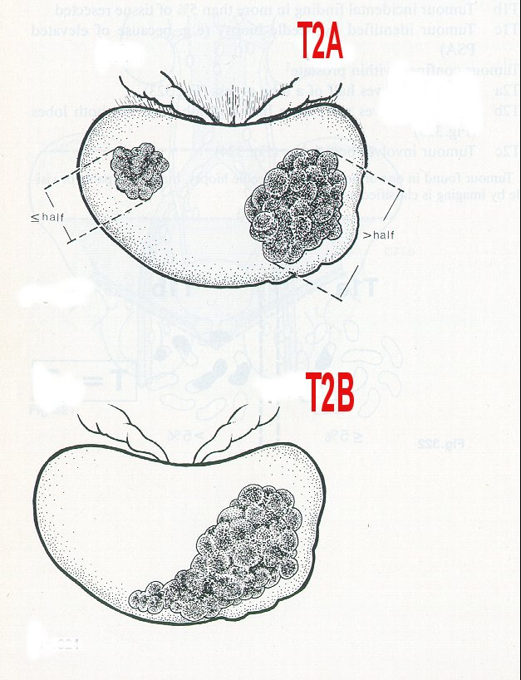
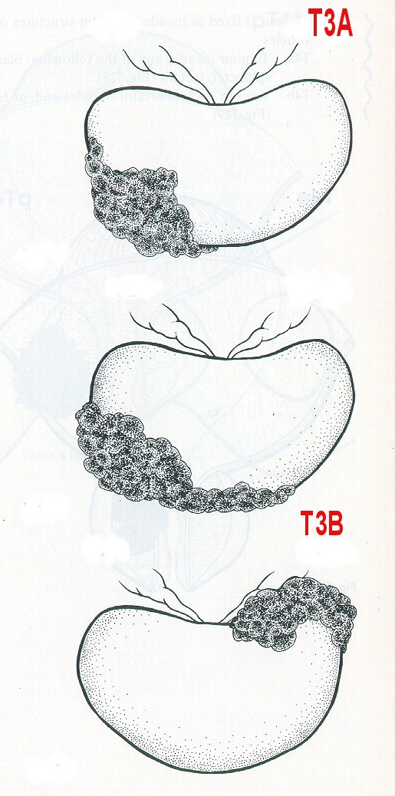
T-Stage for Prostate
T1 / T2 - tumour still confined to prostate gland
T3 / T4 - tumour spread outside prostate gland capsule

Slide 20
Prostate Cancer Risk Categories
Low Risk: (Good chance the cancer is confined to the prostate gland)
  T1a-2a and GS ≤ 6 and PSA ≤ 10 (Confined to Gland)
Intermediate Risk: (Risk the cancer has extended into the tissues around the prostate)
  PSA >10 but <20 and clinical stage T1a->T2c and GS ≤ 7or
  GS=7 and clinical stage T1a->T2c and PSA ≤ 20
High Risk: (Good chance the cancer has spread to the Lymph Nodes, Bones etc) Any one of these parameters:
  ≥T3a OR GS ≥ 8 OR PSA >20

Slide 21
Risk Groups
 | LOW | INTERMEDIATE | HIGH
PSA | <10 | 10 - 20 | > 20
Gleason score | & <=6 | OR 7 | OR 8-10
T- Stage | &T1-T2a | OR T2b, T2c | OR T3,T4
RX. Options | Surveillance Prostatectomy EBRT Brachytherapy Cryotherapy | Prostatectomy EBRT (+/- hormones) Cryotherapy Brachytherapy (a subset of pts.) Surveillance | EBRT &hormones Prostatectomy Cryotherapy Hormones only

Slide 22
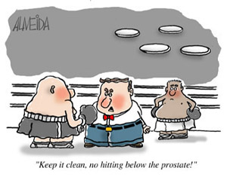
Treatment Options
Surgery vs. Brachytherapy
“”Keep it clean, no hitting below the prostate”

Slide 23
Surgery vs Brachytherapy
Giberti C: Italian Study (200 patients)
  Randomized to brachy or surgery
  5 year results:
    Cure: 91% surgery 91.7% Brachy
      Surgery: Incontinence 18.4% -> 6.5%; Good EF 40% at 5 years
      Brachy: Irritative symptoms 20% at 1 year, Good EF 68% (at 5 years)

Slide 24
Radiation Oncology
Advances in Modern Technology
Advancing Cure

Slide 25
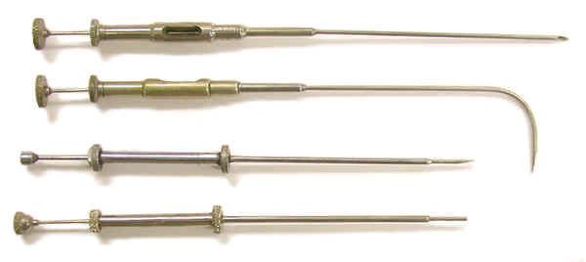
Advances in Brachytherapy
Low Risk:
  Brachytherapy: (Short / Treatment)
    1st Treatment for Prostate Cancer:
      1907 (radium implants)
      A “real” man’s treatment
    What’s New?
      Intra-operative Technology / Computer Guided / Robotic Delivery
      Improved cure rate
      Reduction in side effects

Slide 26
Why Does Prostate Brachytherapy Work: Extracapsular Extension
Extracapsular disease and
Radial extension of tumor
In low risk disease
3mm
80%
5mm
90%
Effective Radiation Dose
From ¹²⁵Iodine is 5 mm (Covers 90%)

Slide 27
Dose Escalation Results
Hanks et al: “Dose selection for prostate cancer patients based on dose comparison and dose response studies” Int. J Radiat Oncol Biol Phys: 2000;46:823-832
5 year Local Recurrence Rates | Radiation Dose
37 % | < 60 Gy
36 % | 60 – 64.9 Gy
29% | 65 – 69.9 Gy
19% | 70 Gy +
5% | 78 Gy +
<1% | Brachytherapy

Slide 28
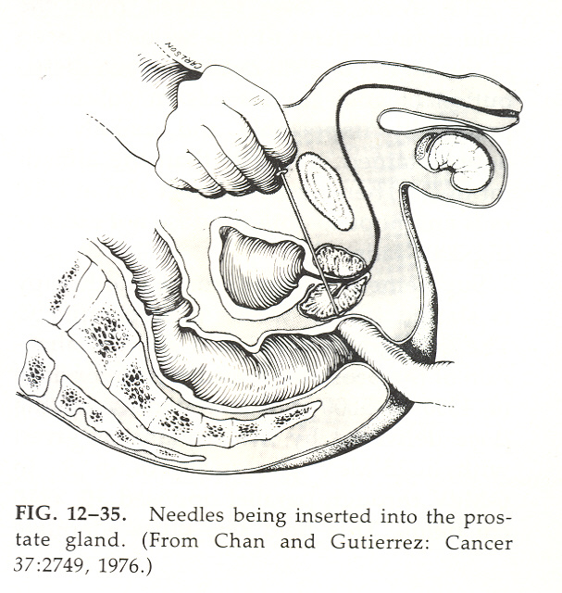
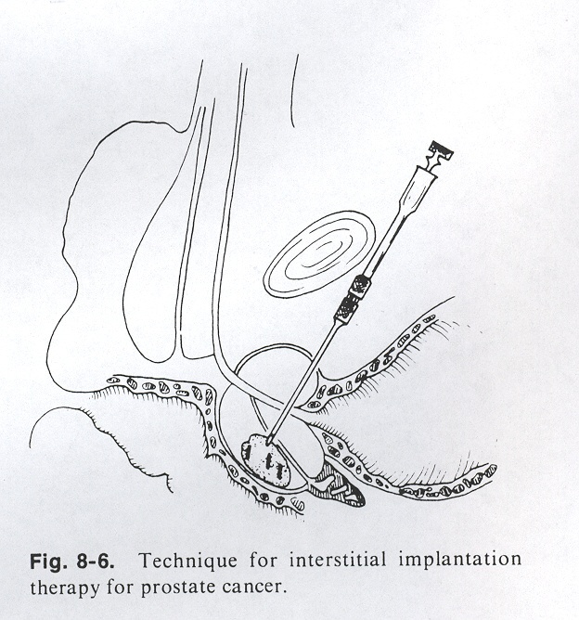
Early Brachytherapy Technique: Open Procedure

Slide 29
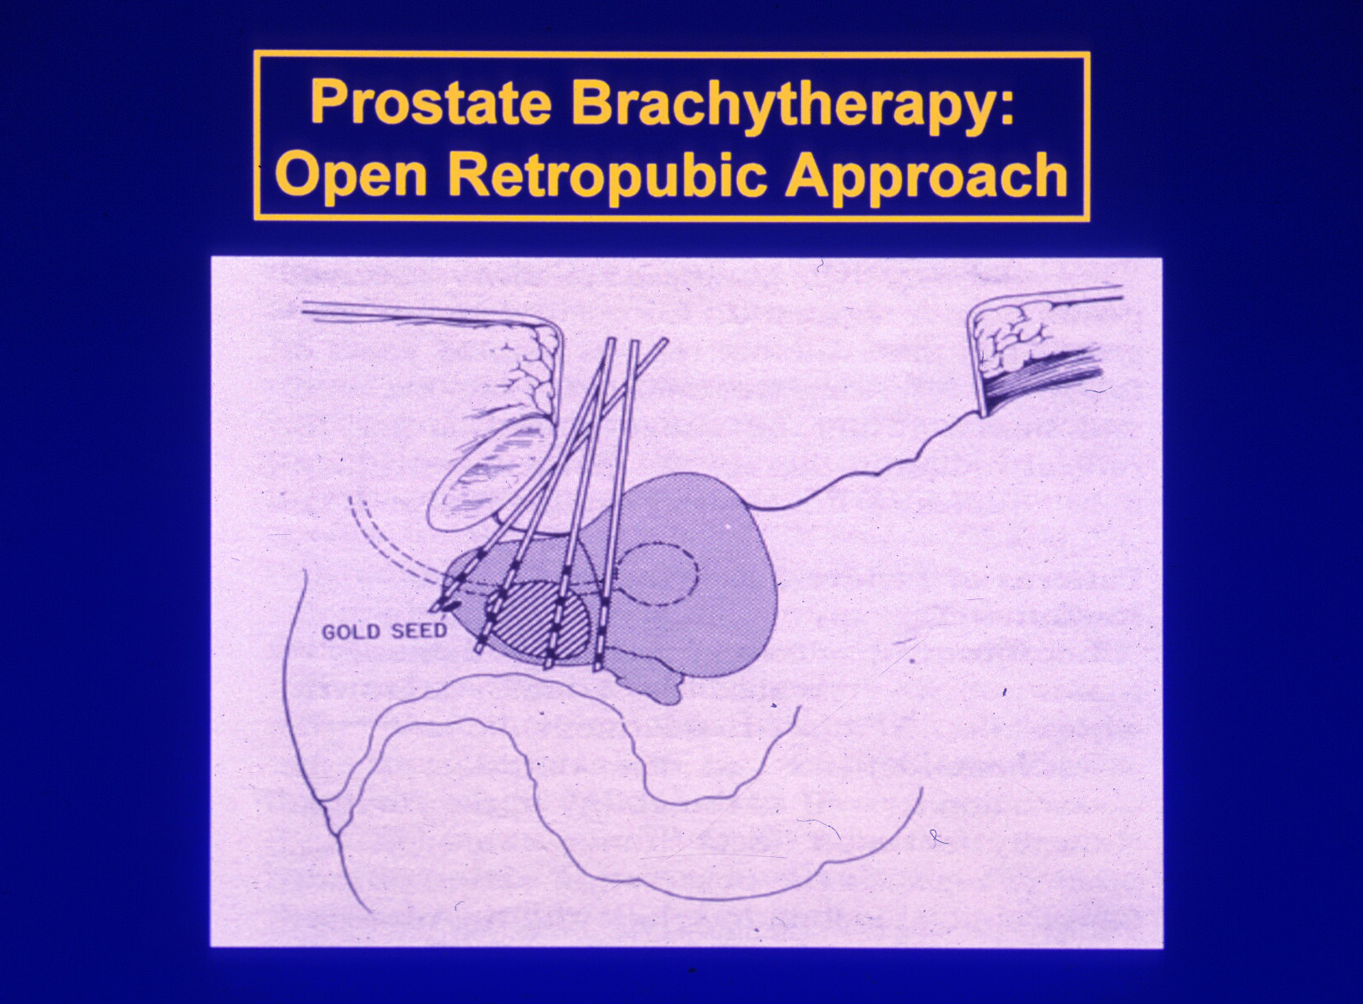
Prostate Brachytherapy: Problems with needle placement and radiation dose

Slide 30
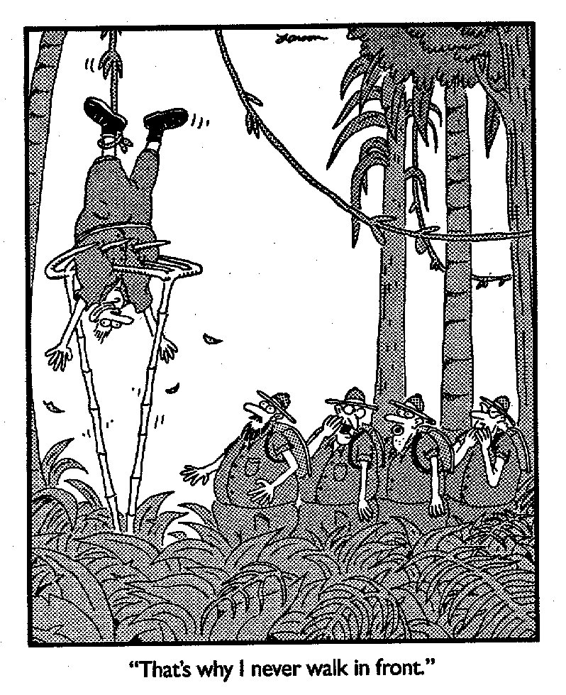

Slide 31
Modern Techniques
Pre- Plan System (1990’s)
  Patient brought in 1 month pre implant
    (TRUS) Ultrasound done for planning purposes
    Implant done 1 month later (Based on the previous images and plan)
Intra-Operative System (2000’s)
  No Pre-Plan
  Patient brought to operating room
    (TRUS) Ultrasound done, Planning done on “live” image, implant performed immediately afterwards

Slide 32
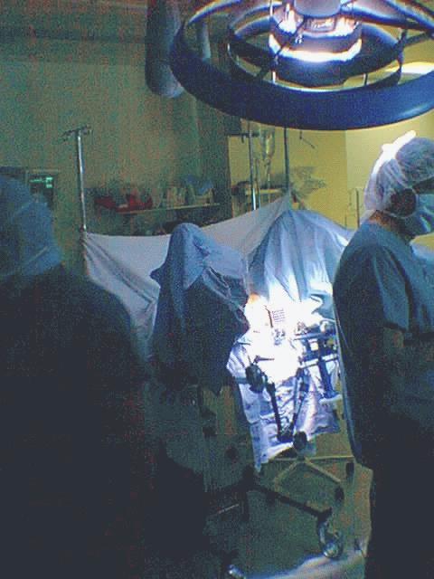
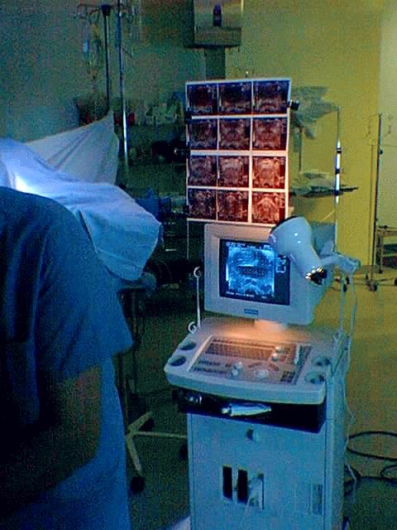
Preparing for implant (Pre-Plan)
TRUS: Images Taken and used For planning 1 Month earlier: Needed to try And Match with
US at time of Treatment

Slide 33
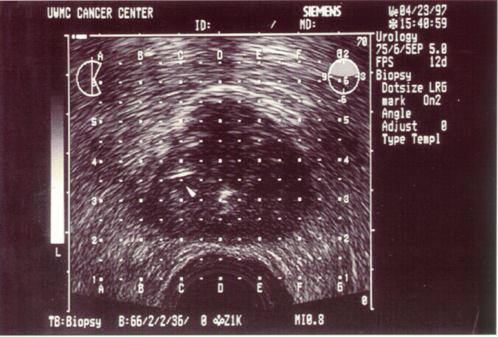
Location of Needle Tip on U/S
Needle Tip

Slide 34
Intra-operativeTechnique (2000’s)
What’s Different ? Using Computers, Live Imaging, Live Planning
Integrating Computers with Medicine:
  Computerized Image Capture in 3 D
  Computerized “Live” Planning
    Deciding on best placement of seeds and needles on the “Live” image
  Computer “Guided” Needle Implant
    Creating a “road map” to guide and accurately place the needles and seeds
  Computerized delivery of Seeds

Slide 35
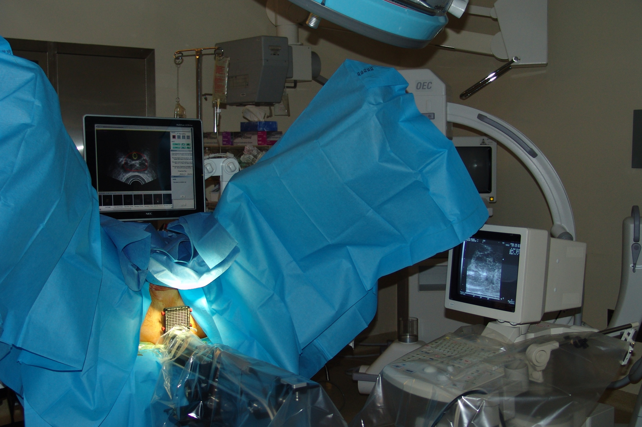
IMPLANT: OR Setup with Computer Screens (No TRUS)
Notes:
Look at how delivery advances

Slide 36
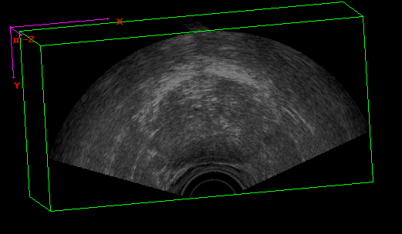
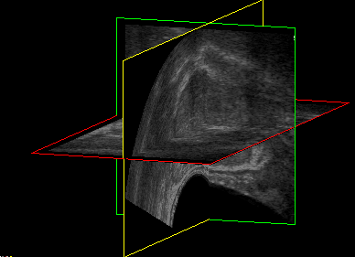
3D Ultrasound: Image captured in approximately 10 seconds, with creation of a 3D model
Notes:
Well, first of all 3D isn’t new. What is new is the direction of the acquisition, and the speed with which a 3D volume can be obtained and reconstructed and the automation of the process.
Transverse images – physicians draws prostate on all slices, physicist digitizes them into their computer
Go to OR a few weeks later – patient’s asleep, guess what? Their prostate doesn’t look the same. The plan they made on that prostate? Clinical results show that most patients do well. But some don’t.
If you could get an image and plan in the OR and then deliver right away – why wouldn’t you?
So what does 3D ultrasound mean for us? US is the technology, the mover is the technology, using it in the OR for prostate brachytherapy live planning is the innovation
For us,
Paitent moves, has gas, requires cleansing just re-scan
Live feedback during treatment on the planning system

Slide 37
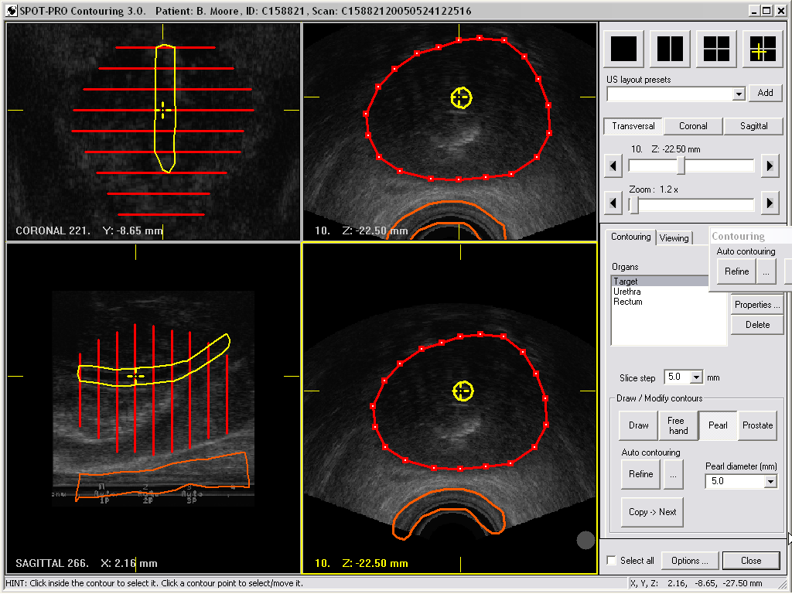
Prostate Mapping: Contouring live in 3D

Slide 38
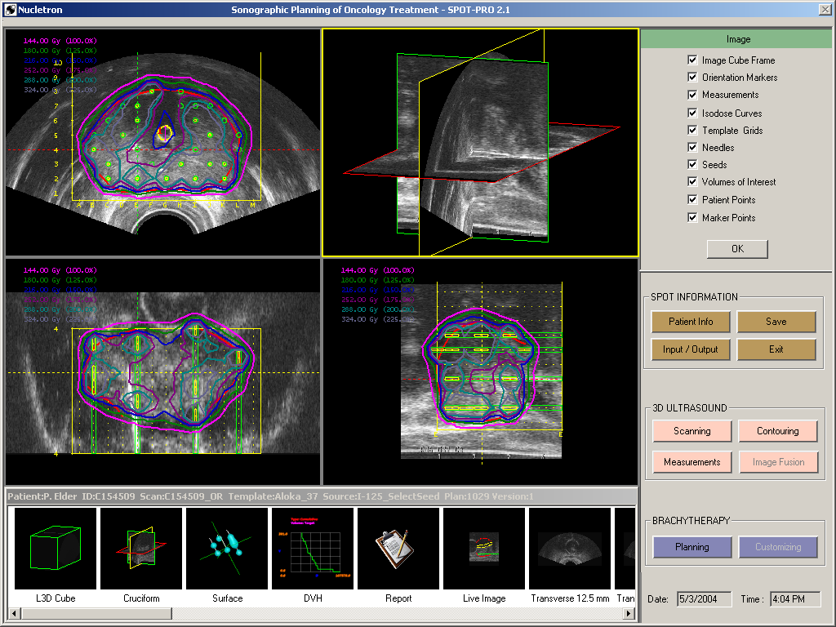
Viewing the plan in 3D: Sagittal, Transverse and Coronal Views

Slide 39
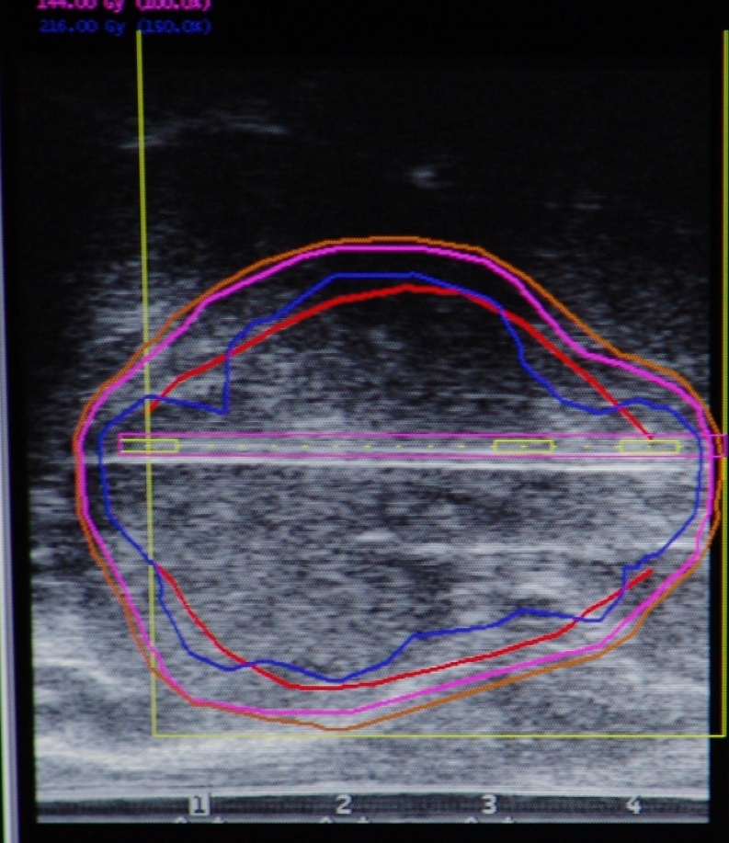
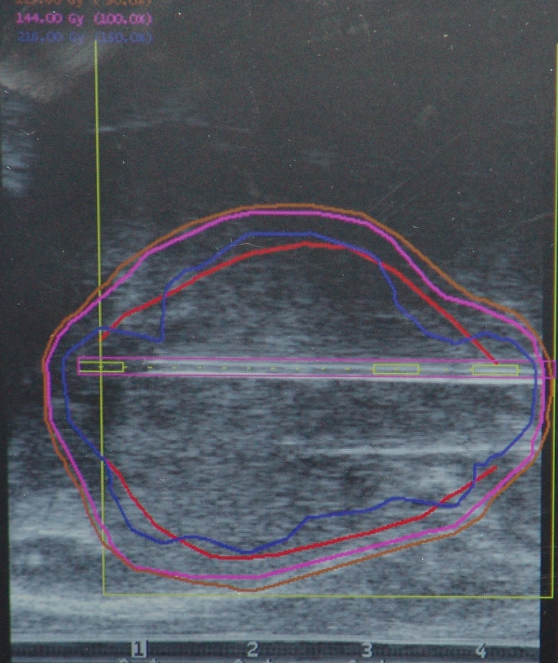
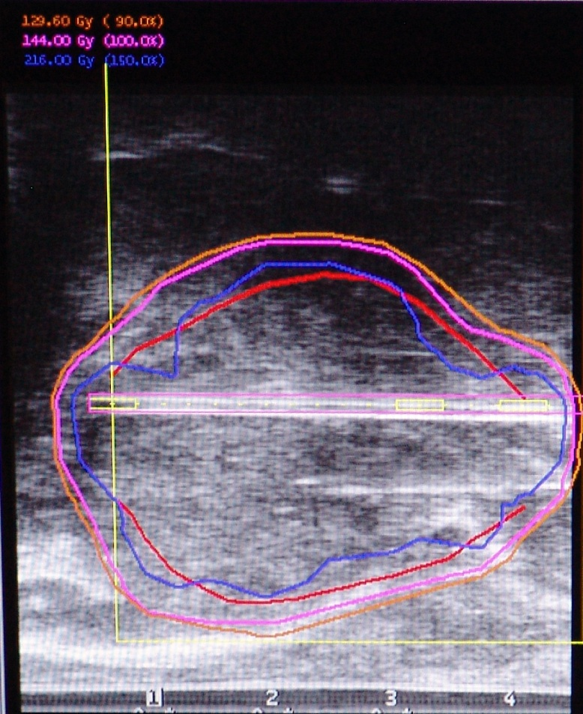
Whole Needle view vs.
Only Needle Tip

Slide 40

Computer Guided Needle Placement
Computer Generated Needle
(Purple) Actual Needle (White)
Whole Needle view vs.
Only Needle Tip

Slide 41

Who’s Eligible for this Treatment

Slide 42
Eligible Patients
  Age (45 to 80)
  Low Risk: PSA ≤ 10 & Gleason ≤6 & T stage ≤ T2a
  1 Intermediate Risk Factor:
    PSA > 10 but ≤ 15
    Gleason score = 7
    Clinical stage >T2a but ≤ T2c
  Gland Volume < 55 (May be downsized to this size if >55 but less than 90 ccs)
  AUA score ≤ 20

Slide 43
Recurrence
What can we do?

Slide 44
Recurrence
Definition:
  Surgery: PSA of >0.2ng/ml measured 6-13 weeks after surgery
  Radiation Treatment –
    (ASTRO definition) 3 consecutive rises following nadir (or the lowest PSA achieved) or
    (Phoenix Definition) nadir PSA +2 ng/ml

Slide 45
Recurrence
First thing to try and identify:
  Where is the recurrence?
    1) Is it localized: Prostate only (or prostate Bed after Surgery)
    2) Is it Regional: In the Lymph nodes located in the Pelvis
    3) Is it Systemic: Spread outside the pelvis into the higher Lymph Nodes, or Bones, or Liver etc.

Slide 46
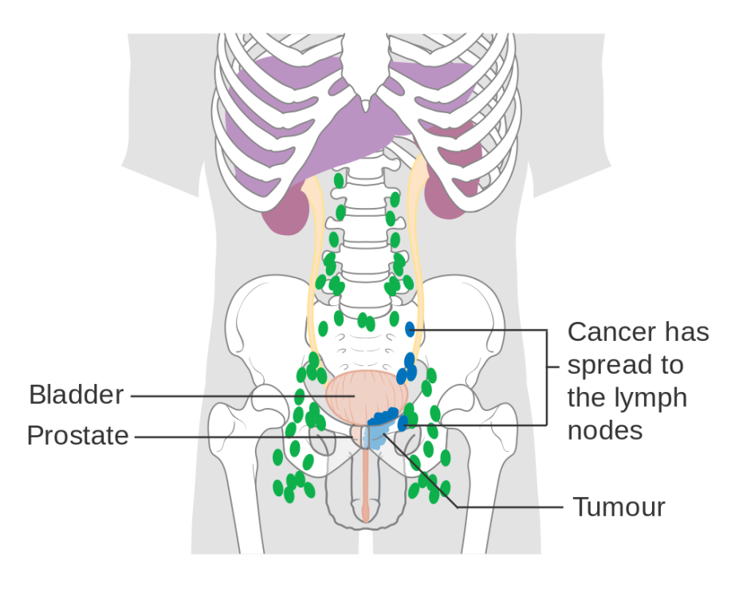
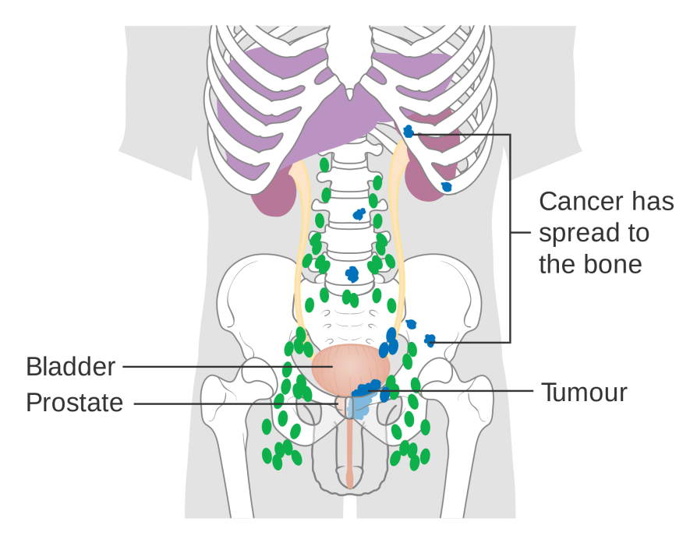
Local/Regional/Systemic

Slide 47

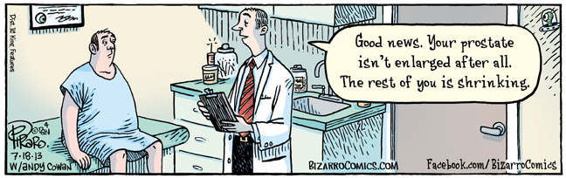
? Benefit of Prostate Exam

Slide 48
Prognostic Factors
Pre Treatment:
  PSA, T-Stage, Gleason Score
After Surgery
  LN Status, Surgical Margins, Extracapsular extension, Gleason Grade, PSA
PSADT (PSA doubling time)
  Pre and post treatment
  <3 mos, 3-9 mos, 9-15 mos and >15 mos)
Time to recurrence

Slide 49
Recurrence
Need to know:
  What was the primary treatment?
    Surgery, Radiation, Cryotherapy
  Where is the recurrence?
    Local (Prostate or Prostate Bed alone)
    Regional (Lymph Nodes)
    Distant (Bone, liver, lung etc.)

Slide 50
Recurrence
How can we decide: Various Tests can help us.
  Biopsy:
    Repeat biopsy of the prostate may suggest if there is cancer in the prostate
  PSA: reflects the amount and growth rate of cancer
    Low PSA – more likely the cancer is confined to a small area
    High PSA – Suggests the caner has spread beyond the prostate
    PSADT – PSA Doubling time
  MRI: 3.0T MRI:
    South Campus Hospital – clear image of the prostate
  Bone Scan, CT, MRI, Nuclear Imaging (PET scans)

Slide 51
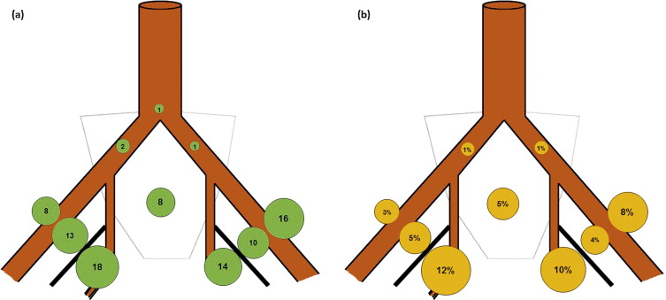

Slide 52
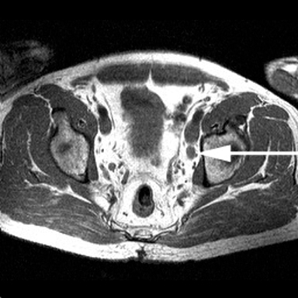
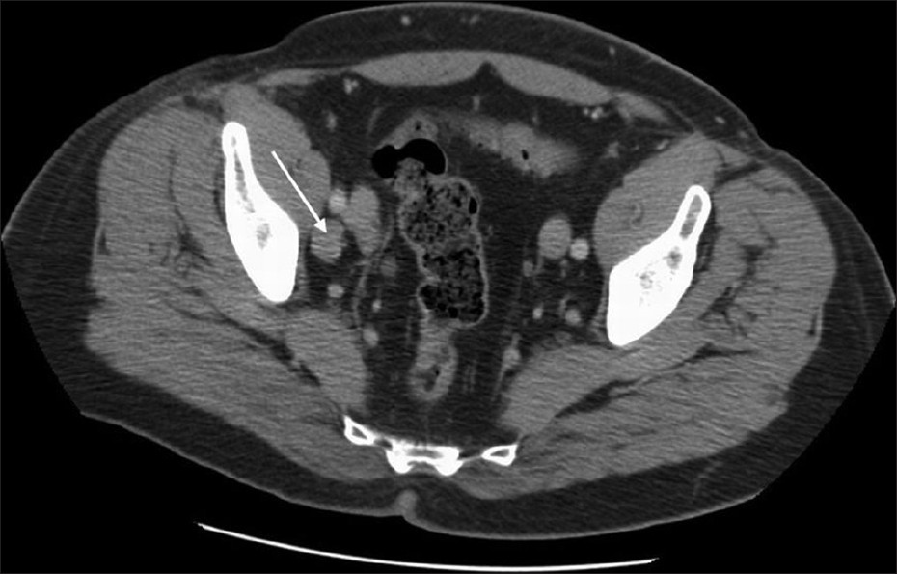
Isolated LN Recurrence

Slide 53
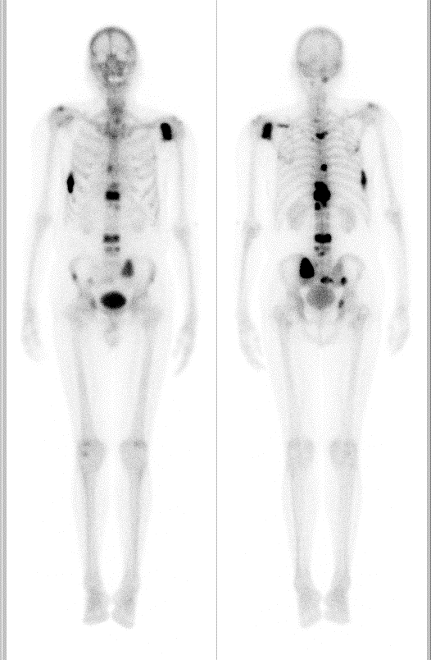
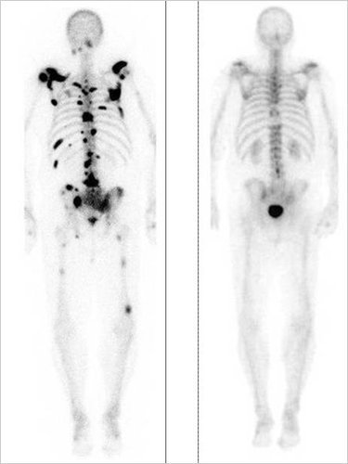
Bone Scan

Slide 54
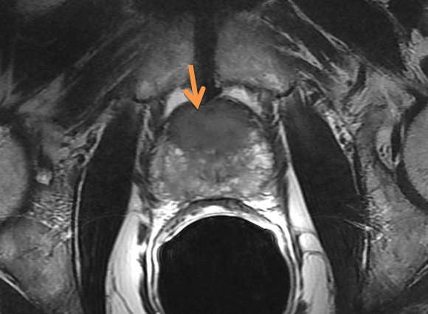
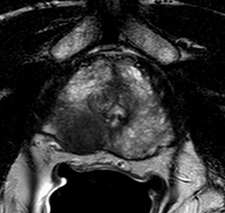
Recurrence in Prostate

Slide 55
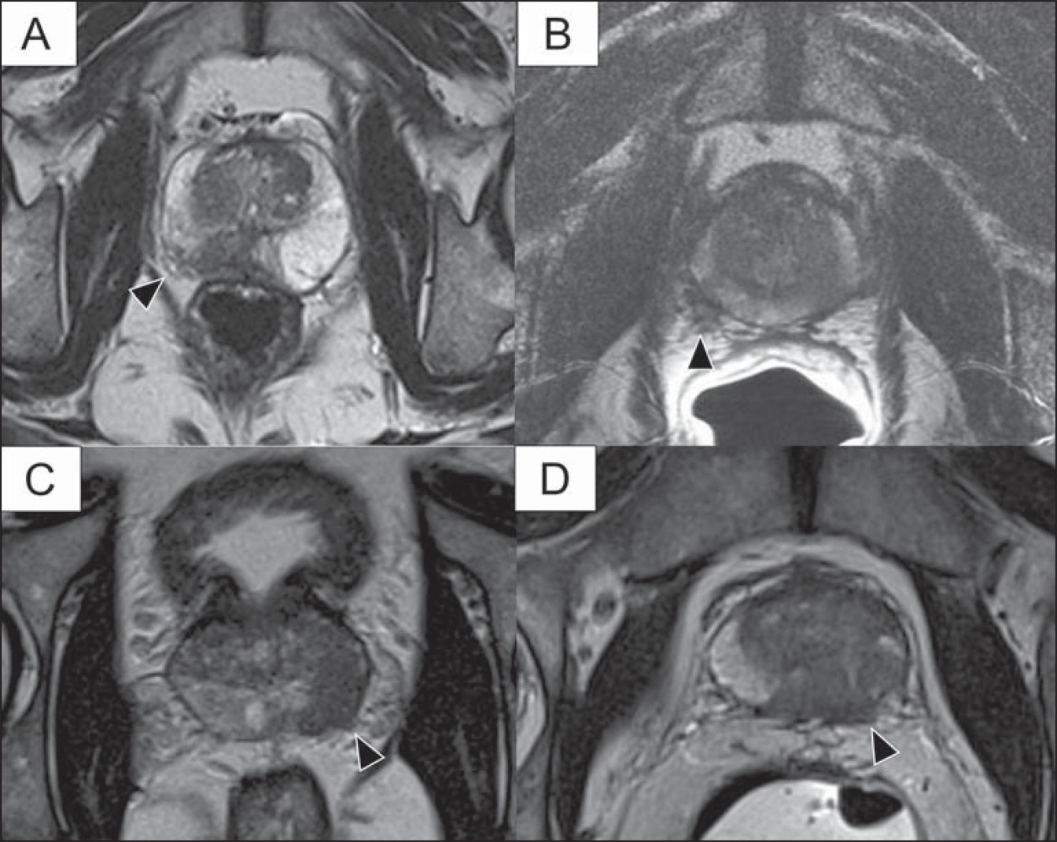
Recurrence with Disease Outside
Arrows show Cancer
Outside the prostate
In the tissues surrounding
The prostate

Slide 56
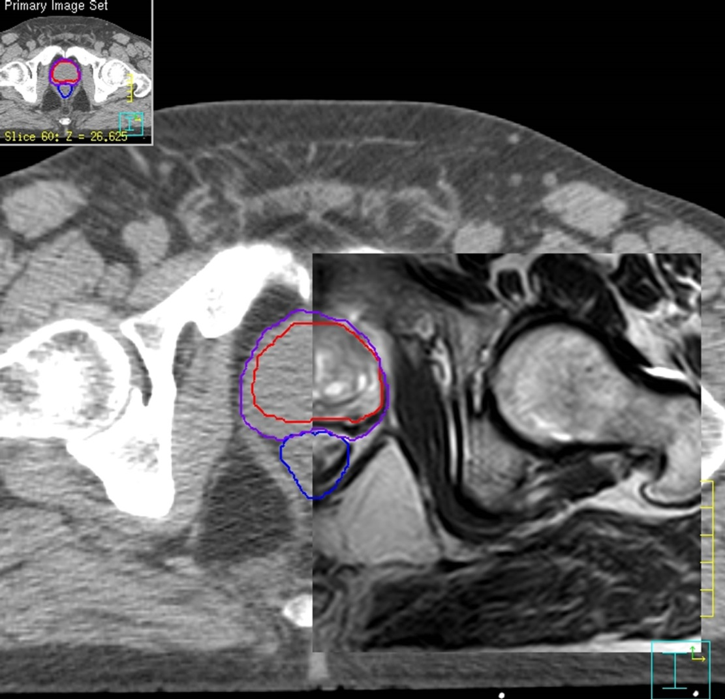
CT / MRI Comparison
Comparison:
CT on the Left and MRI 3.0 T
on the Right

Slide 57
TBCC Data

Slide 58
Brachy Data
Program Started 2003 - 2013
Number of Patients Treated: 822 (till 2013)
1027 to end of 2015
 | All Patients (N=822)
Age at diagnosis [years] | 63.5 (44.0-84.0)
Pre RT PSA [ng/mL] | 6.1 (0.5-15.7)
Pre RT AUA | 6.0 (0-30)
Gleason Score [No. (%)] | 6: 561 (68%) 7: 258 (31%)
Stage [No. (%)] | ≤T1c: 641 (79%) T2a: 137 (17%) T2b: 23 (3%) T2c: 6 (1%)
No. Hormone Rx [No. (%)] | 115 (14.0%)
No. +ve Cores | 3 (1-15)

Slide 59
Outcome
Recurrences: 45 (4.4%)
Deaths: 63 (None from Ca Prostate)
Median Survival (not met yet – in other word it is longer 10 years)
  Relapse Free Survival – 5 years = 94.6%
  Relapse Free Survival – 7 Years = 81.6%
Low Risk: Estimated RFS @ 10 years = 91%
Intermediate Risk: Estimated RFS @ 10 years = 70%

Slide 60
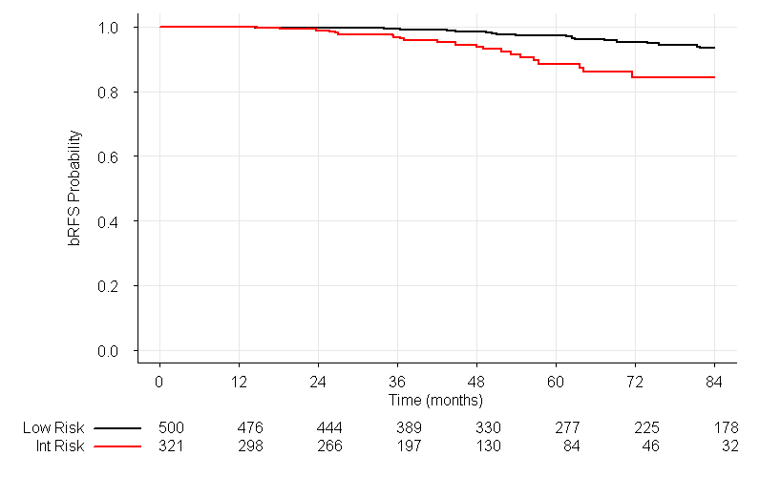
Kaplan-Meier bRFS estimate at 120 months for low risk (blue) and intermediate risk (red) patients.

Slide 61
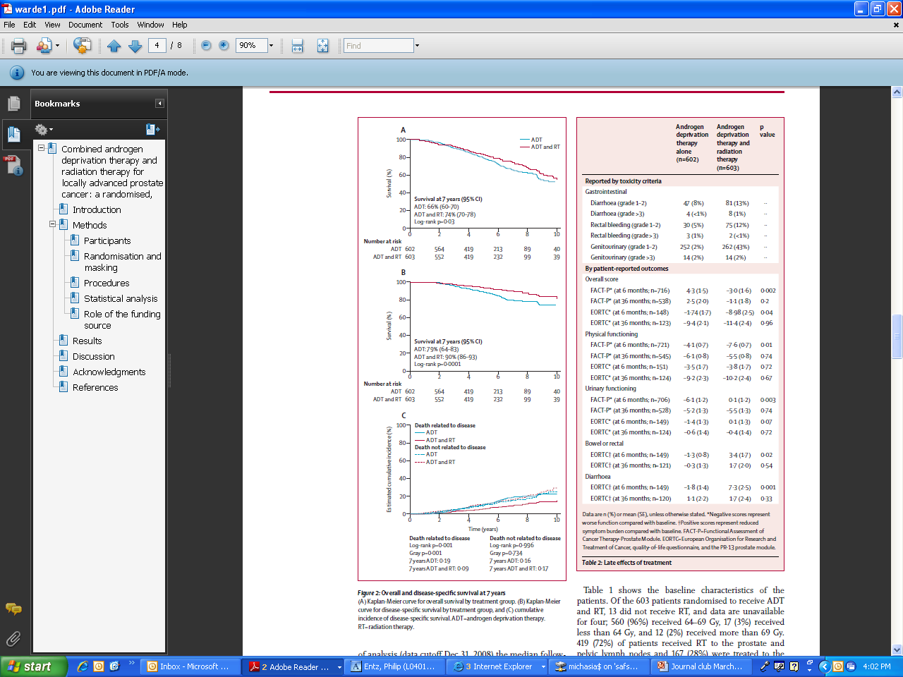

Slide 62
Recurrences
45 Recurrences to date:
  9 within the prostate only.
  36 outside the prostate (Lymph Nodes, Bones)
Treatment:
  10 people: No Treatment (on surveillance)
  23 people: Intermittent Hormonal Therapy
  3 people: Isolated LN recurrence: EBRT
  2 people: surgery
  7 people: re-implant

Slide 63
Local/Regional Recurrence
Local Recurrence / Regional:
  Recurrence only within the prostate with no evidence of cancer outside.
  Or just in the Lymph nodes in the pelvis
Symptoms: usually none
Diagnosed by slow persistent rise in the PSA

Slide 64
Local Recurrence
How to evaluate:
  1st Step: Confirm recurrence with rising PSA (at least 2 ng/ml higher than the lowest PSA value)
  2nd Step: Biopsy -> confirm that there is actually a recurrence in the prostate
  3rd Step: Confirm no evidence of disease outside the prostate (Bone scan and CT scan)
  4th Step: MRI scan (3.0 T MRI)
    Evaluate the prostate for evidence of location of the recurrence.

Slide 65
Local Recurrence
If all criteria are met:
  Rising PSA, positive biopsy, negative bone and CT scan, MRI confirmation of no disease outside the prostate)
Consider local treatment for cure:
  Surgery: possible in select centers
  Repeat Brachytherapy: At present only done in Calgary (in Canada)
  EBRT (external Beam):
  Cryotherapy: Calgary only

Slide 66
Local Recurrence
Since recurrences in the prostate are rare:
  9 local recurrences in approximately 1000 patients (Calgary)
  No real information exists on best management
    Surgery: Difficult (technically) with limited Canadian experience, high risk of side effects
    Radiation / Cryotherapy: No data on re-implanting patients after brachytherapy

Slide 67
Salvage Brachytherapy
What Data is there?
What is the outcome?

Slide 68
Salvage Brachytherapy
No Literature or publications on repeat brachytherapy after initial treatment with brachytherapy:
Some information on salvage brachytherapy after External Beam Failure
  What Data and options are there?

Slide 69
Today
After External beam Radiotherapy:
  If there is cancer in the prostate only
    Options:
      Prostate Brachytherapy
      Cryotherapy
      Monitor and Treat with Hormones when needed (usually when the PSA goes to about 10-20)

Slide 70
Salvage Brachytherapy Studies
Not many Studies:
No Good Long Term Follow up to confirm the benefit
Short Term – Good Results with a drop in the PSA
Side Effects:
  Increase in Urinary side effects

Slide 71
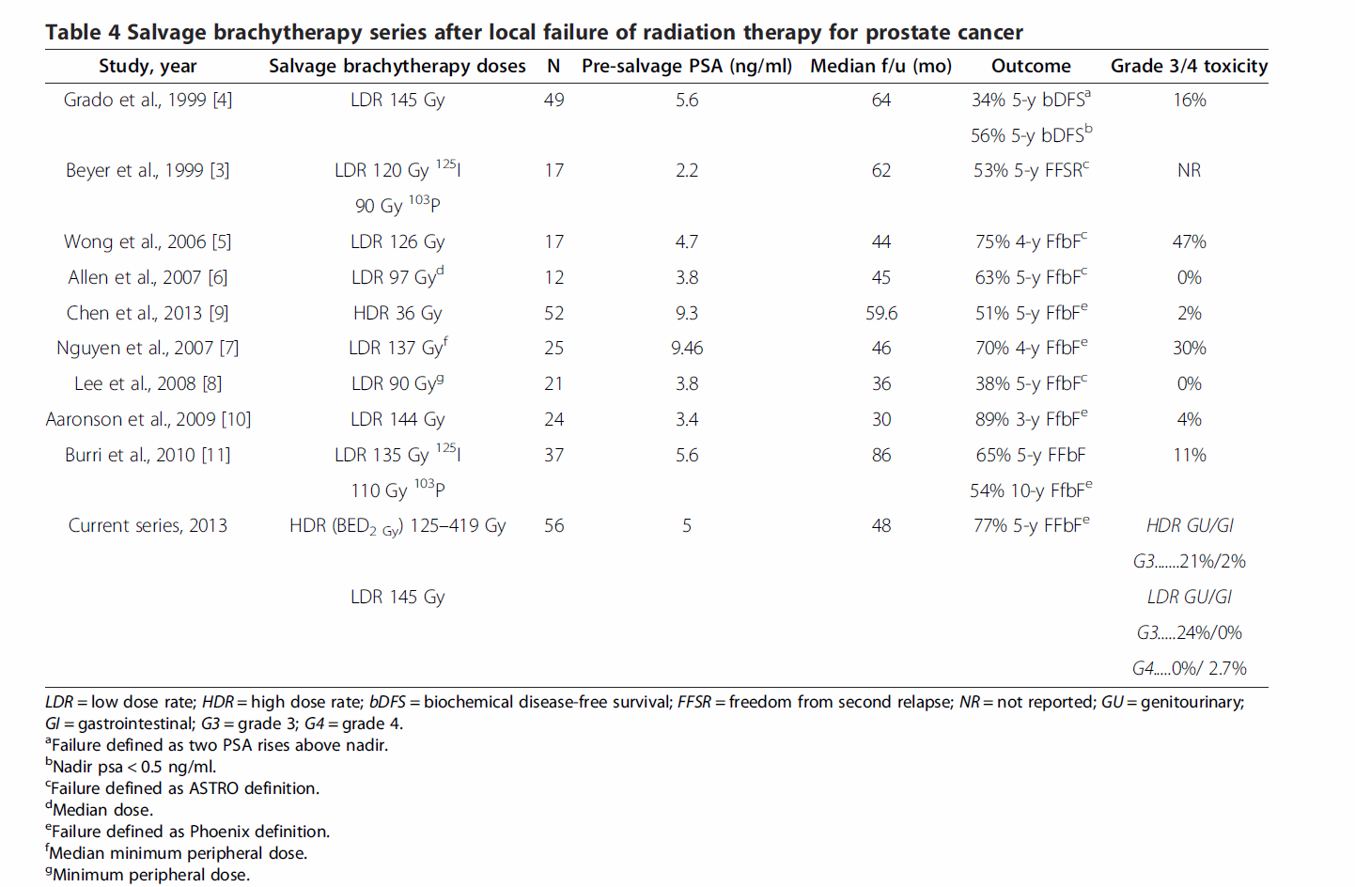
Salvage Brachytherapy

Slide 72
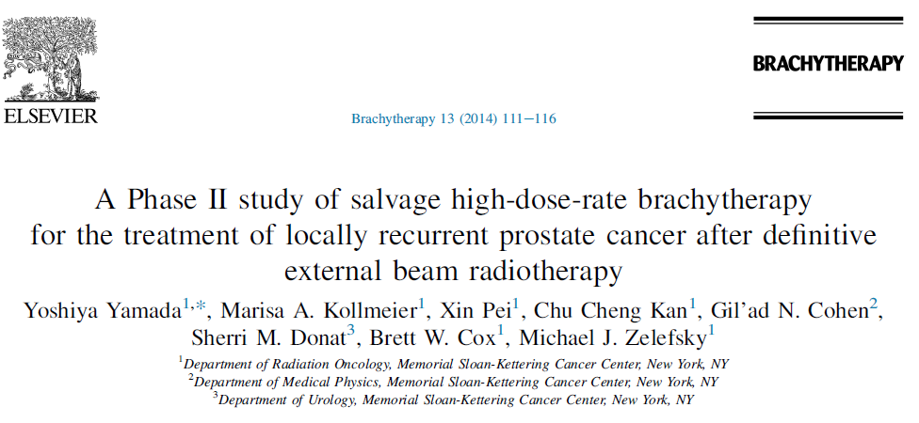
Brachytherapy after EBRT
Few studies

Slide 73
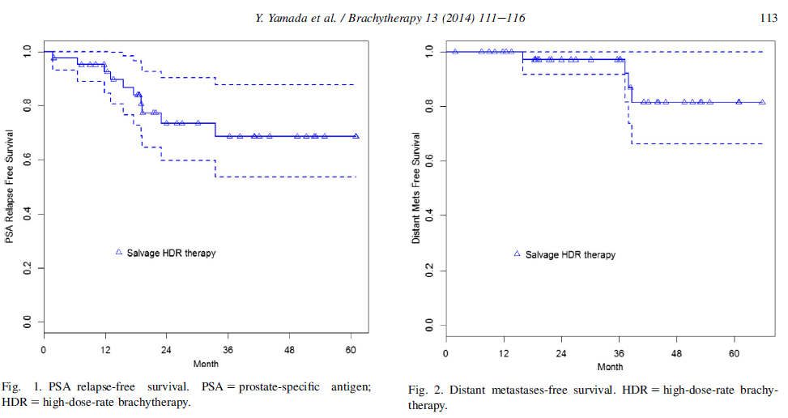
PSA After HDR

Slide 74
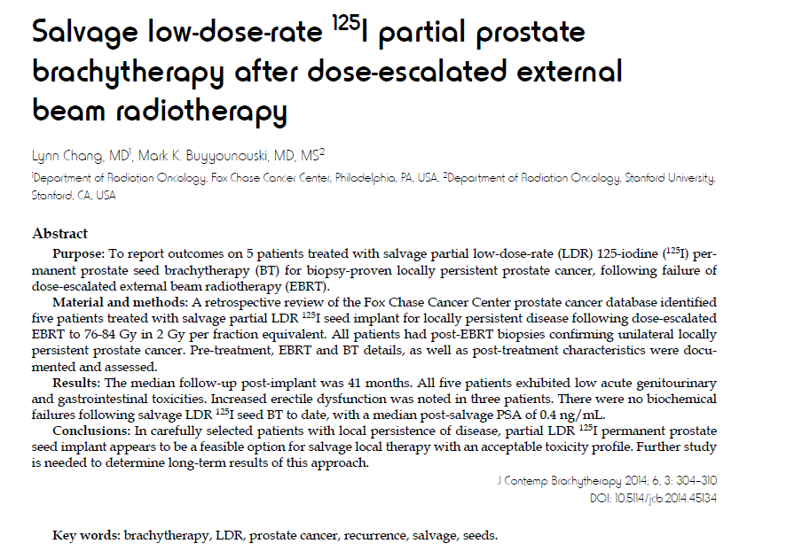
Salvage Brachytherapy

Slide 75

Partial Implant
Did Not Report Outcome as too few patients

Slide 76


Slide 77


Slide 78



Slide 79
What About Surgery?

Slide 80


Slide 81




Slide 82



Slide 83

Side Effects of Each Salvage Treatment

Slide 84
Calgary Experience
What have we done?
Outcomes to date?

Slide 85
Recurrences
9/1027 cases approximately 0.8 % - over 12 years (2003 to December 2015)
3 regional and 33 systemic
Treatment options:
  Surgery: 2 (both done in New York)
  Repeat Brachytherapy: 7 (Calgary)
  EBRT: 3 people
  Cryotherapy, External Beam Radiotherapy: None

Slide 86
Regional Recurrence
3 People with LN recurrence
  Biopsy negative
  Slowly rising PSA
Found on PET Scan (done in Phoenix and Kansas City)

Slide 87


PET Scans:
Showing Lymph Node Recurrence

Slide 88



Radiation Fields

Slide 89
Outcome
1 person:
  Developed further spread 1 year later – now on HT plus Chemotherapy
2 people:
  PSA well controlled
Side effects
  Just during the Radiation (slow stream and tiredness)

Slide 90
Local Recurrence - Surgery
Surgery: 2
  PSA: doing well <0.1ng/ml
  Side Effects:
    1st patient:
      PSA <0.1ng/ml
      Unable to void: Developed a permanent urethral stricture
        self catherization
    2nd Patient:
      PSA <0.1 ng/ml
      Was found to have extensive disease outside the prostate (LN positive)
      Treated with 2 years of Hormones and EBRT after Surgery
      Incontinent: continues to use a pad

Slide 91

Salvage Brachytherapy
Re-Implant:
  7 people

Slide 92
Table 1: Baseline Patient Characteristics
 |  |  | 1st Implant | 2nd Implant
N |  | 7
Follow-up from initial diagnosis
 | Median (range) | 10.0 years (6.1 - 12.2)
Age at Diagnosis
 | Median (range) | 60.3 years (45.9 - 69.7)
Clinical Stage
 | cT1 |  | 6
 | cT2 |  | 1
 | cT3 |  | 0
Gleason
 | <6 |  | 6 | 0
 | 7 |  | 1 | 3
 | >8 |  | 0 | 3
 | Unknown |  | 0 | 1
Baseline PSA
 | Median (range) | 7.2 ng/ml (3.7 - 9.8)
Cores Positive
 | 1-2 |  | 3 | 2
 | 2-4 |  | 4 | 2
 | >4 |  | 0 | 2
 | Unknown |  | 0 | 1
Prostate Volume
 | Median (range) |  | 39 cc (22.3 - 45.6)
Time between Implants
 | Median (range) | 6.0 years (4.2 - 9.2)
Nadir PSA
 | Median (range) |  | 0.4 ng/ml (0.06 - 1.63) | 0.1 ng/ ml (0.1-0.9)

Slide 93
Re-Implant Parameters
Table 2: Dosimetric Parameters for initial and salvage reimplant for individual patients
 | 1st Implant |  |  |  |  | 2nd Implant
# | # I-125 Seeds | Activity (mCi) | D90 (Gy) | V100 | V150 | # I-125 Seeds | Activity (mCi) | D90 (Gy) | V100 | V150 | Area Reimplanted
1 | 92 | 0.385 | 190 | 99.8% | 78.9% | 72 | 0.343 | 165 | 99.9% | 95.30% | LB, LM, LA, RB
2 | 78 | 0.437 | 199.6 | 99.9% | 78.8% | 42 | 0.344 |  | 62.7% | 45.1% | LB, LM, LA
3 | 53 | 0.437 | 183.6 | 97.0% | 71.6% | 56 | 0.371 | 173.2 | 99.9% | 96.7% | RB
4 | 68 | 0.437 | 202 | 100.0% | 79.3% | 58 | 0.344 | 238.2 | 99.8% | 96.2% | RM, RB
5 | 64 | 0.437 | 201 | 99.9% | 79.4% | 53 | 0.344 | 149.9 | 97.4% | 75.4% | LA,LM,RA,RM,RB
6 | 62 | 0.427 | 177.8 | 96.3% | 77.3% | 54 | 0.342 | 155.1 | 99.4% | 92.6% | LA,RA,RM,RB
7 | 66 | 0.437 | 183.1 | 96.8% | 77.5% | 35 | 0.343 | 193.52 | 99.2% | 84.2% | RA

Slide 94

Partial Re-implants

Slide 95



Partial Implants

Slide 96


Partial Implants

Slide 97


Partial Implants

Slide 98



Partial Implants
Targeting SV

Slide 99



Intra-Operative Targeting
MRI Showing Recurrence
Post-Op X-Ray
Intra-Operative targeting

Slide 100

PSA Outcome after Re-Implant

Slide 101


Slide 102
Salvage Brachytherapy
Re-Implant: 7
  PSA declining in 5 (71% cure rate at this time)
  2 with a slowly rising PSA – on surveillance at this time
Side Effects:
  Urinary stricture (2/7) – TURP

Slide 103
Summary
Salvage Brachytherapy or a Re-Implant after Brachytherapy is possible, has good outcomes, less side effects than surgery and may cure more than half the people with an isolated recurrence
We are proud to be the only center in Canada to have done this and hopefully our publication will lead others to think of doing the same

Slide 104

Thank You

