Slide 1
www.APCaRI.ca
@APCaRI_CA
John D. Lewis, Ph.D.
Department of Oncology
University of Alberta
Notes:
clathrin-mediated endocytosis of small nanoparticles
1.42x10e16 beads/mL stock = 50mg/mL = 3.52x10e-18g per bead
14mg/mL at 5600kDa/particle
Final concentration = .5mg/mL = 9.299x10e-18g per virus
http://jdlewis.gotdns.org:81/microspheres1.jpg
Seminar outline
1. Intro, talk about sensitivity of in vivo probes
- brightness isn't everything
- toxicity, dispersion, specificity problems with current methods
- ask Phil about POLYSTYRENE BEADS IN VIVO!!!
2. talk about CPMV in terms of its strengths
- stable in wide range of pH (gut)
- non-infective to animals
- defined structure and sequence
- lysine chemistry for attachment of ligands
- antibody
- knowledge of administration, processing, evacuation
3. structure and multivalency of CPMV
4. Use for general imaging - attachment of dye to CPMV
- fixable, bright, disperse signal
- nontoxic
THINGS YET TO DO:
1. statistics for cell adhesion assays
2. statistics for CAM assay
3. future plans
4. preliminary data, which to include?

Slide 2
The Alberta Prostate Cancer Research Initiative
A made-in-Alberta initiative
to make innovative research a part of care for those living with prostate cancer.

Slide 3
Prostate cancer: the numbers
36% of newly diagnosed cancers, and 10% of all cancer deaths in men
Out of every 100 men...

Slide 4
Prostate cancer: the numbers
36% of newly diagnosed cancers, and 10% of all cancer deaths in men
18 will be diagnosed
with prostate cancer in their lifetime

Slide 5
Prostate cancer: the numbers
36% of newly diagnosed cancers, and 10% of all cancer deaths in men
But up to 80 of them will have
prostate cancer by age 70

Slide 6
Prostate cancer: the numbers
36% of newly diagnosed cancers, and 10% of all cancer deaths in men
And 3 will die from it.

Slide 7
Prostate cancer: the numbers
36% of newly diagnosed cancers, and 10% of all cancer deaths in men
But which 3 ?

Slide 8
Do I have cancer?
Screening & Diagnosis:
>1M prostate biopsies yearly in NA
+PSA test means only 30-50% chance of a positive biopsy
Chance of hospitalization following biopsy increases by 250%
Each 5% increase in accuracy for a prostate screening test would eliminate 165,000 unnecessary biopsies and 7000 hospitalizations each year in North America

Slide 9
Do I need treatment?
Prognosis: who to treat?
50% of prostate cancer is low risk, yet 90% of patients choose treatment
Up to 50% of prostate cancer are not lethal even without treatment
Side effects of treatments have a dramatic impact on the quality of life of patients.

Slide 10
Which treatment is most effective?
Treatment options:
Active Surveillance
Surgery (open, laparoscopic, robotic)
Radiation (external beam, brachytherapy, Ra223)
Focal Therapy (cryo, HIFU, etc)
Androgen ablation (old gen and new gen)
Chemotherapy
We simply do not have enough information to make informed decisions…

Slide 11
Easier things to decide than prostate cancer treatment….
Which car to buy?
Which tie to wear?
????
vs.

Slide 12
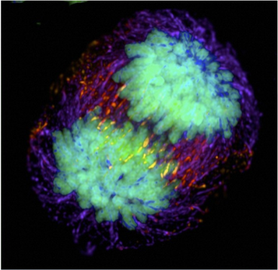
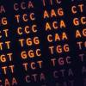
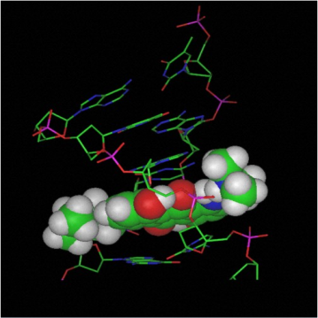
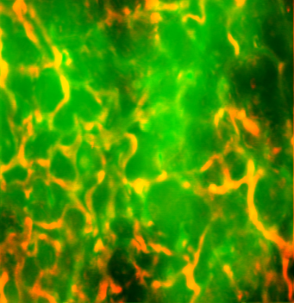
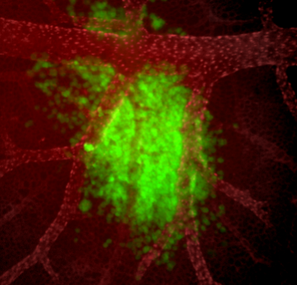
We live in a time of incredible scientific opportunity…
We can do things we couldn't even imagine 10 years ago!
Understanding cancer biology
Bioinformatics computation
New designer cancer drugs
Better imaging
Using nature to fight back
Personalized medicine
Earlier detection
Better treatments – better patient care

Slide 13
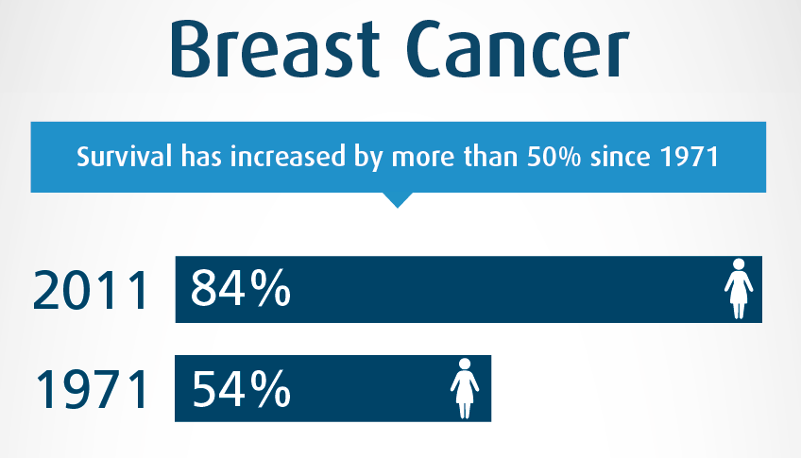
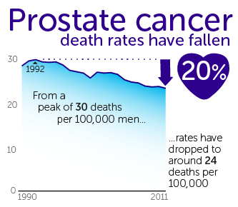
It may not seem like it sometimes…
But research has had an incredible impact on cancer
SURVIVAL

Slide 14
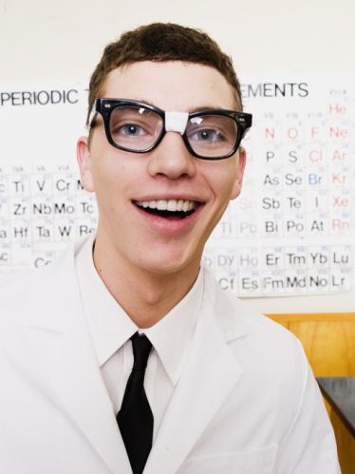
Research can mean different things…
“evaluating the practical application of new products or processes”
“learning about the fundamental nature of things without specific applications or products in mind”
Translational Research
Basic
Research
Fundamental
Research
Clinical Research

Slide 15
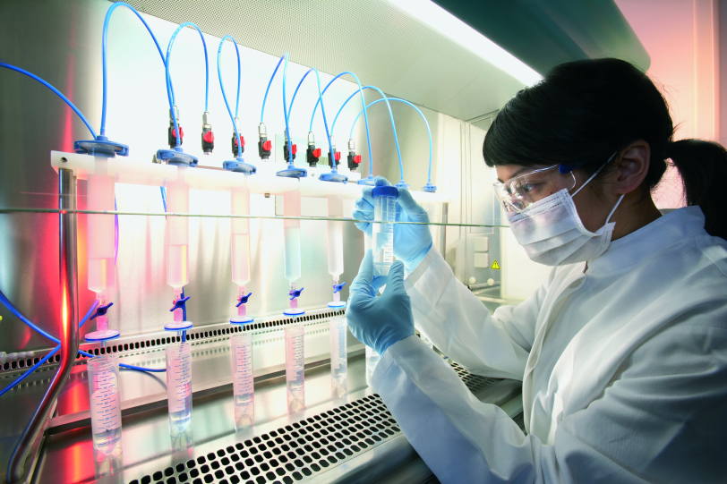
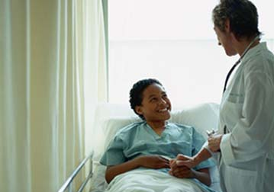
What is Translational Research?
Research with a clear line of sight to the patient…
New idea!!
Laboratory
Clinical
Trials
Clinical Practice

Slide 16
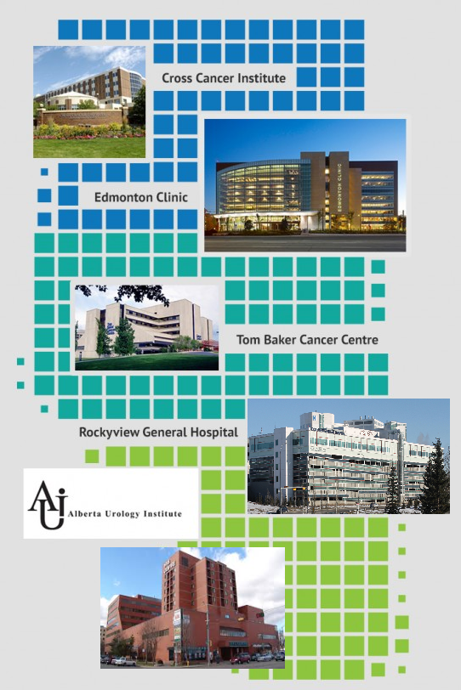
The Alberta Advantage
More than 3.7 million people using a single medical system
The majority of prostate cancer patients in Alberta are seen in 2 clinics
Demographic and clinical data is available for the entire population
Allow for province-wide changes to prostate cancer management
Opportunity to set an example for other jurisdictions.

Slide 17
Meet the APCaRI Team
TRANSLATIONAL
Research Groups
Urologists
Medical
Oncologists
Commercial Partners
Radiation
Oncologists
Pathologists
Universities
Biostatisticians
CANADA
Biobanks
AUSTRALIA
Collaborators
USA
United
Kingdom

Slide 18
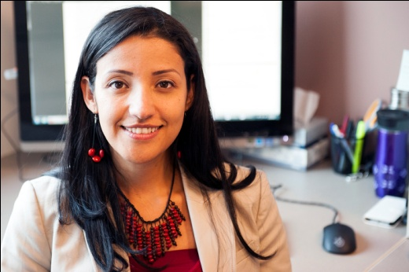
Meet the Team
Reda Alhajj
Bioinformatics
Program
Director
Andries Zijlstra
Cancer Biology, Metastasis
Gane Ka-Shu Wong
Genomics
Catalina Vasquez
APCaRI Program
John D. Lewis
Cancer Biology, Nanotechnology
TRANSLATIONAL
Research Groups
Hans Vogel
Metabolomics
Jack Tuszynski
Computational Biology
Frank Wuest
Imaging
Urologists
Morley Hollenberg
Proteinases
Michael Chetner
Pathologist
Bryan Donnelly
Urologist
Medical
Oncologists
Gerald Todd Urologist
Scott North
Medical Oncologist
Peter Venner
Medical Oncologist
Eric Hyndman
Urologist
Ron Moore
Urologist
Dean Ruether
Medical Oncologist
Kiril Trpkov
Pathologist
Cancer
Registry
Adrian Fairey
Urologist
Radiation
Oncologists
Pathologists
Trafford Crump
Manager
Leanne Deman
Data manager
Nawaid Usmani
Radiation Oncologist
Matthew Parliament
Radiation Oncologist
Demetrios Braddock
Pathologist
Biostatisticians
Jackson Wu
Radiation Oncologist
Tarek Bismar
Pathologist
Karen Kopciuk
Statistician
Sunita Ghosh
Biostatistician
Michael Mengel
Pathologist
David Broadhurst
Applied Biostatistician
CANADA
Prostate Cancer
Canada Network
OICR
Tumor Bank
Alberta Urology
Institute
Vancouver
Prostate Cancer
Centre
Terry Fox
Research
Institute
AUSTRALIA
APOGEE
UK
Alberta
Health Services
Alberta
Cancer
Foundation
CHUM Groupe
du cancer
de la prostate
USA
United
Kingdom
Prostate
Cancer Centre
Calgary
Prostate
Cancer Centre
Toronto
Movember
Foundation
Australian
Prostate Cancer
Bioresource
Malvern
UK
Alberta Cancer
Research
Biorespository
Motorcycle
Ride for Dad
Vanderbilt
University
(TN)
Nanosight
UK

Slide 19
The Alberta Prostate Cancer Research Initiative
“The right treatment to the right patient at the right time”
Build a world-class provincial translational prostate cancer research and training program.
Facilitate translational prostate cancer research
Facilitate grant applications, ethics protocols
Support “high content” clinical trials
Establish the Alberta Prostate Cancer Registry.
Facilitate clinical data collection to measure outcomes in Alberta
Establish the Alberta Prostate Cancer Biorepository.
Support and drive the clinical translation of innovative technologies
Novel biofluid-based test to improve the diagnosis, prognosis and treatment selection for prostate cancer
New treatments to block aggressive and metastatic prostate cancer.

Slide 20
New APCaRI Clinical Trials
http://apcari.ca/prostate-cancer/clinical-trials/
MAST: Metformin in AS patients to delay progression and/or definitive treatment.
PREMIUM: Metformin in patients receiving radiation and ADT to delay/reduce metabolic syndrome and improve OS in patients with Pca.
ENACT: Enzulatamide in patients with localized prostate cancer under active surveillance. Ethics approved and will start recruiting in the coming months

Slide 21
The PRIME Study
Movember Translation Acceleration Grant of $1.5 million
Canadian Cancer Trials Group led study.
Principal Investigators:
Dr. Bernie Eigl (BC)
Dr. Nawaid Usmani (Alberta)

Slide 22
The PRIME Study
Endpoints:
R
A
N
D
O
M
I
Z
E
iADT
Metformin (850 mg PO BID)
Primary:
MS at 1 yr
Secondary
Incidence of comps
metabolic syndrome
DM, HTN, lipids
QOL (EORTC QLQ-C30)
Toxicity (CTCAE 4.0)
bPFS, PCSS, OS
Biochemically Recurrent
Or Asymptomatic Metastatic Prostate Ca
iADT
Placebo (850 mg PO BID)
Sample Size: 300 patients Statistics: 80% power for 2-sided α to detect 15% reduction in incidence of MS (from 44% to 27% at 1 yr).
Notes:
PRIME Study – Prevention and Intervention for MEtabolic syndrome
iADT – intermittent androgen deprivation therapy

Slide 23
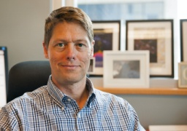
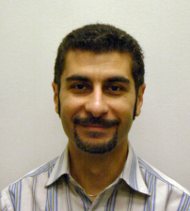
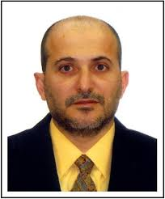
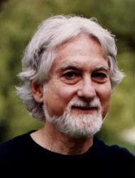
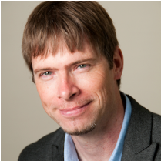
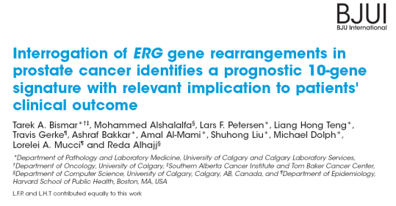
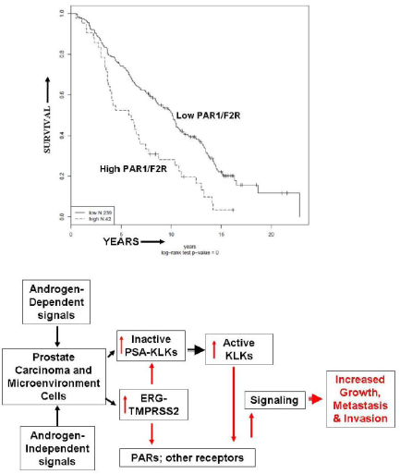
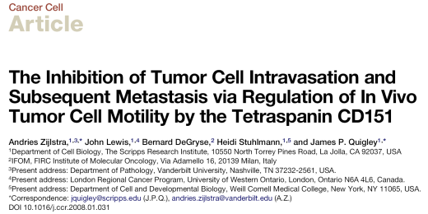
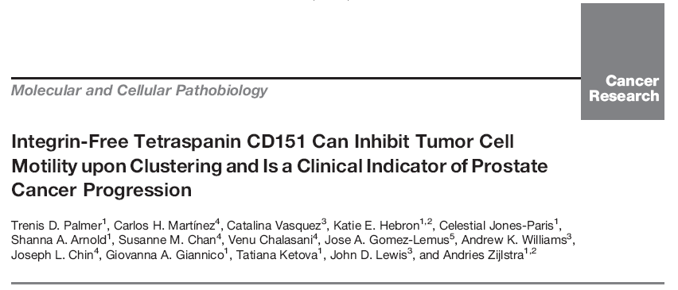
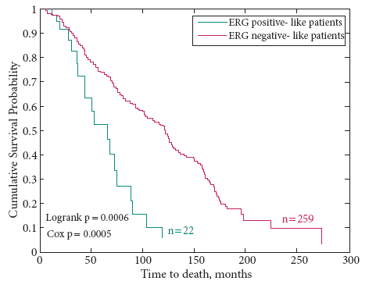
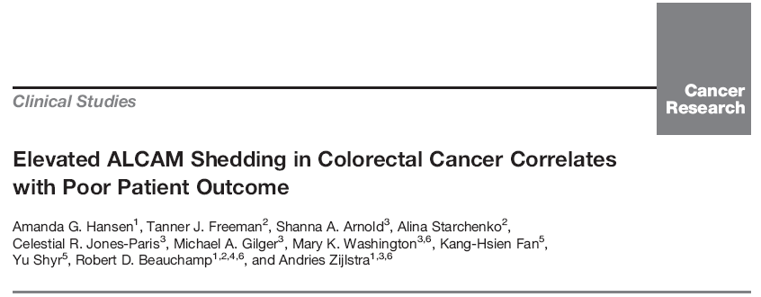
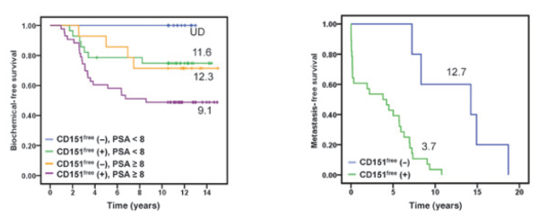
Exciting Discoveries
Cell Motility
Dysregulated growth factors
Protease-activated signaling

Slide 24
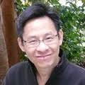
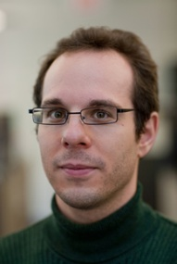
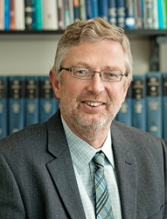
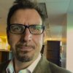
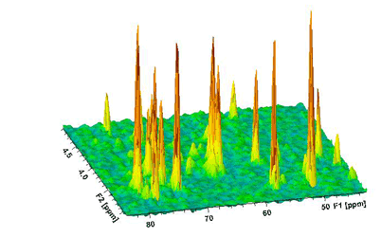
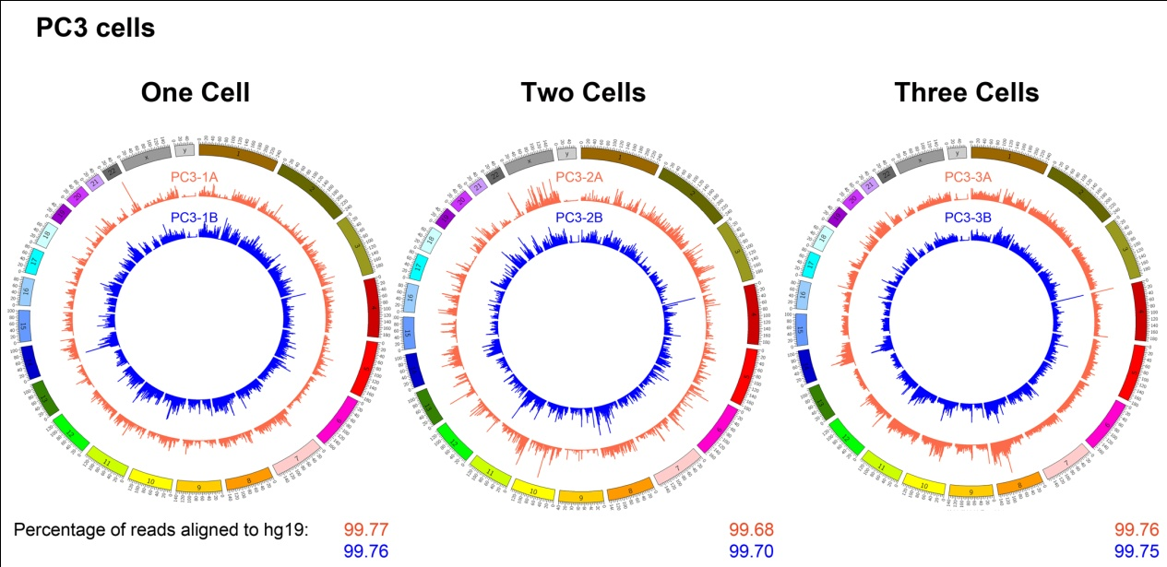
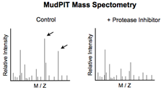
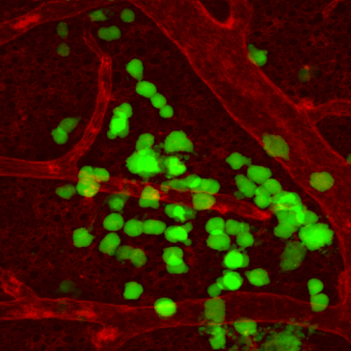
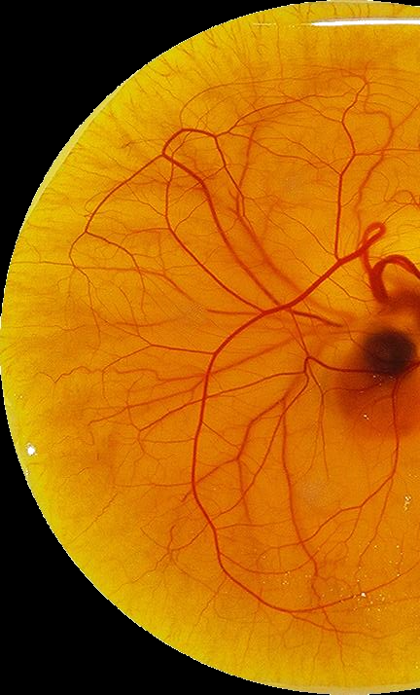
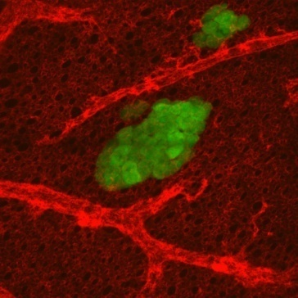
Advanced Discovery Platforms
Genomics
Metabolomics
Proteomics
In Vivo Screening

Slide 25
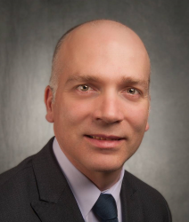
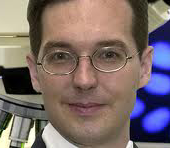
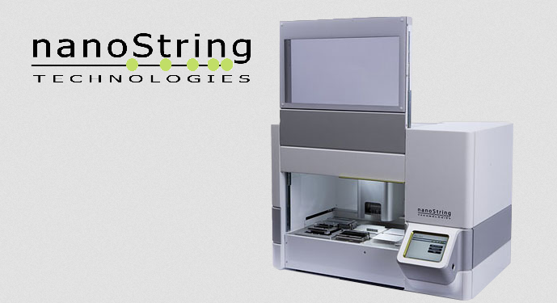
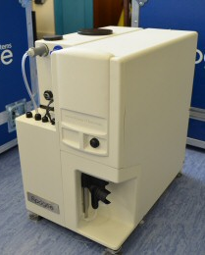
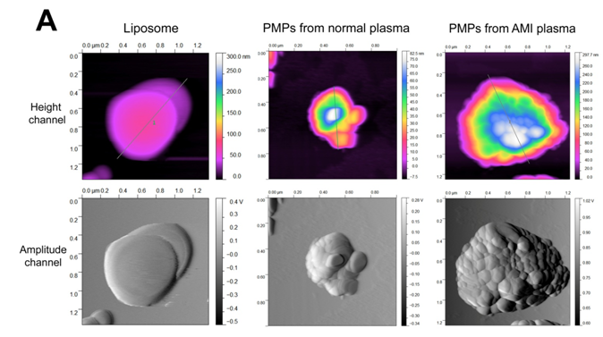
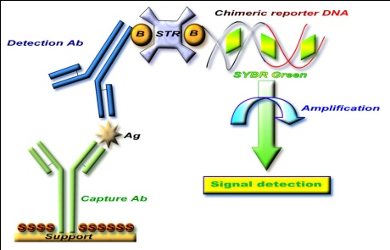
Integrative Technology Platforms
Metabolomics
Cancer Microparticles
NanoString
ImmunoPCR

Slide 26
Prostate cancer: the numbers
36% of newly diagnosed cancers, and 10% of all cancer deaths in men
But which 3 ?

Slide 27
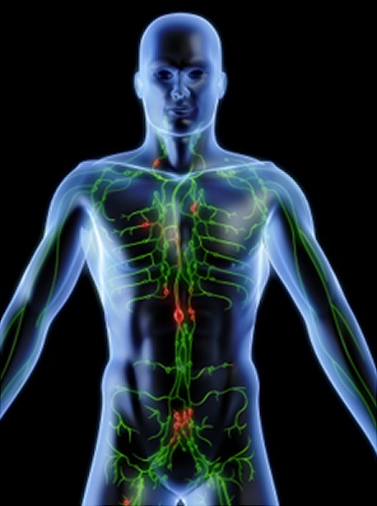
The deadliest aspect of cancer
Men with prostate cancer do not die from cancer that stays in the prostate
The deadliest aspect of prostate cancer is its spread, or metastasis
In North America, the average 5 year survival rates for:
Localized prostate cancer : 100%
Metastatic cancer: <30%
Current diagnosis tools do not predict whether metastasis will occur
Current treatments do not prevent or cure metastasis
Bones
Lymph nodes
Bones
Prostate

Slide 28
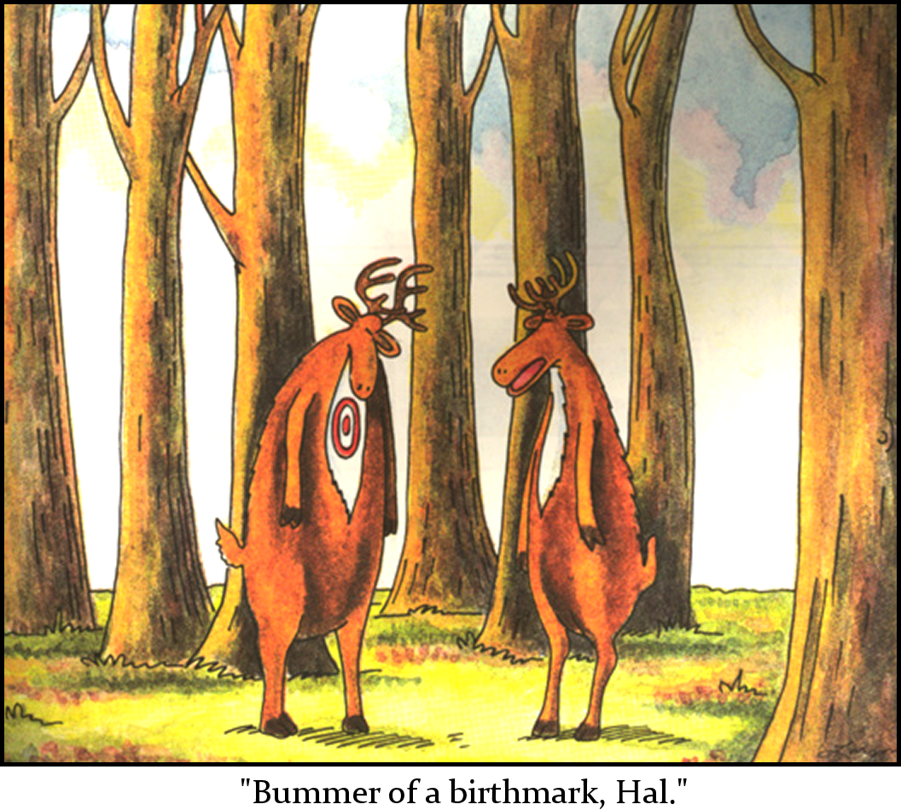
What is the difference between cells that spread
and cells that don’t?

Slide 29
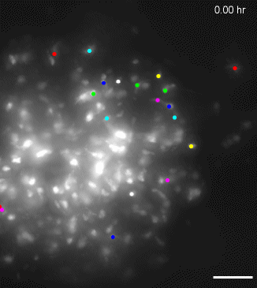
Stopping cancer in its tracks
No tumour glue drug

Slide 30
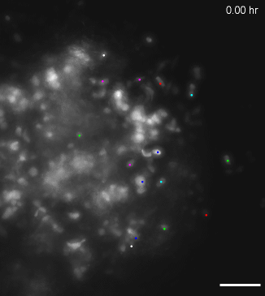
Stopping cancer in its tracks
… with tumor glue!
No tumour glue drug
With tumour glue drug

Slide 31
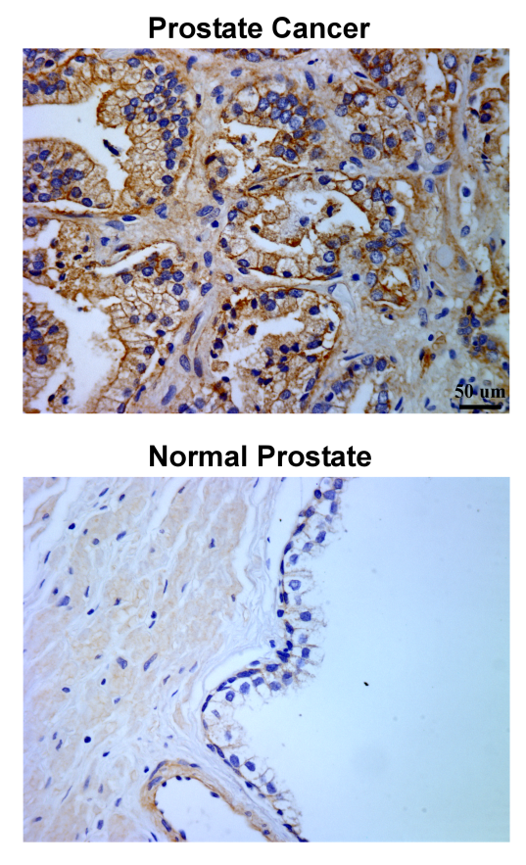
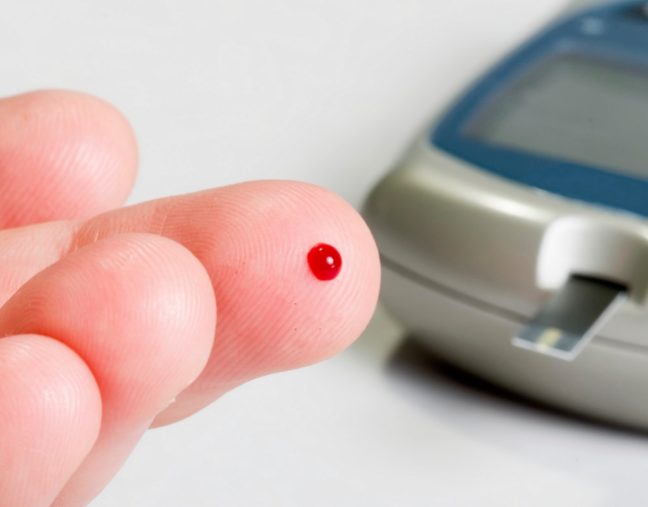
How to make a near-term impact?
If tumor glue targets cancer cells that are spreading, perhaps we can use it as a test to detect or predict metastasis…
We developed a Pathology test and a blood test using tumour glue
Patients who tested positive developed metastasis 10 years earlier

Slide 32
Alberta Prostate Cancer
Registry and Biorepository
APCaRI
Alberta Prostate Registry and Biorepository
Clinical Information
Alberta Prostate Cancer Registry
Alberta Prostate Cancer Biorepository
Clinical Outcomes
Patient – reported outcomes
Samples and data available for all investigators

Slide 33
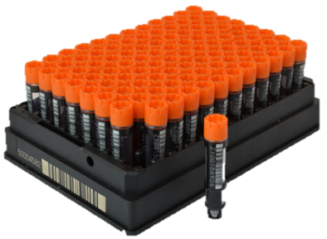
Alberta Prostate Cancer
Registry and Biorepository
Blood
Urine & Semen
2D Barcode system
Storage at CBSR
P1
P2
P3
P4
1 2 3 4 5 6 7 8 9 10 11 12
1559 participants enrolled
Over 100,000 sample aliquots available and stored at the Canadian Biosample Repository
Available for researchers in Alberta, Nationally and Internationally

Slide 34
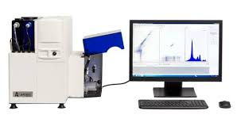
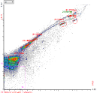
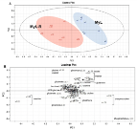
Alberta Prostate Cancer
Registry and Biorepository
Patient identified and consented when biopsy is ordered
Retrospective and prospective clinical data collection
Sample collection
Samples and Data stored and utilized to validate diagnostic and prognostic biomarkers
Cancer Microparticle analysis
Metabolomics
Proteomics
Genomics

Slide 35
Alberta Prostate Cancer
Registry and Biorepository
The Cross Cancer Institute
Dr. Scott North
Dr. Nawaid Usmani
Dr. Peter Venner
Michelle English
Dr. Matthew
Parliament
+ a team of Medical and Radiation Oncologists and the CCI laboratory!!

Slide 36
Alberta Prostate Cancer
Registry and Biorepository
The Kaye Edmonton Clinic
Dr. Ronald Moore
PI at KEC
Afendi Auditi
Clinical Data Entry Clerk/
Lab assistant
+ KEC laboratory

Slide 37
Alberta Prostate Cancer
Registry and Biorepository
The Alberta Urology Institute
Dr. Adrian Fairey
APCaRI Co-PI
Dr. Michael Chetner
Dr. Gerald Todd
Ruth Freer-Fazio
Clinical Research Coordinator
Afendi Auditi
Clinical Data Entry Clerk/
Lab assistant
+ a team of Urologists, MOAs and Clinic Administrator… all committed to the success of the study

Slide 38
Alberta Prostate Cancer
Registry and Biorepository
The Prostate Cancer Centre
Dr. Bryan Donnelly
APCaRI Co-PI
Dr. Eric Hyndman
Dr. Geoffrey Gotto
Cody Deman
Clinical Data Entry Clerk
& Lab assistant
Madison Turk
Clinical Data Entry Clerk
& Lab Assistant
+ a team of Nurses, Lab Assistants, Clinical Research personnel, Urologists, MOAs and PCC Director… all committed to the success of the study!!

Slide 39
Alberta Prostate Cancer
Registry and Biorepository
The Tom Baker Cancer Centre
Dr. Jackson Wu
Dr. Dean Ruether
Dr. Daniel Heng
+ a team of Medical and Radiation Oncologists

Slide 40
Working Internationally

Slide 41
Professor
Prostate 2.0
A tool that …
… researchers can use …
to ask questions about patient population: general database queries
identify all patients with certain properties, then show other features
for Kaplan Meier plots wrt specified subsets
… physicians can use …
to quickly see information about specific patient
… all on single page
including PSA history, doubling time, …
find “similar” patients... and see what happened to them
… is easy to use
drag and drop
visual
Dr. Russ Greiner, UofA

Slide 42
Professor
Prostate 2.0
… researchers can use …

Slide 43
Professor
Prostate 2.0
… Physicians can use …

Slide 44
APCaRI Annual Symposium
Forum to share new research, build collaborations and brainstorm new ideas
Every October - our 6th meeting is coming up in Banff in 2016
Participation from Clinicians, Scientists, Trainees, Donors, and our partners like the PCCN
Internationally recognized invited speakers
This year:
Andrei Drabovich, University of Toronto – proteomics and liquid biopsy
Neal Shore, Carolina Urologic Research Centre – MYRIAD’s Prolaris test

Slide 45
APCaRI Web Portal

Slide 46
APCaRI Web Portal

Slide 47
www.APCaRI.ca
Prostate Cancer Information
Our Team
Our Research
Clinical Trials
Ways to Get Involved/Events
Blog
Fundraising

Slide 48
How to get involved!
Go to www.APCaRI.ca
- sign up for our newsletter
- follow us on twitter (@APCaRI_CA)
- read the Blog
- learn about clinical trials, research, news and events
Enroll in our clinical trials
- APCaRI Registry and Biorepository
- MAST, PREMIUM, ENACT, PRIME
Participate in our activities and events
- read more at http://apcari.ca/get-involved/events/

Slide 49
Wouldn’t be possible without…
Frank Sojonky
1928 - 2012

Slide 50
Some of my motivations…
Notes:
PRIME Study – Prevention and Intervention for MEtabolic syndrome
iADT – intermittent androgen deprivation therapy

Slide 51
Thank You!
Notes:
clathrin-mediated endocytosis of small nanoparticles
1.42x10e16 beads/mL stock = 50mg/mL = 3.52x10e-18g per bead
14mg/mL at 5600kDa/particle
Final concentration = .5mg/mL = 9.299x10e-18g per virus
http://jdlewis.gotdns.org:81/microspheres1.jpg
Seminar outline
1. Intro, talk about sensitivity of in vivo probes
- brightness isn't everything
- toxicity, dispersion, specificity problems with current methods
- ask Phil about POLYSTYRENE BEADS IN VIVO!!!
2. talk about CPMV in terms of its strengths
- stable in wide range of pH (gut)
- non-infective to animals
- defined structure and sequence
- lysine chemistry for attachment of ligands
- antibody
- knowledge of administration, processing, evacuation
3. structure and multivalency of CPMV
4. Use for general imaging - attachment of dye to CPMV
- fixable, bright, disperse signal
- nontoxic
THINGS YET TO DO:
1. statistics for cell adhesion assays
2. statistics for CAM assay
3. future plans
4. preliminary data, which to include?

