Slide 1
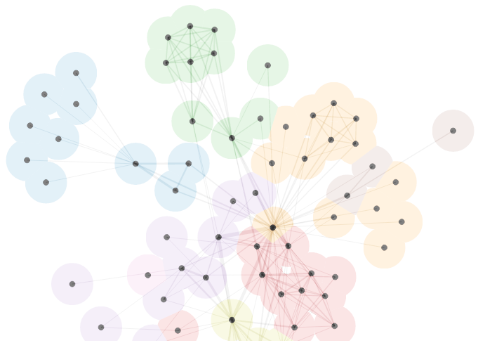
Combining Data Mining and Network Analysis to find
Prostate Cancer Biomarkers
Gabriela Jurca

Slide 2
Today:
Background
Research results
Prostate cancer survey

Slide 3
1 in 7 men will develop prostate cancer
Worldwide: #2 most diagnosed cancer in males
Developed countries: #1
Why?
Notes:
Prostate cancer is a deadly disease. About 1 in 7 men will develop prostate cancer.
http://www.cancer.org/cancer/prostatecancer/detailedguide/prostate-cancer-key-statistics
However, when we compare statistics, we see that prostate cancer is the second most diagnosed cancer in males worldwide, whereas in developed country it’s the most diagnosed cancer in males.
Why is there a difference?
The difference is partly due to increased usage of biomarker tests in developed countries, which leads to earlier detection.

Slide 4
Cancer biomarkers
Repaired
Healthy
Normal BRCA1 gene
UV, X-rays, etc
Damaged DNA
Cancer
Parents
Mutated BRCA1 gene
Death
Notes:
A biomarker is anything that serves as an indication of cancer in the body. It can be the tumour shape, proteins floating in the blood, or genetics. Our project focused on different genes that can serve as bio-markers to breast cancer. Let’s look at an example of how a famous genetic breast cancer bio-marker: The BRCA1 or 2 genes.
But lets look at genetic biomarkers as an example.
In most of the cases, DNA is repaired as normal when it gets damaged.
However, if it is repaired incorrectly, the cell may lose the ability to die. This may lead to cancer.
Some genes are particularly sensitive, such as the BRCA1 gene which is known to be associated with prostate and breast cancer, and if these genes are mutated, then you have a higher risk of getting cancer.
Sensitive genes such as these are often responsible for suppressing tumours, are involved in parts of the cell cycle, or cell signaling.
Mutations in these genes can also be inherited.
Sensitive genes like these are known as cancer biomarkers, because they may indicate cancer when mutated.

Slide 5
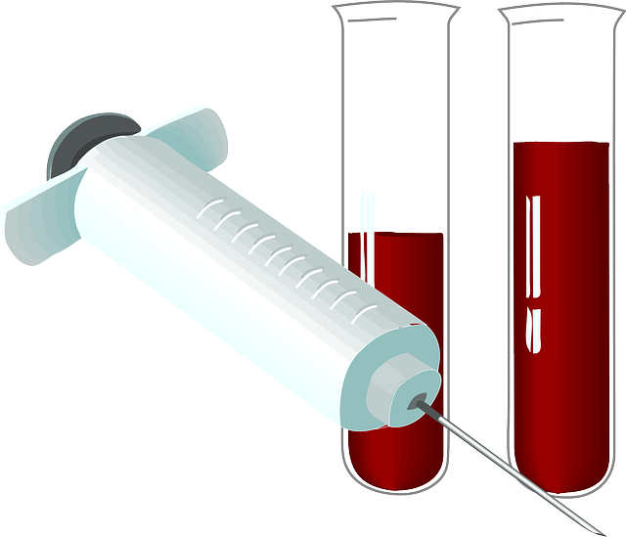
Prostate-specific antigen (PSA)
Biomarker for prostate cancer
A protein detected in blood
Routinely used for:
Early detection of prostate cancer
Treatment monitoring
.. But often not specific or sensitive enough.
We could use more cancer biomarkers!
Notes:
Last year the cancer task force of Canada recommended to remove the PSA test altogether because it leads to too many false positives
Canadian Task Force on Preventive Health Care
PSA can also be detected when:
Prostate is enlarged
Prostate infected

Slide 6
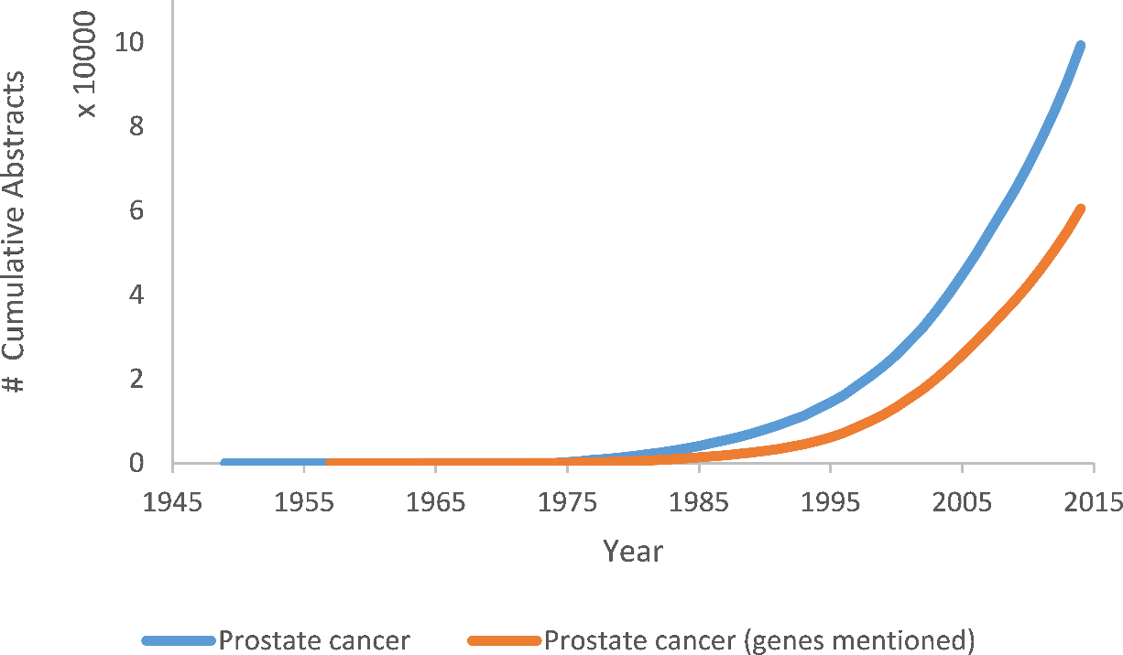
Finding cancer biomarkers…
There are 25 000 – 30 000 protein coding genes
Best way to narrow list down is through text mining
Finding patterns and trends from existing literature
Various data mining techniques can also be used

Slide 7
Existing work out there
Other people have also researched cancer text mining:
Build gene-gene or gene-disease co-occurrence networks
Integrated databases
Rank genes related to disease
A
B
C
…
Notes:
Gene-gene cooccurence networks hope to find links between genes that you may not have known existed

Slide 8
Our Approach
Retrieve research abstracts on prostate cancer
Find the genes mentioned in the abstracts
Analyze
~125 000 of them

Slide 9
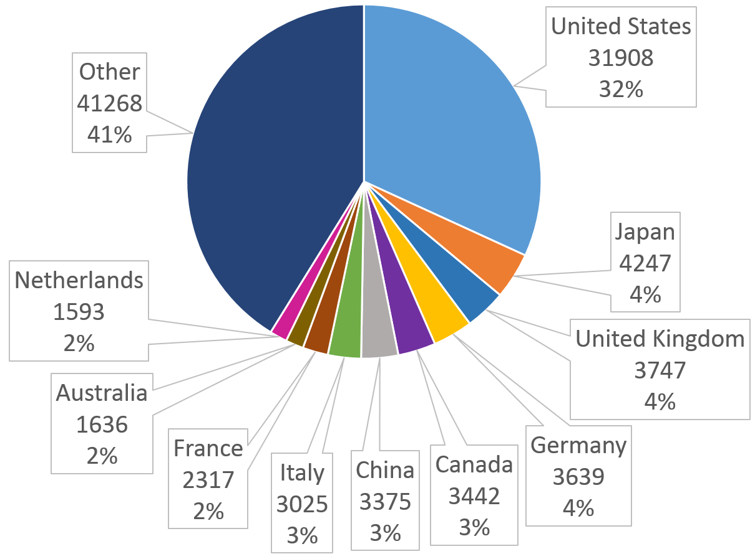
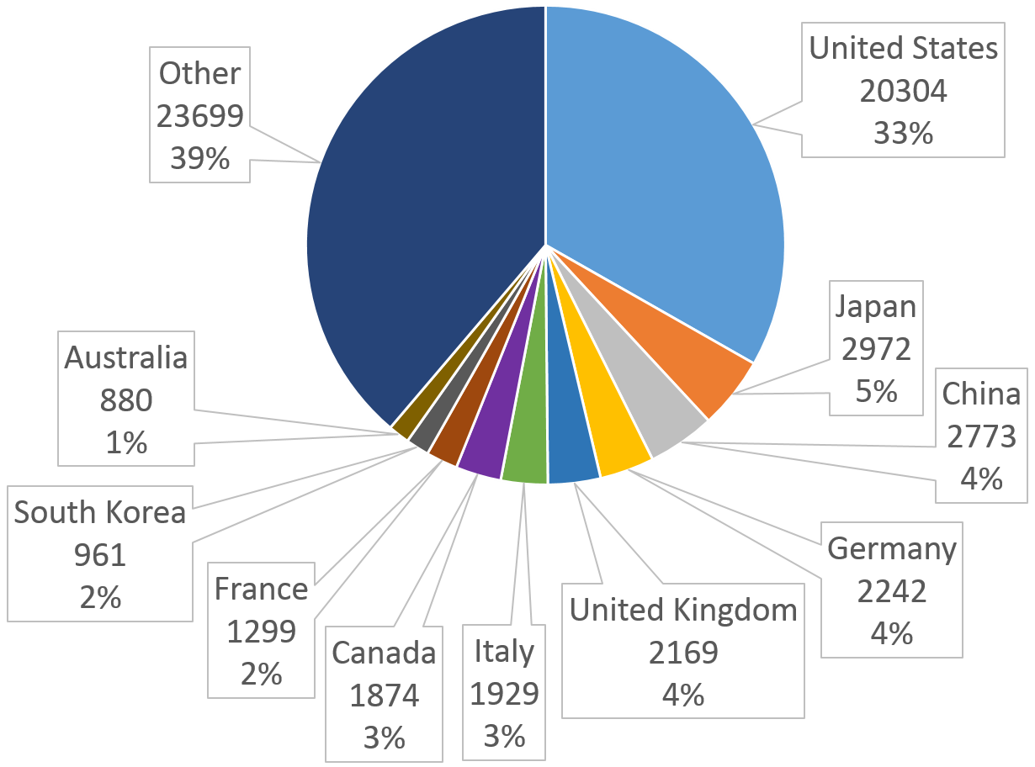
What are top countries in prostate cancer research?
All abstracts under “prostate cancer”:
Abstracts that also mention genes:

Slide 10
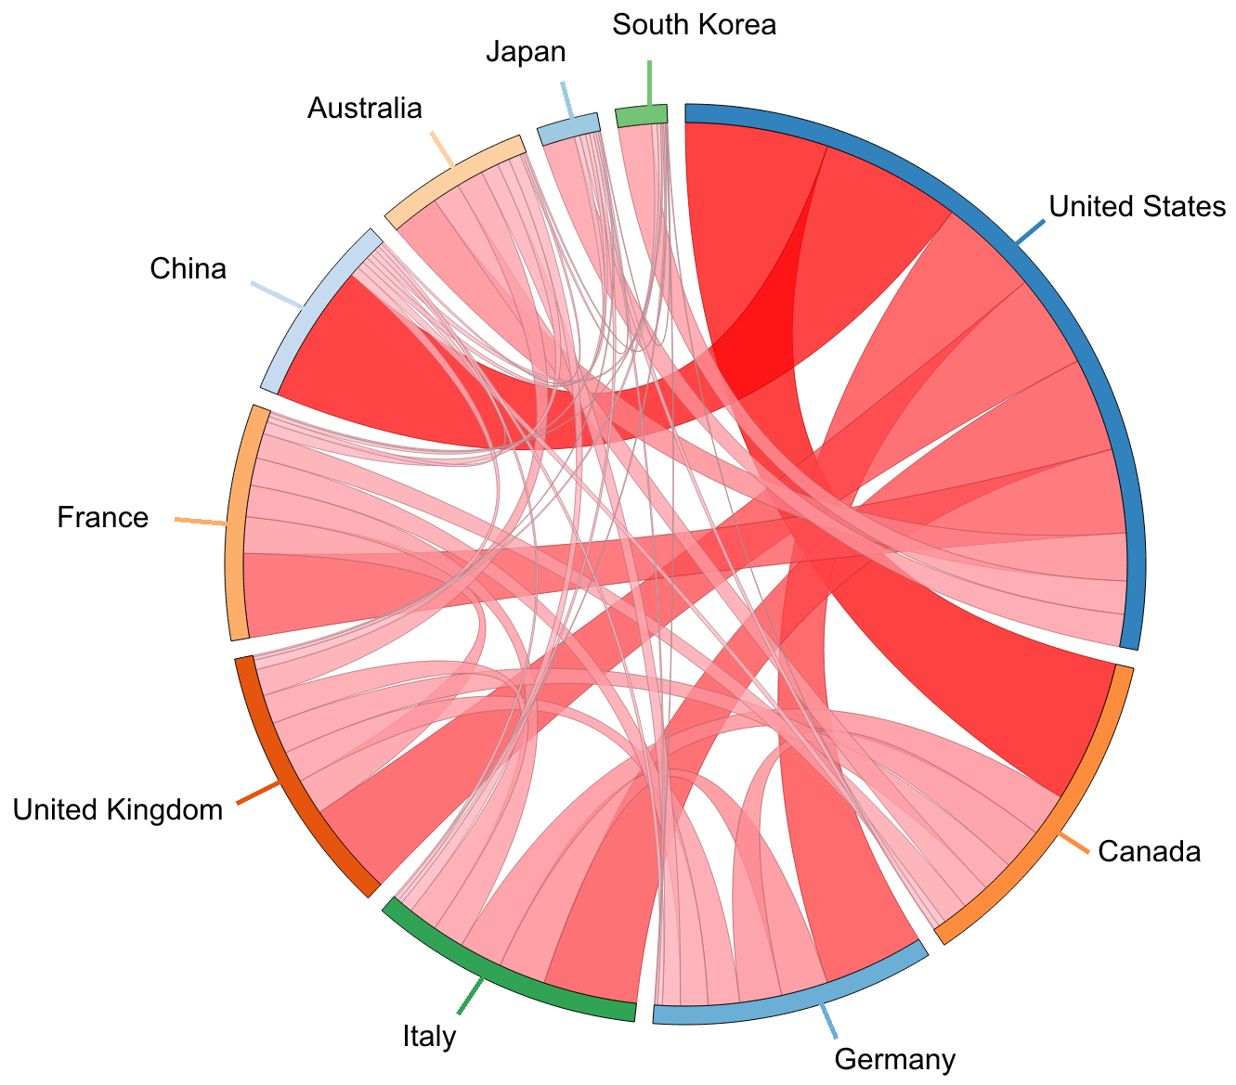
Collaborations between the top 10 countries

Slide 11
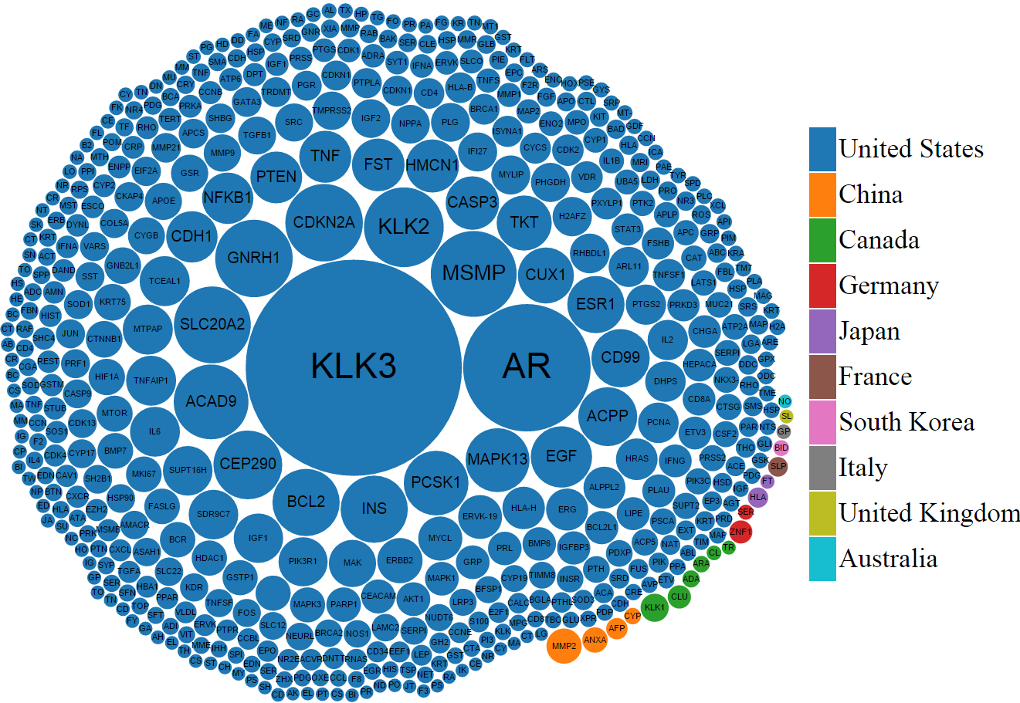
What are the top genes?
KLK3 is the gene responsible for Prostate-Specific Antigen (PSA)
Notes:
Clustered according to country which studied it the most
China studied MMP2 the most
Some countries are more interested in some of the genes

Slide 12
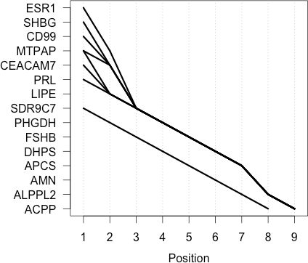
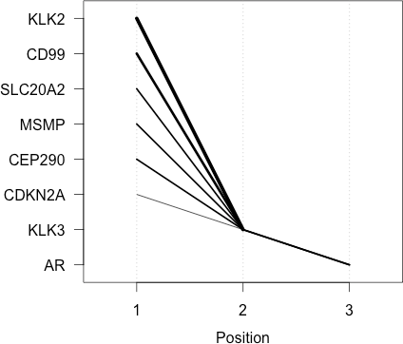
Genes most frequently studied together?
Gene-Year
Gene-Country
Notes:
Genes frequently mentioned together by papers written in the same year. For example, if two genes were both mentioned in the same year, then they get a point.
Genes frequently mentioned together by papers which were affiliated to the same countries

Slide 13
Genes most frequently studied together?
Gene-Year
Gene-Country
Association
Rule Mining
Association
Rule Mining
Soft clustering on 52 (years) dimensions
Soft clustering on 132 (countries) dimensions
All in the fuzzy area
All in the fuzzy area
Notes:
All of the items in all the item sets were found in the “fuzzy”, or “grey” areas of the clusters. They are connector genes.

Slide 14
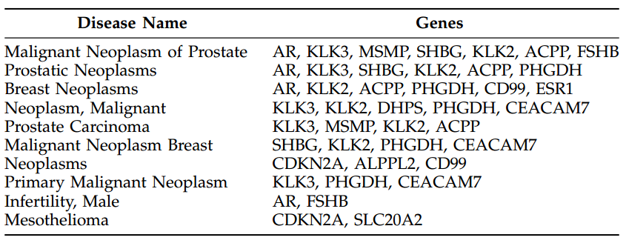
What are the top 10 diseases?
Used the web tool DisGeNet to find diseases for each gene
Notes:
We unioned the gene-year and gene-country item sets
Mesothelioma is rare cancer that forms on protective lining of internal organs of the body
Several genes were not found for any of these diseases!

Slide 15
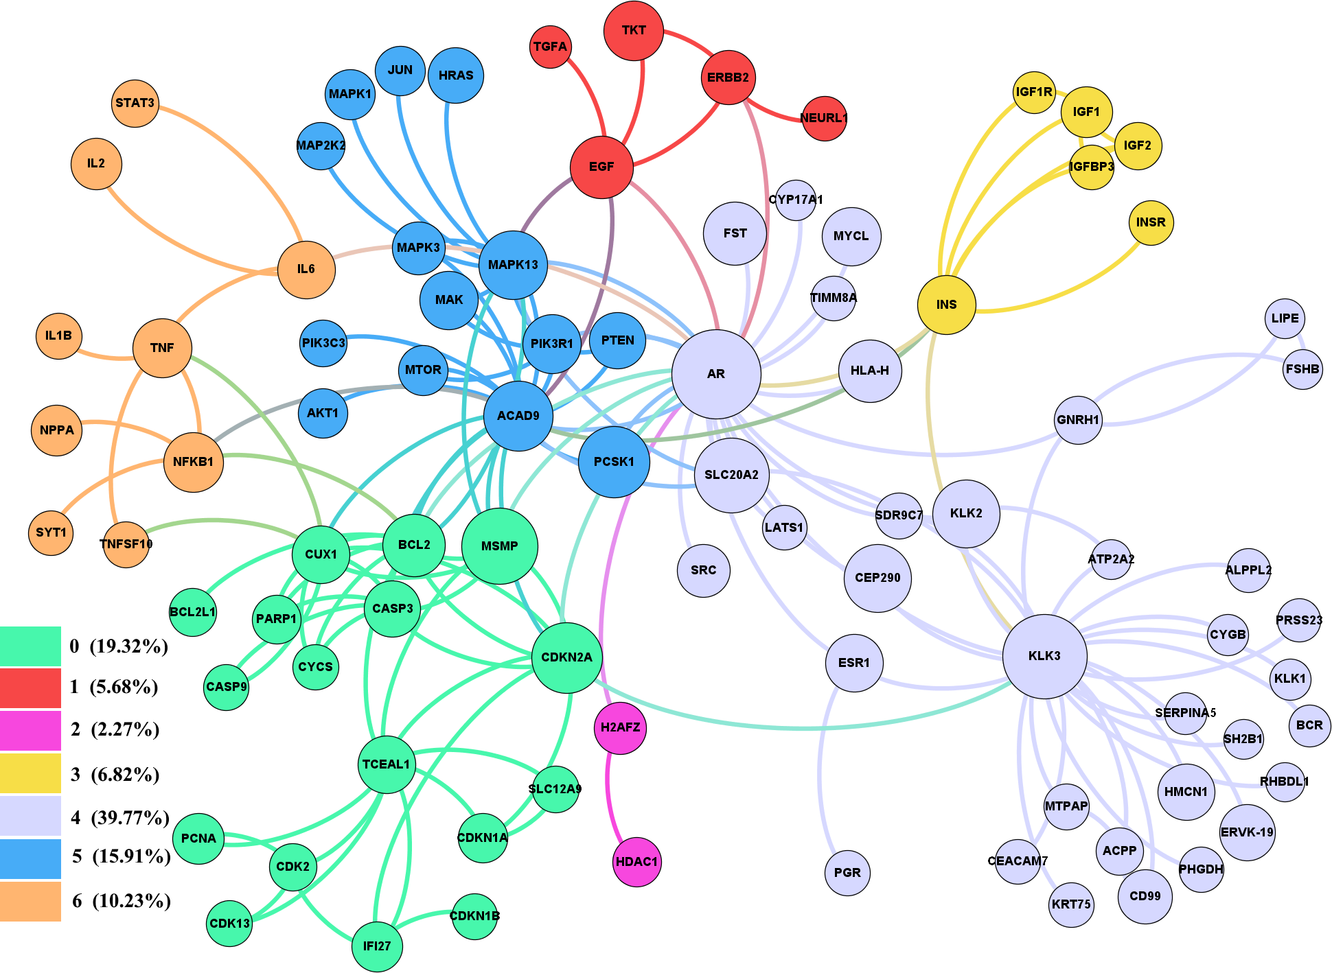
What communities of genes exist?
Highest betweenness centrality
(key genes):
AR
KLK3
ACAD9
CDKN2A
INS
Notes:
Many of the items in the itemsets were found in community 4
Some of the connected genes that may appear to have no connection may have a yet to be discovered connection

Slide 16
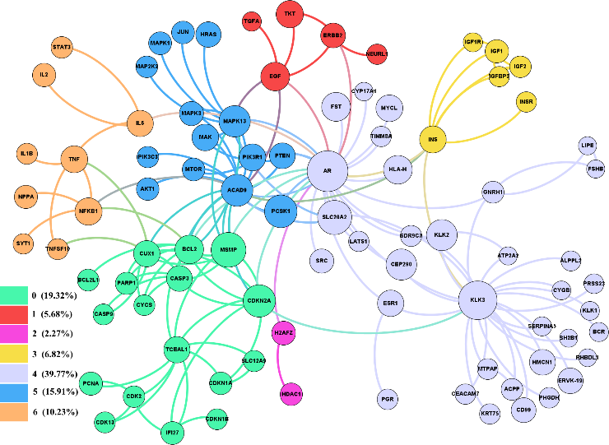
Diseases among the communities
Notes:
We found some papers that link schizophrenia to prostate cancer, endometriosis and prostate cancer

Slide 17
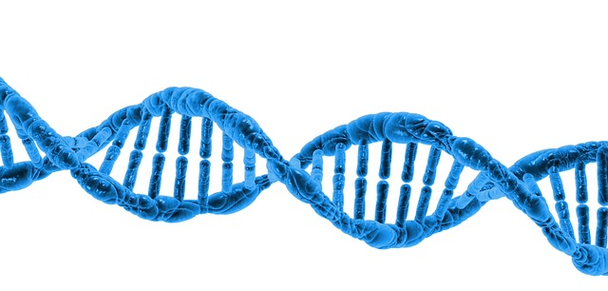
Contribution
Presented a new methodology to explore prostate cancer genetic biomarkers
Combined data mining and network analysis to find some interesting trends in prostate cancer research
Explored new relationships: gene-year, gene-country, abstract-country

Slide 18
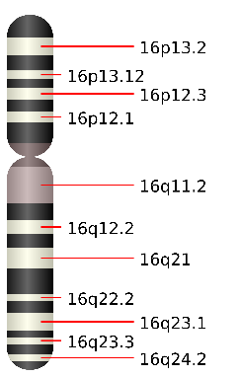
Future Work
Compare results between prostate and breast cancer
Validate with experimental results, such as expression data
Compare the gene locations on the chromosomes
Prostate cancer survey

Slide 19
Prostate cancer survey
Another data source that we can use to enhance our results
Survey results
Research abstracts
Experimental data
Strong results

Slide 20
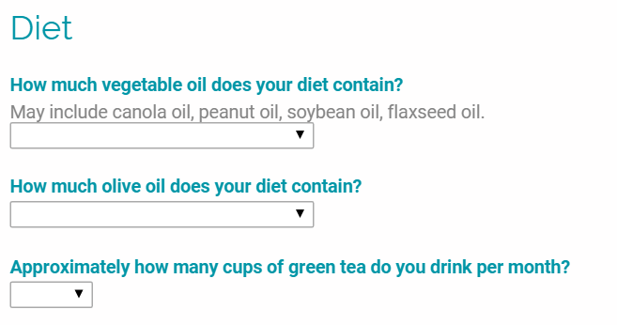
Prostate cancer survey
A survey regarding your body, lifestyle, and environment
Example:

Slide 21
Why is the survey useful?
We can find interesting correlations.
For example:
2 cups of green tea a day correlates with lower prostate cancer incidence
Lactose intolerance correlates with higher prostate cancer incidence

Slide 22
Type of questions on the survey:
Body metrics (ex. Height)
Smoking
Geographical location
Medication
Diet
Ancestry
Disease
Exercise

Slide 23
What will we do with the data?
The anonymous data will be used in aggregate form to find trends
We may use data mining and social network analysis to analyze results
The results may then be validated by wet-lab researchers!

Slide 24
Please take the survey!
Online (prostatecancer.alhajj.ca)
Hardcopy (Today)

Slide 25
Thank you! Questions?

