Slide 1
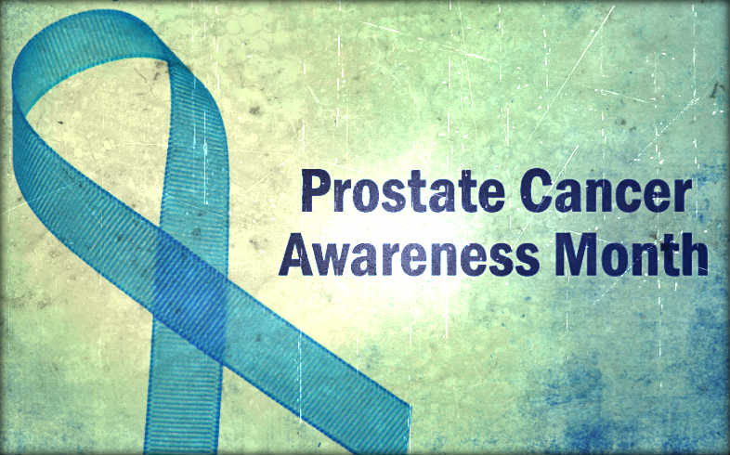
Sexuality and Prostate Cancer
Reanne Booker, MN BScN September 12, 2017

Slide 2
Conflict of interest disclosure
I have no relevant financial relationships with members of the pharmaceutical industry or medical supply companies

Slide 3
Disclaimer
This presentation is intended for educational purposes only and is not a substitute for medical advice. Please consult your physician or healthcare provider if you have any questions regarding the treatment of medical conditions and before making any changes to your current treatment plan.
Notes:
In addition to the above disclaimer, I’d also like to mention that I get incredibly nervous when I’m in front of a camera. While most of what I’m about to say is based on research and fact, there is a small chance that I might get camera-shy-induced jitters and make something up entirely.
Will discuss treatments that are undergoing investigation and are still considered experimental; will also discuss off-label use of medications/treatments

Slide 4
Objectives
To discuss the following:
What is sexuality?
What are common changes in sexuality that may occur after prostate cancer?
How can altered sexuality and altered sexual function be managed?
Q&A

Slide 5
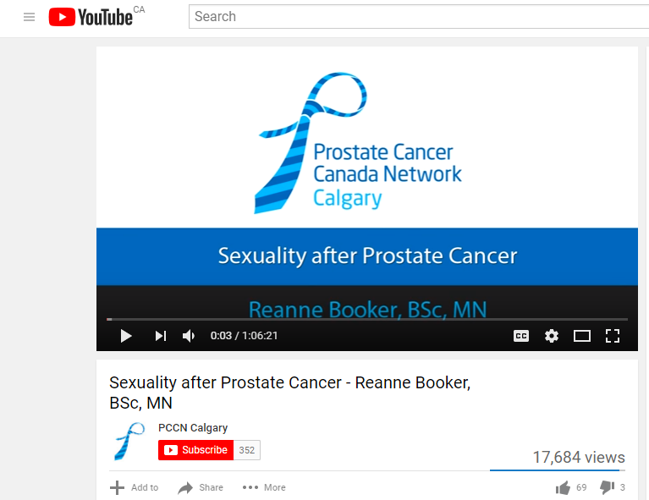
www.youtube.com/watch?v=AqCTLh84tAs

Slide 6
Sexuality
“…a central aspect of being human throughout life encompasses sex, gender identities and roles, sexual orientation, eroticism, pleasure, intimacy and reproduction. Sexuality is experienced and expressed in thoughts, fantasies, desires, beliefs, attitudes, values, behaviours, practices, roles and relationships. While sexuality can include all of these dimensions, not all of them are always experienced or expressed. Sexuality is influenced by the interaction of biological, psychological, social, economic, political, cultural, legal, historical, religious and spiritual factors.” (WHO, 2006a)
www.who.int/reproductivehealth/topics/sexual_health/sh_definitions/en/
Notes:
Busy slide; draw your attention to the bolded section
And also, want to emphasize that sexuality is not the same as sexual function!! Sexual function may be part of sexuality but it’s not the only part nor is it the defining part.
“Sex…something we do; sexuality…something we are” (Girts, 1990. Rehabil Nurs; 15: 205-206
Sexuality in palliative care: the capacity of the individual (and partner?) to link emotional needs with physical intimacy within the constraints of their ability’

Slide 7
What is Sexual Satisfaction?
www.nerve.com/love-sex/what-we-mean-when-we-say-sexual-satisfaction Pascoal et al. 2013. The Journal of Sex Research. 1: 22-30.
Notes:
Perhaps a more enigmatic question is, ‘what is sexual satisfaction’?
What is required??? Is it possible to be sexually satisfied without a partner? Is an erection needed? Ejaculation? Can you be satisfied without orgasm? Is emotional intimacy needed?
What is Sexual Satisfaction? Thematic Analysis of Lay People's Definitions
We present thematic analysis of written responses of 449 women and 311 men to the question “How would you define sexual satisfaction?” The participants were heterosexual individuals with a mean age of 36.05 years (SD = 8.34) involved in a committed exclusive relationship. In this exploratory study, two main themes were identified: personal sexual well-being and dyadic processes. The first theme focuses on the positive aspects of individual sexual experience, such as pleasure, positive feelings, arousal, sexual openness, and orgasm. The second theme emphasizes relational dimensions, such as mutuality, romance, expression of feelings, creativity, acting out desires, and frequency of sexual activity. Our results highlight that mutual pleasure is a crucial component of sexual satisfaction and that sexual satisfaction derives from positive sexual experiences and not from the absence of conflict or dysfunction.
Most commonly described terms: "feel", "pleasure", "activity", "relationship", "partner", and coming in last, "orgasms".

Slide 8
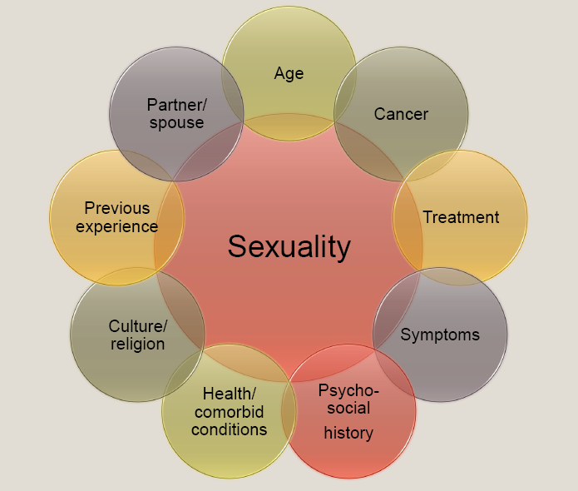
Cancer and Sexuality
Booker, 2007
Notes:
Sexuality is a broad concept encompassing aspects of self-image, body image, patterns of affection, social/family/gender roles and physical and emotional intimacy.
Factors influencing sexuality may precede a cancer diagnosis, may arise upon being diagnosed with cancer or may emerge with treatment. Some of these factors may be associated with normal aging while others may be exclusively related to the cancer or its treatment.
Sexual function relies on nervous, vascular and endocrine system function
An array of psychological factors may contribute to altered sexual function and sexuality. These include body image, self-esteem, altered mood, depression, anxiety, perceived lack of control, gender role confusion and fear. Many of these factors are influenced directly and indirectly by the cancer or its treatment. Comorbid medical conditions may also impact sexual function and sexuality. Diabetes, peripheral vascular disease, depression, heart disease, hormone deficiencies, trauma, prolactinoma and pain can all affect sexual function.

Slide 9
Sexuality Across the Illness Trajectory
→ At diagnosis
→ During treatment (surgery, chemo, radiation, hormone therapy)
→ Recovery & survivorship
→ During advanced disease and at end-of-life
Notes:
Stages associated with illness:
Crisis phase → reorganization, adaptation to treatments, flexibility to social demands of illness
Chronic phase → renegotiate relationships with family, learn to live with uncertainty, balance connectedness and separateness within social/familial relationships
New diagnosis…concerned about what it will take to control/cure the cancer; focus on getting better/surviving; important time to ask about fertility
Fertility preservation
What are the sexual side effects of treatment
Preserving function/preventing adverse effects on sexual function
Treatment…side effects, low counts, fatigue/nausea/vomiting, etc Managing side effects of treatment and impact on sexuality
Safe sex practices
Recovery & Survivorship…reintegrating…fear of recurrence…starting new relationships Getting back to ‘normal’ or ‘a new normal’
Advanced disease/EOL Preserving intimacy (physical, emotional)
Managing symptoms at EOL

Slide 10
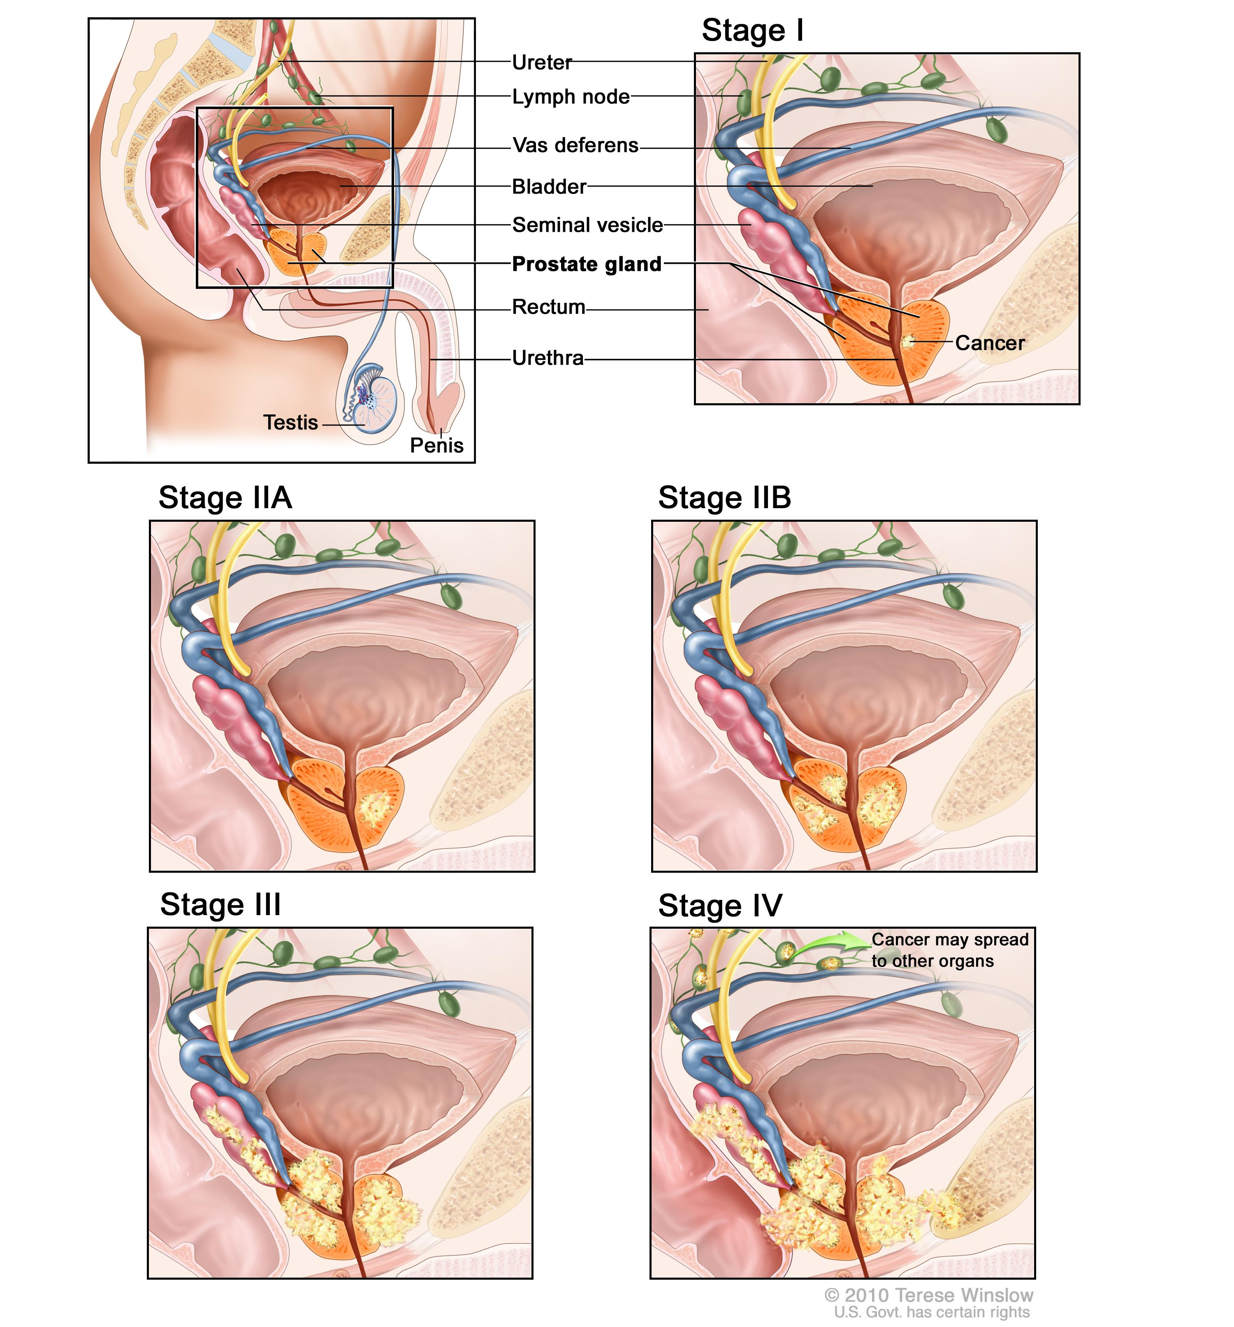
Prostate cancer and Sexuality
Watchful waiting/surveillance
Surgery
Radiation therapy
Hormone therapy
Combination
Supportive care
www.cancer.gov/types/prostate/hp/prostate-treatment-pdq
Notes:
There are different modalities of treatment for prostate cancer and while there may be some overlap in terms of the types of side effects induced by each, there are some differences as well. Further, each person…each individual may react to treatment very differently. Some men may experience very mild side effects while other men may experience profound side effects.
Talk about sexual side effects but there are other side effects that may also impact sexuality (bladder and/or bowel incontinence)
Watchful waiting --- anxiety; changes secondary to prostate cancer itself
Other types of treatment:
Chemotherapy
Biologic therapy
Bisphosphonate therapy
New types of treatment are being tested in clinical trials
Cryosurgery
High-intensity–focused ultrasound therapy
Proton beam radiation therapy

Slide 11
Clinicians should discuss post-op ED (temporary or permanent)
Validated instruments for assessing erectile function recovery are available to monitor erectile function recovery
There is insufficient evidence that a specific surgical technique (open vs laparoscopic vs robot assisted RP) promotes better results in post-op EF recovery
Predictors of EF recovery (not limited to):
Younger age
Pre-op EF
Bilat. Nerve sparing surgery
Patients should be informed about the key elements of pathophysiology of post-op ED (such as nerve injury and cavernous venous leak)
Recovery of post-op EF can take several years
Conflicting data as to whether penile rehab with PDE5i improves recovery of spontaneous erections
Data are inadequate to support any specific regimen as optimal for penile rehab
Men undergoing RP (any technique) are at risk of sexual changes other than ED (including decreased libido, changes in orgasm, anejaculation, Peyronie-like disease, changes in penile size)
Salonia et al. 2017. Journal of Sexual Medicine. 14(3): 285-296; 297-315.
Notes:
I was happy to see these recommendations published earlier this year. IN particular, the recommendations serve to remind clinicians to address sexual function prior to treatment for prostate cancer and also make some suggestions in terms of how to manage sexual dysfunction.
Salonia et al. Journal of Sexual Medicine. 14(3): 285-296

Slide 12
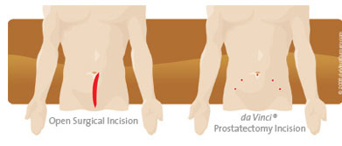
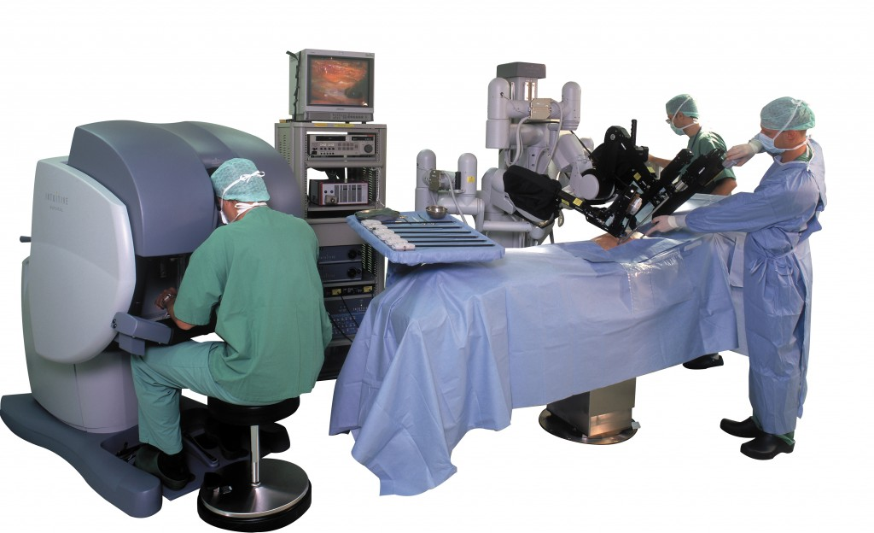
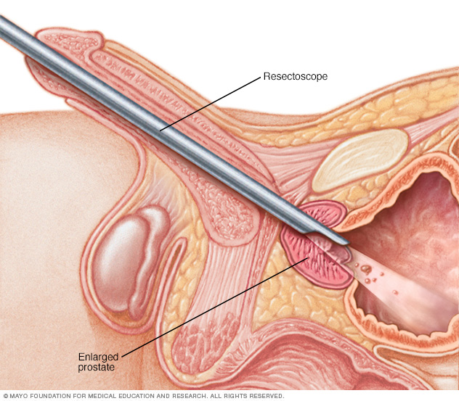
Surgery for prostate cancer
Radical prostatectomy (RP)
Open RP (ORP)
Robot-assisted/laparoscopic RP (RARP/RALP)
Orchiectomy
Transurethral resection of the prostate (TURP)
www.mayoclinic.org/tests-procedures/turp/details/what-you-can-expect/rec-20211838
www.ucdmc.ucdavis.edu/urology/specialties/robotic_surgery/prostatectomy.html
Notes:
Prostatectomy
Orchiectomy
TURP – for benign prostate issues or, in advanced prostate cancer (not to cure but to relieve symptoms)
After surgery:
TURP: retrograde ejaculation (into bladder), ED (lower risk) RP – no ejaculate, penile shortening, ED
Orchiectomy - diminished desire, ED,
Damage to nerve bundles that control blood flow to the penis
Reduced blood flow to the penis
RP: removal of the prostate and seminal vesicles for prostate cancer
Nerve sparing surgery
Sometimes surgeon must seal off some of the small arteries that feed into the 2 main blood vessels involved in erection; blood flow is then slowed (like a river after the streams that run into it have been dammed)
Can take up to 2 years to regain erectile function after surgery
Important factors in predicting post-surgery erectile function: age (younger men have better ability to regain erectile function); erections before surgery
Penile shortening: Nerve sparing surgery and recovery of erectile function appeared to have an independent protective effect on penile length loss at 1 year.
Early sexual rehabilitation; keep the tissues of the penis healthy, prevent tissue changes (try to have erections within weeks of surgery)
Prostatectomy: removal of seminal vesicles and prostate gland → no fluid can come in from testicles or prostate → no fluid buildup in urethra…sense of fullness/inevitability abates → NO ejaculate May also experience change in pelvic floor function
TURP: This operation is more often used to treat men with non-cancerous enlargement of the prostate called benign prostatic hyperplasia (BPH). But it is also sometimes used in men with advanced prostate cancer to help relieve symptoms, such as urination problems. (It is not used to try to cure the cancer.)
. An instrument called a resectoscope is passed through the tip of the penis into the urethra to the level of the prostate. Once it is in place, either electricity is passed through a wire to heat it or a laser is used to cut or vaporize the tissue

Slide 13
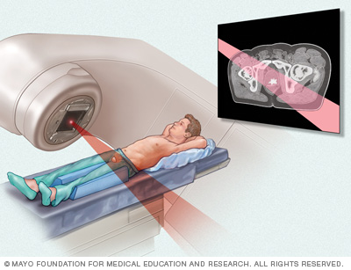
Radiation for prostate cancer
External beam
Brachytherapy
Combination
Incrocci. 2015. Transl Androl Urol, 4(2): 124-130
www.mayoclinic.org/tests-procedures/prostate-brachytherapy/home/ovc-20271519
www.mayoclinic.org/tests-procedures/external-beam-radiation-for-prostate-cancer/home/ovc-20204694
Notes:
May experience
Erectile changes (~60-70%); may increase for the first 1-2 years post RT
Rates after brachytherapy a bit better: 5-51%
Decreased volume or absence of semen (2-56%)
Discomfort during ejaculation (3-26%)
Hemospermia (5-15%)
Decreased libido (8-53%)
Decreased intensity of orgasm
Decreased satisfaction with sex (25-60%)
Etiology of damage…likely vascular (arteriogenic…damage to arteries by RT); also likely neurogenic (damage to nerves)
Radiation can speed up hardening, narrowing or even blockage of the pelvic arteries
Post RT epididymitis → painful ejaculation
May also affect the nerves that control a man’s ability to have an erection
Improved techniques and approaches:
Intensity modulated RT – enables adequate dose delivery with improved sparing of normal tissues
Hypofractionated (higher dose per fraction) --- one study published last year, no sig differences in erectile fn
Stereotactic body RT
No randomized trials of newer approaches (only comparative) --- acceptable efficacy and toxicity
Most still cause ED

Slide 14
Proton therapy vs Photon Therapy
www.praxis-margareten.at/2013/proton-therapy/
http://jamanetwork.com/data/Journals/JAMA/929972/jpg140007fa.png
Mahmood et al. 2016. Advances in Radiation Oncology, 1(3):161-169.
Notes:
Proton therapy --- one prospective trial found reduced rates of ED but all men were <60y
The lifetime costs associated with proton therapy for prostate cancer approach$73,000, compared with less than $42,000 for intensity-modulated radiation therapy, (IMRT), according to a 2008 report from the Institute for Clinical and Economic Review.
Think of the difference between X-rays and protons this way: Imagine that an X-ray is a bullet that enters the body, strikes a tumor, and then exits the body through the other side. Throughout this process, the X-ray releases energy, damaging healthy and malignant tissue alike.
By contrast, doctors can calculate how deep in the body they want a proton beam to fire. That means a proton beam doesn’t exit the body, so it delivers most of its energy in the tumor.
In theory, this pinpoint-targeting ability should make proton beam therapy less likely than conventional radiation treatments to damage healthy tissue in the vicinity of a tumor—damage that can result in side effects such as erectile dysfunction, incontinence, and serious gastrointestinal problems such as bleeding and ulcers.
But the JAMA findings raise an important question: All else being equal, if proton beam therapy is more likely than IMRT to produce adverse gastrointestinal effects, why pay the additional cost?
The patient-level studies have not demonstrated a significant, sustained clinical advantage to PBT. Gray and colleagues found modest transient benefits in bowel and urinary symptoms with PBT immediately post-treatment, but these disappeared by 1 year. You may be eligible for proton therapy treatment if: 1) You have a cancer which has not spread outside the prostate gland 2) You are prepared to travel outside Canada and pay for the treatment ($50,000 or higher.)

Slide 15
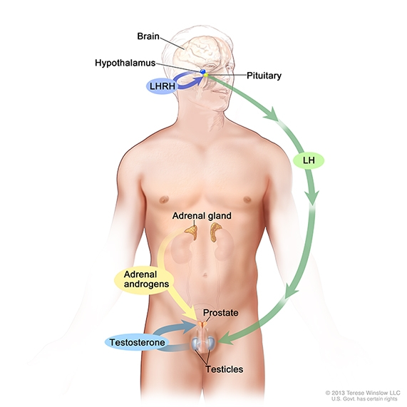
Hormone therapy for prostate cancer
Achieved by:
↓ androgen production by the testes
Blocking the action of androgens in the body
Blocking the production of androgens throughout the body
www.cancer.gov/types/prostate/prostate-hormone-therapy-fact-sheet
Notes:
Surgical castration
Luteinizing hormone releasing hormone agonists
Luteinizing hormone releasing hormone antagonists
Antiandrogens
Androgen synthesis inhibitors
Drawing shows that testosterone production is regulated by luteinizing hormone (LH) and luteinizing hormone-releasing hormone (LHRH). The hypothalamus releases LHRH, which stimulates the release of LH from the pituitary gland. LH acts on specific cells in the testes to produce the majority of testosterone in the body. Most of the remaining androgens are produced by the adrenal glands. Androgens are taken up by prostate cells, where they either bind to the androgen receptor directly or are converted to dihydrotestosterone (DHT), which has a greater binding affinity for the androgen receptor than testosterone.
Some potential side effects:
↓d libido
Erectile dysfunction
Hot flashes
Weight gain
Fatigue
Gynecomastia
↓d penile length and testicular size

Slide 16
Changes in Sexual function

Slide 17
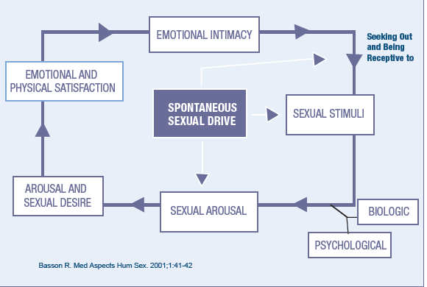
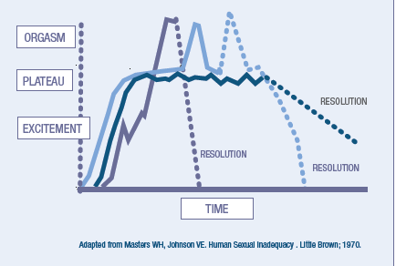
Changes in Libido/Desire
→DESIRE
www.arhp.org/Publications-and-Resources/Clinical-Practice-Tools/Handbook-On-Female-Sexual-Health-And-Wellness/Female-Sexual-Response
Notes:
Can happen with any of the treatment modalities for prostate cancer…including watchful waiting and also common as we age!
Desire…has garnered more attention in recent years, particularly in the context of female sexual health with the push for approval of a medication to help hypoactive sexual desire in women.
Flibanserin…finally approved by the FDA and promptly sold for $1 billion US but has not found to be as efficacious as hoped
Desire…complicated. Involves the biggest sex organ in the body…the brain!!
Influenced by numerous factors, physical and psychosocial alike. Desire can be impacted by pain, sexual function, quality of the relationship, conflict, etc.
The notion of spontaneous desire vs responsive desire
Sexual satisfaction, and not orgasm, appears to be the focus in some womenA woman begins a sexual response experience from a point of relative sexual neutrality but with a goal of emotional intimacy with her partner; she may seek or be receptive to sexual stimuli
Goals for sexual activity may be complex and not merely for internal satisfaction of an “innate” sexual hunger
Receptivity to sexual stimuli allows the woman to move to a state of physiologic arousal
If the mind continues to process the stimuli on to further arousal, sexual desire may encourage the woman to move forward to sexual satisfaction and orgasm fostering intimacy and reinforcing sexual motivation
This model reinforces the notion that female motivation for sexual activity is complex and not specifically an innate phenomenon

Slide 18
Changes in Erectile function
Difficulty achieving erections
Difficulty maintaining erections
Insufficient firmness for penetrative intercourse (vaginal or anal)
Loss of spontaneous erections Loss of nocturnal/early morning erections
Albaugh et al. 2017. BMC Urol, 17(45): 1-9.
Canalichio et al. 2015. Transl Androl Urol. 4(2): 103-109.
Incrocci. 2015. Transl Androl Urol. 4(2): 124-130.
Notes:
After many types of cancer, erectile function can change. Many men report difficulties with achieving erections, maintaining erections and with rigidity of erections. I want to mention that we know that anal intercourse requires a firmer erection (approx. 30% firmer than is required for vaginal intercourse) – much of the research that has been done to date has focused on vaginal intercourse.
We know that changes in erectile function can also happen with aging, even in the absence of a cancer diagnosis. In addition, there are a number of medical conditions and medications that can also influence erectile function.
More than 50% of men age >40y have some degree of ED
But…the good news is that erections are not necessary or required for orgasm!!!

Slide 19
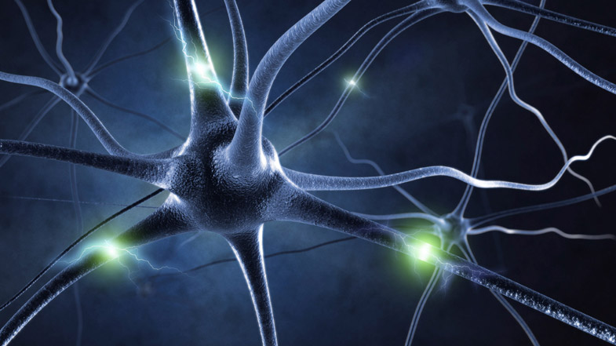
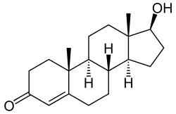
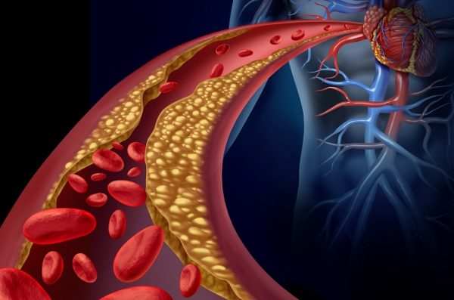
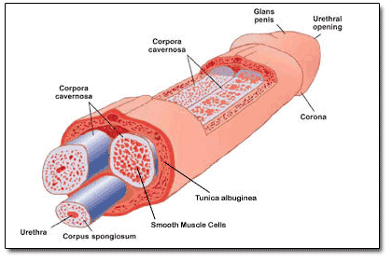
Mechanisms of Erectile dysfunction
Neurogenic
Vasculogenic:
Hormonal
Anatomic (cavernosal)/musculogenic
Psychogenic
Combination of any or all of the above
De Tejada et al. 2005. Journal of Sexual Medicine, 2(1): 26-39
Mahmood et al. 2016. Advances in Radiation Oncology, 1(3):161-169
www.amherst.edu/academiclife/departments/psychology
Notes:
erectile process (failure to initiate [neurogenic], failure to fill [arterial], and failure to store [venous]
Nerve function, blood flow, psychological, hormonal, combination of all
Neurogenic: : Neural trauma leads to structural changes in erectile tissue; denervation apoptosis Vasculogenic:
Arteriogenic: Arterial injury (accessory pudendal arteries)
Venogenic: Cavernosal hypoxia-induced fibrosis with venous leak
Combination arteriogenic/venogenic
Hormonal: hypogonadism Psychogenic: Impact of cancer diagnosis on erectile function; impact of anxiety centered on re-initiation of intimacy
Anatomic?
Loss of compliance of the penile sinusoids associated with increased deposition of collagen and decreased elastic fibers may be seen in diabetes, hypercholesterolemia, vascular disease, penile injury, or old age
ED --- can be an early warning sign of cardiovascular disease…what is happening in the penile arteries, can also be happening in the coronary arteries

Slide 20
Changes in Ejaculation
Delayed or premature ejaculation
Little or no ejaculate (‘anejaculation’)
Urine leakage during ejaculation (‘climacturia’)
Pain with ejaculation (‘dysejaculation’)
Capogross et al. 2017. World J Mens Health. 35(1): 1–13.
Notes:
If prostate and seminal vesicles are removed → no semen (dry orgasm) Sperm cells will be reabsorbed by the body
Climacturia (use of condoms or constriction bands may help)
Pain with ejaculation (may be caused by irritation of the urethra from RT...should go away over time after RT ends)
May produce less semen (after RT to prostate, hormone therapy for prostate cancer)
Orgasm if no ejaculation: * some men say it is unchanged, some say it is less intense, some say it is more intense
Retrograde ejaculation
Delayed ejaculation
Premature ejaculation
Climacturia:
Prevalence ~20-93% (variability in terms of frequency and also amount of urine that leaks)
Reduced ejaculate with RT, ADT,

Slide 21
Changes in Orgasm
Changes in orgasmic sensation
Decreased intensity
Increased intensity
Painful orgasm (‘dysorgasmia’)
Loss of orgasm (‘anorgasmia’)
Capogrosso et al. 2017. World J Mens Health. 35(1): 1–13.
Notes:
After RP
Changes in orgasmic sensation: Reported prevalence of ~30-70% post RP
Painful orgasm: ~20% prevalence after RP
Climacturia: ~20-93% (some just lose a few drops, some lose a lot of urine; some, just occasionally and some all the time) Anorgasmia: ~33-77%
Assoc with: age
Nerve-sparing technique
Prostate weight (<59g associated with better orgasmic function after surgery)
Usually at the level of the penis (usually penile shaft or testes) but can affect other sites as well (rectum, lower abdomen)
Post-RT epididymitis

Slide 22
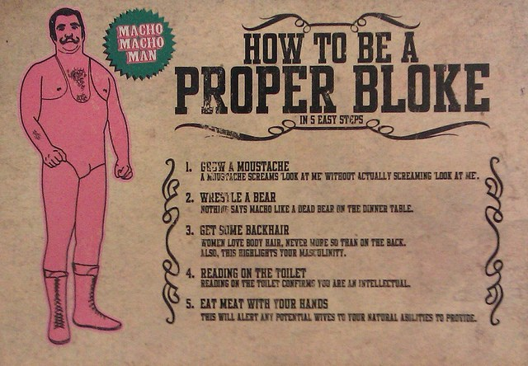
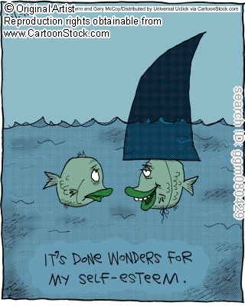
Body Image
http://i2.wp.com/www.inside-man.co.uk/wp-content/uploads/2014/07/7266356160_b32dfc1c3f_z.jpg
Notes:
Penile shortening
Testicular shrinkage
Gynecomastia
Weight gain, weight loss
Penile shortening: potential loss of penile length and girth after RP, ADT, ADT+RT
Mechanisms unclear but suspected cavernosal hypoxia which induces a profibrotic state and increased collagen deposition – changes in smooth muscle endothelium
Reported after RP
Lin & Wang, 2013. Transl Androl Urol 2(1): 61-66
Benson et al. 2013. Journal of Andrology, 33(6): 1143-1154
Concerns in Gay and Bi community:
Looks and in particular, penile length/girth given a lot of importance
What does it mean to be a man? How is ‘masculinity’ defined? Richard Wassersug (Professor at UBC) has done a lot of work in this area and has written some thought provoking articles on how masculinity is defined and experienced in the context of prostate cancer. PCCN video
Anxiety, depression
Identity

Slide 23
Changes in Fertility
Fertility preservation:
semen collected for freezing
can be stored and used at a later date
Collection needs to happen before treatment starts
Loren et al. 2013. Journal of Clinical Oncology, 31(19): 2500-2510.
Notes:
sperm cryopreservation (sperm banking) as the only established fertility preservation method
Other methods (eg, testicular tissue cryopreservation, which does not require sexual maturity, for the purpose of future reimplantation or grafting of human testicular tissue) are experimental
Treatment for prostate cancer may temporarily or permanently impact fertility. Ideally, discussions on fertility preservation should occur prior to the initiation of treatment
Cost → ~$400 for first year of storage and $200/year thereafter for storage fees
Pt recently in workshop --- friend said she was ‘selfish’ for thinking about fertility and wanting to have a baby (in context of breast cancer).
Another comment about a young male patient with prostate cancer --- fam member said he shouldn’t think about marriage, children, etc.
No guarantee for any of us…why should pts with history of cancer be discriminated against?

Slide 24
Fertility Preservation
If possible, talk to your health care team before treatment about effects on fertility and options
If desired, request a referral to a fertility preservation specialist
Financial assistance for fertility preservation:
Generations of Hope (P: 403-2849103; Email: info@generationsofhope.ca)
Fertile Future (1-877-HOPE-066; fertilefuture.ca)
Notes:
Referral to fertility preservation specialist (can see before, during or after treatment)
Sometimes, it is not practical or safe to delay treatment to pursue fertility preservation options. At the very least, it might be worthwhile to ask your healthcare providers about how fertility might be affected and what the options are prior to starting treatment.
There are specialists across Canada who deal with patients who are going to be treated for or have been treated for cancer. It may be useful to meet with one of these specialists if you are considering fertility preservation options or want to find out about the status of your fertility after treatment.
Fertility preservation can be expensive; provincial health and insurance plans generally do not cover the costs associated with fertility treatment. There are a number of fertility centers across Canada who will offer reduced or subsidized services for patients who have had cancer.

Slide 25
Relationship changes
www.cancer.net/navigating-cancer-care/dating-sex-and-reproduction/dating-and-intimacy
www.cancer.ca/en/cancer-information/cancer-journey/life-after-cancer/relationships-after-cancer/?region=on
www.dana-farber.org/For-Adult-Cancer-Survivors/Caring-For-Yourself-After-Cancer/Social-Relationships.aspx
www.cancervic.org.au/about-cancer/information_for_carers/changing-relationships
www.healthtalk.umn.edu/2016/09/08/gay-prostate-cancer-patients/
https://www.sovhealth.com/health-and-wellness/spouse-cancer/
http://lgbtcancer.org/
Notes:
Can be challenging for:
Existing relationships (either new or long-term)
Starting new relationships
Jen Smith, a 35-year-old divorced mother in Champaign, Ill., calls cancer her "d-bag filter.“
("I do have cancer but that's a part of me like having brown eyes") and others that don't. She says she received more responses with the latter approach, but with the former heard more often from the type of man she'd like to date -- someone who has the same enthusiasm for life, she says, whether that means embracing a vacation together or just giggling while cooking a shared dinner at home.
Most experts agree that disclosing a cancer diagnosis should be done by the 4-5th date, before there is significant emotional involvement
People who have been through a core-shaking experience like cancer may experience a shift in perspective that ultimately makes them even more lovable, she points out -- they might have a new appreciation for life that a healthy person doesn’t.
Body changes and concerns about sex can affect the way you relate to your partner or how you feel about dating. As you struggle to accept changes yourself, you may also worry about how someone else will react to scars, ostomies, sexual problems, and loss of fertility. Sexual problems can make feeling close even harder. Even for a couple that has been together a long time, staying connected can be a major challenge at first. It may be a comfort to learn that very few committed relationships end because of ostomies, scars, or other body changes. Divorce rates are about the same for people with and without a cancer history.
How will cancer change our relationship?
If I’m doing all the caring they may feel like they’ve lost their independence.
I might need to take on new responsibilities that will reverse our roles.
The intimacy we shared might be replaced by the caring role.
We might need to re-evaluate our priorities and set new goals.
Ways to manage changes in your relationship
Arrange home help if you feel uncomfortable doing the bathing and dressing.
Allow time for both of you to get used to the change in roles, particularly if your roles have reversed.
Set boundaries to maintain independence and allow both of you to feel in control.
Listen to each other’s needs and find ways to meet them.
Use touch to show you care.
Talk about the changes to avoid misunderstandings.
Give the person you’re caring for the chance to do things for themselves so they feel useful.

Slide 26
Partners
May feel:
Fearful of causing pain/discomfort during sexual activity
Unwanted/unattractive/rejected due to decreased sexual activity
A change in role from partner to caregiver
Worried about loss of partner
Albaugh et al. 2017. BMC Urology. 17:45
Hawkins et al. 2009. Cancer Nursing. 32: 271-280 Taylor. 2015. Sex Disabil. 33: 365-374 Taylor. 2014. Palliative Medicine. 28: 438-447
Notes:
This is an area that has received relatively little attention in the lit.
May have a fear of initiating sexual activity –worried about causing partner pain or, even death during sex
Unwanted/unattractive: may be perceived as rejection in not aware of effect of treatment on sexuality
Change in role: Caregiver role may change how the person sees the other in a sexual way
Taylor: Does the caring role preclude sexuality and intimacy in the coupled relationship? (Yes, sometimes but not always; how couples handled role change was determined by the sense of equality in the relationship)
Change in role may also mean partner has to take on dominant role in sexual activity
May disconnect/distance in anticipation of impending loss
Partner: may look at pt differently due to physical or behavioral changes (secondary to disease/treatment) → BRAIN TUMOUR PTS Partners may also have their own sexual health concerns → women (vulvovaginal chas associated with menopause; other medical conditions, etc.).

Slide 27
Potential Challenges for Gay, Bisexual and men who have sex with Men
Prostate as site of sexual pleasure during receptive anal sex
Loss of ejaculate, inability to participate in semen exchange
Rectal irritation or pain → painful receptive anal sex
Inadequate penile rigidity for insertive anal sex
Change in sexual roles (top, bottom)
Absence of erection
Change in penile size
Rosser et al. 2016. LGBT Health. 3(1): 32–41.
Ussher et al. 2017. Archives of Sexual Behavior. 46(7): 2043–2057
www.prostate.org.au/media/246182/3_side-effects.pdf
Notes:
While GB men experience the same sexual changes after PCa that have been reported by heterosexual men, there are a number of GB-specific meanings and psychological consequences attached to sexual changes
Identity challenges
Relationship challenges
Loss of prostate --- takes away site of sexual pleasure (not just for GB, MSM --- but any man) Loss of ejaculate – semen exchange can be important for men; lack of visible ejaculate can be a big deal Rectal irritation or pain (particularly after RT or surgery) – may make receptive anal intercourse painful
Penile size – important and may be associated with sexual roles [men w small penises may take on bottom role]; comparison
Social support – GB may have less familial/social support; sexual minority status is a negative predictor of QOL following prostate cancer treatment
Patient educational materials quite heterosexist (but a number of good websites exist and some literature is also available)
Research on penile rehab strategies have focused on penis-in-vagina sex → need studies on other types of sexual activity including anal intercourse and involve GB, MSM patients and partners
Intercourse not the most frequently practiced activity; many men able to adapt and incorporate different practices
More research needed:
Open relationships in GB men
Single GB men
Male partners of GB

Slide 28
Prostate cancer And Transgender Women
Most transgender women will still have a prostate
Feminizing hormone therapy may include estrogen as well as anti-androgen and/or alpha reductase inhibitor therapies
Prostate is androgen-deprived
PSA not a reliable indicator for prostate pathology
Risk of prostate cancer is thought to be low but not zero
Deebel et al. 2017. Urology. pii: S0090-4295(17)30906-8. doi: 10.1016/j.urology.2017.08.032. [Epub ahead of print]
Sharif et al. 2017. Prostate. 77(8): 824-82. Turo et al. 2013. Can Urol Assoc J. 7(7-8): E544–E546.
Notes:
Transgender woman will have a prostate, regardless of whether or not she has undergone a gender-confirming surgery, such as orchiectomy or vaginoplasty. During gender confirming surgery, the prostate is typically spared, as its removal is intricate and can lead to complications including urinary incontinence[i]. Therefore, for women who have or have not had genital surgery, it is possible for prostate cancer to develop. As part of feminizing hormone therapy, trans women often receive estrogen as well as either or both antiandrogens and 5-alpha-reductase inhibitor therapies. This creates an environment in which the prostate is androgen-deprived[ii]. There are conflicting theories about whether this environment reduces prostate cancer development or whether it may lead to more aggressive prostate cancers[iii].
PSA not reliable indicator (feminizing hormones lower PSA)
It can be emotionally difficult to have a male-associated cancer as someone who does not identify as male, especially since most prostate cancer support groups and resources are targeted at men.

Slide 29
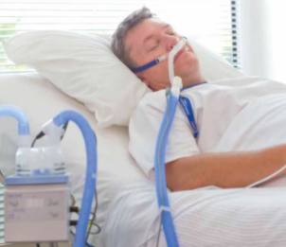
Sexuality in Advanced Disease and at End-of-life
Research has found that:
The importance that people place on sexuality does not change at EOL but the expression of sexuality may change as disease advances
Sexuality is a key component of quality of life for many people
Barriers to maintaining sexuality:
Lack of privacy, shared rooms
Uninviting space
Intrusion of staff
Single beds
Equipment: oxygen, IV tubing, feeding tubes
Lemieux et al. 2004. Palliative Medicine. 18: 630-637 Taylor. British Journal of Occupational Therapy. 2011; 74: 435-442.
Notes:
Dr. Laurie Lemieux study, 2004: cited by other authors more than 110 times
Qual study; 10 pts with advanced cancer were interviewed about their perspectives on sexuality
The level of importance pts placed upon sexuality had not changed since becoming ill but expression of sexuality had changed
Sexuality was seen as not being solely about sexual intercourse but also included emotional intimacy/connection, verbal and non-intercourse forms of intimacy
Participants reported that sexuality: important aspect of QOL; loss of sexuality was significant to patients
Barriers identified: lack of privacy, shared rooms, uninviting space, intrusion of staff, single beds
Discussion: some participants felt that being part of the study was helpful and emotionally cathartic
All participants felt that sexuality should be brought up by health care providers (only one pt had ever been asked about it)
Participants felt that homecare nurses and physicians – were ideal clinicians to discuss issue

Slide 30
Considerations at EOL
Symptoms
Pain
Dyspnea
Fatigue/weakness
Nausea/vomiting
Dry mouth (xerostomia)
Cognitive changes
Shell. 2008. Seminars in Oncology Nursing. 24:131-134
Notes:
Focus may move from sexual intercourse to other forms of physical intimacy (hugging, cuddling) or to emotional intimacy
Cog changes → from disease (brain tumor, dementia); delirium, meds
Many strategies and options for managing pain and other symptoms at EOL
Private rooms; signs for door requesting privacy; double beds, if possible!
Partner/caregiving role: support/assistance for partner to retain role as partner

Slide 31
Interventions
Psychology
Sociocultural
Interpersonal
Biology
Biopsychosocial Model for Sexual Health
Althof et al. 2005. J Sex Med, 2(6): 793-800
Thomas & Thurston. 2016. Maturitas, 87: 49-60
Notes:
J Sex Med. 2005 Nov;2(6):793-800.
Psychological and interpersonal dimensions of sexual function and dysfunction.
Althof SE¹, Leiblum SR, Chevret-Measson M, Hartmann U, Levine SB, McCabe M, Plaut M, Rodrigues O, Wylie K.
Need multidisciplinary approach…can’t just fix one part
Biology: medications, procedures, devices, etc.
Psychology: anxiety, depression, etc. (counselling) Interpersonal: relationship concerns, etc. (counselling)
Sociocultural: more difficult to change (upbringing, norms, culture, religion, etc. – but counseling can help with managing concerns in the context of one’s values, upbringing, etc.
Psychosocial:
Counseling
Communication
Mindfulness based strategies

Slide 32
Interventions
Partner/person
self-awareness
communication
adaptability
Psychology/counseling
Non invasive assistive devices
Medical interventions
Medications, assistive devices, injection therapy, implants
Referrals to urology, gynecology, endocrinology, pelvic flood physio, others
Notes:
Self-awareness…patient and partner. Psychologically…what are the concerns? What were the concerns before cancer/treatment? Have these changed? Physically…what are the concerns? Self-exploration…touching (alone or with partner).
Body image issues…common. Many people do not feel sexy, attractive or desirable (even if partner still feels attraction/desire). Getting dressed up, planning romantic evening…
Setting the mood, couples massage, light touch, romantic dinner
vary sexual positioning
timing of sexual activity
timing of medication administration

Slide 33
Things to think about when trying interventions
Acknowledge the change/loss of sexual function → grieving process
Be aware of potential failure of strategies
Consider sexual activity despite low libido
Consider flexibility in sexual practices
Work with erections of reduced quality
Persistence; don’t give up!
Walker et al. 2015. Nat Rev Urol. 12(3):167-76.
Notes:
Be aware that some treatment strategies may not be effective (PDE5i, ICI, VED, etc.)
Normalize grieving process --- few patients can expect to return to baseline erectile function...this is a loss and it is ok to grieve this loss
Sexual activity despite low libido: sexual activity does not have to be preceded by spotaneous sxual desire!!! Engage in sexual play as arousal and desire can follow sexual stimulation
Promote flexibility: take a broad outlook on sexual activities...not just erection dependent activity. Erection does not need to be present!!
Arousal and orgasm can still occur in the absence of an erection
Manage erections: can work with partial or even absent erections and still achieve orgasm and/or satisfaction

Slide 34
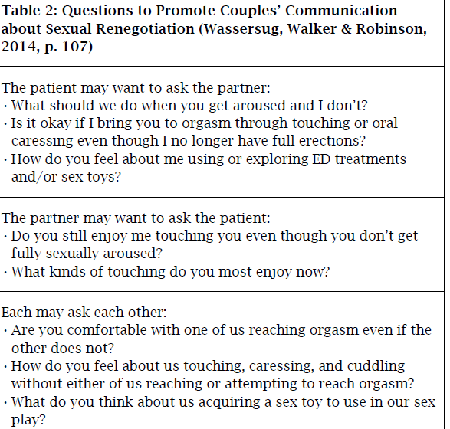
Communication
Talk openly with your partner about your feelings (emotional and physical)
Be concerned about how your partner feels
Plan ahead (may lessen fatigue/pain)
Take it slow
Be patient
http://renewintimacy.org/counseling.aspx
Walker et al. 2014. CONJ, 24(4): 256-263
Notes:
Patients may wait for partner to initiate activity or partners may wait for patient to initiate; as a result, neither initiates
Be persistent in the sexual recovery process….if something’s not working, keep trying or try something different
Acknowledge loss of sexual function; recognize grief
Adapt or change the goal of sexual activity…may no longer be sexual intercourse
Be sexual even when spontaneous desire is lacking
It may be worthwhile to establish new thoughts on what sexual activity should look like. May require changes in positions…may require changes in sexual practices…may mean that sexual intercourse is no longer the goal. Intimate time with your partner may involve might be a bath with candles, cuddling up and watching a movie, slow dancing in the kitchen.
Take it slow and keep talking to each other.
There may be complete avoidance of physical intimacy…no kissing, cuddling, hugging…as one partner does not want to start something that he/she cannot finish.

Slide 35
Improving intimacy
Intimacy:
Emotional, sensual, sexual
Sensual activities
Non-intercourse sexual activities, ‘outercourse’ or ‘othercourse’, very erotic non-insertive sex (VENIS)
Special exercises: sensate focus
Albaugh et al. BMC Urology (2017) 17:45 Cialis.com
Katz. 2005. Can Fam Physician, 51:977-982.
www.hotoctopuss.com/the-ultimate-guide-to-outercourse/
Notes:
May need to revise ideas about sexual activity; intercourse may not be the be all/end all
Take intercourse off the table!!
VENIS: very erotic non-insertive sexual activity Other sensual and intimate activity: hugging, kissing, caressing, cuddling, hand holding
Sexual activity that is not sexual intercourse: manual/digital stimulation, oral stimulation, intra-thigh or intra-mammary intercourse
Sensate focus is an exercise that couples can do to enhance intimacy in their relationship. It is primarily used to alleviate anxiety related to intercourse. It is very effective in the treatment of desire, arousal, and orgasmic disorders. Typically, it takes 20-60 minutes 2 to 3 times a week for 6 weeks to complete the exercise.
Each session should be carried out in a private environment without the possibility of interruption. Ideally, the couple should be completely undressed. If this causes anxiety, undergarments may be worn during the first stage. Create a romantic environment with music/candles.
Week 1-2: The couple takes turns exploring the other’s body and face. The genitalia and breasts should be avoided. The purpose of the exercise is to pay attention to tactile sensation. It is the individual’s responsibility to tell the other person what feels good to them. Sexual intercourse and orgasms are not permitted during weeks 1-2.
Week 3-4: Begin with week 1-2 exercises. Breast and genital stimulation are included this week. Self-stimulation, mutual self-stimulation, and orgasms are also permitted.
Week 5-6: Begin with week 1-4 exercises. Intercourse is permitted this week. Start slowly in a comfortable position. If anxiety or pain occurs, try going back to exercises from weeks 1-4 until an appropriate comfort level is gained in order to attempt intercourse again.

Slide 36
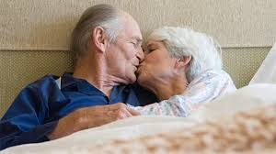
Improving Desire
Awareness of responsive desire (vs spontaneous)
Counseling
Mindfulness-based medication
If on ADT, possible intermittent dosing (if non-metastatic disease)
https://health.clevelandclinic.org/2014/03/how-you-can-help-a-spouse-with-cancer/
Abrahamsson. 2017. Asian Journal of Urology, In Press.
Nguyen et al. 2015. European Urology, 67, 825–836
Notes:
Helping to improve other concerns (pain, erectile concerns, ejaculatory concerns, etc.)
If on ADT, is intermittent therapy an option (not usually an option in metastatic context)
IADT seems to be as efficacious as CADT, especially in patients with lower disease burden; however, one should also remember that careful patient selection is the key to a good outcome. This implies that patients who achieve PSA levels 7, and have longer PSA doubling time may actually benefit with IADT. Importantly, this is the population that may truly benefit in terms of improved overall survival, slower time to progression, and have an improved QoL. Therefore, to achieve the maximum treatment benefit, it is important to closely monitor the patients on IADT for PSA and testosterone levels.

Slide 37
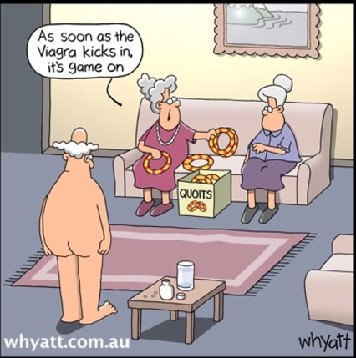
Improving erectile function
Assess reason(s) for erectile difficulty
Potential strategies to assist with EF:
Medications: PDE5 inhibitors, alprostadil cream
External penile prosthesis
Elator
Constriction ring
Vacuum erection device (VED)
Penile injections
Penile implant
Hatzimouratidis et al. 2016. J Sex Med. 13(4): 465-488.
Wassersug & Wibowo. Trans Androl Urol. 2017. 1-19
http://urology.ucla.edu/dealing-with-erectile-dysfunction
Notes:
Erections need not be the holy grail of sexual satisfaction!
Loss of erectile function…is a loss. Need to acknowledge as such
BUT…erection is not required for orgasm…
Reframing sexual practices
Oral, manual stimulation
Solo or mutual masturbation
Change in positions
Use of assistive aids (strap-ons, sleeves, Elator, etc. )
Use of vibrators, vibrating penis rings, prostate massagers
MSM, GB → removal of prostate can alter sensation and pleasure in receptive anal intercourse; receptive partners may find anal intercourse uncomfortable;
For GB, MSM and heterosexual men who engage in anal sex… may not achieve erection firm enough for penetration (needs to be ~ 30% firmer)

Slide 38
External Aids for Erectile function
Wassersug & Wibowo. Trans Androl Urol. 2017. 1-19
Notes:
(A) An external penile prosthesis; also called a belted prosthetic phallus in medicalized language (28) and a strap-on dildo in vernacular English (29). Some men recover orgasmic capability despite severe ED when they use this device for coitus. (B) A penile sleeve. Depending on the size, shape, thickness of sleeves, such aids can be used for sexual intercourse by men with ED. Some versions, like the RxSleeve, are designed to be used with a harness, others not. (C) The Elator, a penile support device. This device can be used for coitus. It works by extending the penile glans away from the base of the penis and bracing the penile shaft. (D) A VED. A commonly recommended device used to induce tumescence in the penile shaft, but erections acquired with a VED suffer from the hinge effect, which interferes with normal penile kinematics during an intercourse

Slide 39
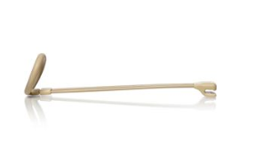
www.theelator.com/photosandvideos
Notes:
$298 per device (custom made according to penile length and girth)
Additional sleeves $89
https://www.theelator.com/

Slide 40
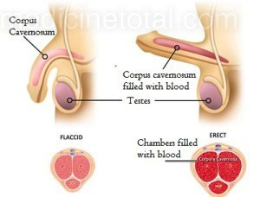
PDE5 Inhibitors
sildenafil, vardenafil, tadalafil
PDE5i → cause smooth muscle relaxation and increased blood flow into the penis
As needed/on-demand or daily dosing
Bella et al. 2015. Can Urol Assoc J. 9: 23-29
Hatzimouratidis et al. 2016. J Sex Med. 13(4): 465-488.
www.cialismd.com/mechanism-of-action.html
http://medicinetotal.com/how-does-viagra-work-the-principle-of-action-of-the-famous-blue-pill/
Notes:
Not helpful in all cases of ED…depends on the cause; for example, if etiology is neurogenic, may not derive any benefit from PDE5i; similarly, if the pt is hypogonadal, it may be necessary to replace T in addition to PDE5i
Similar SE profile and efficacy; biggest difference is t½…4-5 hours for sildenafil and vardenafil and ~18h for tadalafil
Cialis 5mg daily dosing (more spontaneity; solo activity…cost etc)
Do not cause indefinite erection…require sexual stimulation and then resolve following
PDE5 inhibitors: class-related SE, headache, dyspepsia, facial flushing, nasal stuffiness, altered vision (PDE6 inhibition), myalgia, back pain, all SE predom mild-mod
NO NITRATES
Staxyn: Orally disintegrating tablet (not SL); pharmacokinetically and dynamically similar to vadenafil;
Avanafil [Stendra] (newer PDE5i; recent approved in the US; not approved in Canada)…quicker onset, shorter half-life; nitrates can be given with 12 hours
‘Internet Viagra’ Herbals

Slide 41
Alprostadil cream
Topical transdermal alprostadil cream
Applied to tip and head of penis prior to sexual activity
May cause penile pain and redness
Considered 2nd line for ED
Anaissie & Hellstrom. 2016. Research and Reports in Urology :8 123–131
https://pdf.hres.ca/dpd_pm/00029108.PDF
Hatzimouratidis et al. 2016. J Sex Med. 13(4): 465-488.
Notes:
Rejected by FDA in 2014 – carcinogenicity in transgenic mouse models
Resubmitted application
Launching in Canada in 2018 (? May be awaiting approval in US..market at same time?)
Approved for use in Canada (2015)
Several RCTs have shown improvement in EF (vaginal penetration, persistence of erection, satisfaction) when compared to placebo
Alprostadil is a synthetic analog of prostaglandin E1 (PGE1). Its mechanism of action involves binding to G proteins coupled to PGE1 receptors on the surface of smooth muscle cells, activating cyclic adenosine monophosphate (cAMP) pathway and thus inducing vascular smooth muscle relaxation and erection. Unlike PDE5 inhibitors, which utilize the NO pathway, alprostadil’s action as a direct agonist means that it can produce erection independent of a stimulus.33
Because it influences blood flow, might be particularly helpful in vasculogenic ED…may not be as effective in neurogenic or hormonal ED
Onset: 5-30 mins
Duration: 1-2 hours Cannot use more than once/24 hours
Well tolerated (mild pain, redness at site of application). No significant drug-drug interactions.
Partner exposure…female partners did report occas vaginal burning, itching (temporary, resolved within 1-2 hours)
Do not use if partner is pregnant. Do not use if having oral sex (can use condoms)
Dodecyl-2-N,N-dimethylaminopropionate hydrochloride

Slide 42
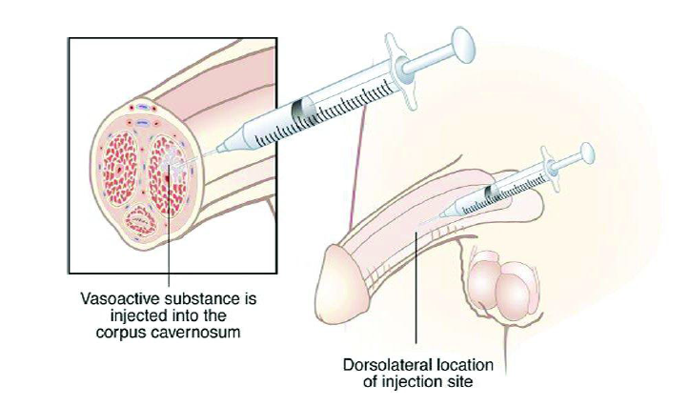
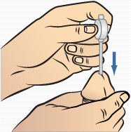
Other Options for Erectile Dysfunction
Intracavernosal injection (ICI) therapy
Transurethral therapy medicated urethral system for erection [MUSE]
Hatzimouratidis et al. 2016. J Sex Med. 13(4): 465-488.
www.mskcc.org/cancer-care/patient-education/penile-injection-therapy
www.muserx.com/hcc/about-muse/how-to-use-muse.aspx
www.urologic-specialists.com/sites/default/files/patient_information/Intracavernosal%20Self%20Injection%20Information.pdf
Notes:
ICI: 27g needle at lateral aspect of penile shaft; bypasses the need for neural input of NO (pts with a largely neurogenic form of ED, ex postradical prostatectomy, who fail oral therapy can be successfully treated with low dose ICI)
First dose usually given in urologist/physician’s office; pt’s often taught to self-inject Erection (with stimulation/foreplay) after ~20 mins
Efficacy: 85-90%; helpful for pts with neurogenic ED
Transurethral (medicated urethral system for erection [MUSE]) – alprostadil suppository [‘pellet’] (absorption from urethra and transport through the erectile bodies by communicating vessels between the corpus spongiosum and the corpora cavernosa)
Efficacy: 20-40%

Slide 43
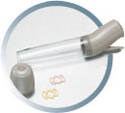
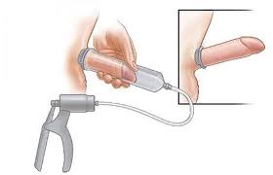
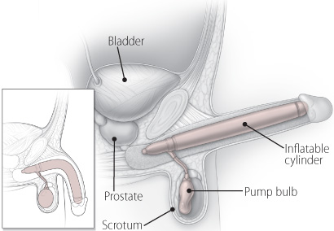
Other Options for Erectile Dysfunction
Vacuum devices
Penile implants
Hatzimouratidis et al. 2016. J Sex Med. 13(4): 465-488.
www.urologygroupvirginia.com/adult-patient-library-web-pages/erectile-dysfunction/erectile-dysfunction/
www.harvardprostateknowledge.org/treating-erectile-dysfunction-with-penile-implants
Notes:
Vacuum erection devices (VED): efficacy 90-100%
Inflatable implants. These may have a two- or three-piece design. Three-piece implants consist of a fluid-filled reservoir in the abdomen, a pump with a release valve in the scrotum, and two inflatable cylinders in the penis (see Figure 1). Squeezing the pump transfers fluid from the reservoir into the cylinders, causing an erection. Pushing the release valve drains the fluid back into the abdominal reservoir. Two-piece implants combine the fluid-filled reservoir and the pump in the scrotum (see Figure 2). Bending the penis returns the fluid to the reservoir.
Semirigid, or malleable, rods. As the name implies, this type of implant consists of bendable rods, usually constructed of braided stainless steel wires or articulating plastic disks, covered with silicone (see Figure 3). The rods are bent upward to have sex and pointed down to conceal the device under clothing. This type of implant is always firm.
Efficacy: 95-100%

Slide 44
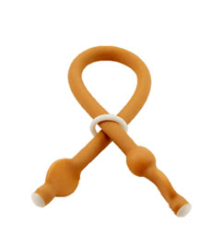
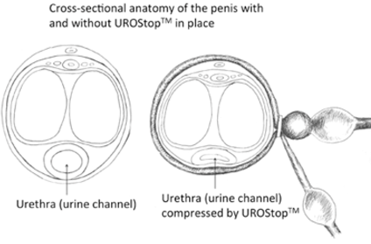
Managing Ejaculatory changes
Lack of ejaculate
awareness
discussion with partner
Climacturia
Empty bladder before sexual activity
Avoid caffeine, alcohol, etc.
Constriction ring
Condom
Pelvic floor physio
Painful ejaculation – will discuss on slide about orgasm
https://zionhealth.myshopify.com/products/urostop-stop-urine-leak-during-sex Mehta et al. 2012. BJU International. 111: 500-504
Notes:
Urostop -- $20 each; cheaper if more are purchased; non-latex
Painful ejaculation (dysorgasmia) – discuss on orgasm slide
Study on pelvic floor physio in pts after prostate cancer → ~50% of pts improved
Climacturia:
Empty bladder
Condom
Constriction ring → put on once achieved highest quality erection
Pelvic floor physio
Surgery → urinary sphincter or urinary sling (small study in men who also had incontinence

Slide 45
orgasm
Limited studies done on orgasmic dysfunction after prostate cancer
Possible strategies:
Psychotherapy: counseling, mindfulness
Penile vibratory stimulation (PVS)
Medication: pain medication, tamsulosin, cabergoline
Capogross, 2017. World J Mens Health, 35(1): 1-13. Hollander et al. 2016. Sex Med. 4(1): e28–e33.
Jenkins & Mulhall, 2015. Fertil Steril. 104(5): 1082-1088.
Notes:
the available therapeutic options for impaired or absent orgasmic sensation after surgery have been under-investigated. Poor understanding of mechanisms involved in orgasmic dysfunction after treatment etiology is likely multifactorial (psychogenic, neurovascular, hormonal, etc.) From a general perspective, there are no highly effective pharmacotherapies for altered orgasmic sensations, and the treatment is largely based on addressing potential causative factors, as well as on the use of psychotherapy
Diminished sensation at time of orgasm
Painful (dysorgasmia)
Lack of orgasm (anorgasmia)
PVS: applied to frenular area of glans Tamsulosin: 1 study, prospective, non-placebo controlled. No control group → was improvement d/t spontaneous recovery ?
Cabergoline: is a dopamine agonist that acts centrally to normalize serum prolactin (prolactin is thought to be responsible for refractory period); found to improve EF and libido in men with Parkinson’s disease
A recent report described resolution of idiopathic anorgasmia in an 82-year-old man using oxytocin.2 Prior studies have indicated that oxytocin levels increase during arousal and peak during orgasm.20 However, the 2- to 3-minute half-life of oxytocin necessitates intranasal administration during intercourse at the point when orgasm is desired, a significant inconvenience to the patient.2
Also, recent report published (2017) that oxytocin may be involved in pathogenesis of prostate cancer
N=131 men treated with cabergoline for orgasmic disorder, 87 (66.4%) reported subjective improvement in orgasm and 44 (33.6%) reported no change in orgasm.
Age and history of prostatectomy do not influence the efficacy of cabergoline, its use might be applicable in all men with orgasmic disorde

Slide 46
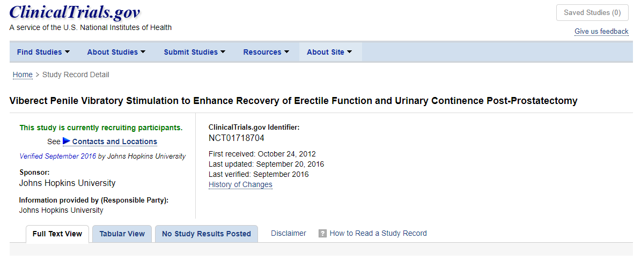
Penile vibratory stimulation (PVS)
https://clinicaltrials.gov/ct2/show/NCT01718704
Notes:
Penile vibratory stimulation is mostly used to stimulate an erection in men with ED and ejaculation in men with spinal cord injury. It works through the stimulation of branches of the pudendal nerves that lie along the penile shaft. The stimulation causes a reflex parasympathetic erection through the activation of nerve terminal endings that release nitric oxide and hence cGMP and cAMP that cause cavernosal smooth muscle dilation
Fode et al. (40) reported the first human trial to investigate if PVS helps to recover EF in patients undergoing nerve-sparing RP. In their study, they randomized 68 patients into using PVS with oral PDE5Is versus oral PDE5Is alone. PVS consisted of stimulating the frenulum once daily for at least 1 week before surgery and for 6 weeks after catheter was removed. After 12 months, results showed that IIEF scores were higher in patients using the combination of PVS with oral PDE5Is, although no statistical difference was appreciated. Although they did not specify which type, frequency or dosage of the PDE5Is was used, this trial suggests that PVS may play a future role in penile rehabilitation.
/
Vol 6, No 1 (February 2017) /
The controversy surrounding penile rehabilitation after radical prostatectomy
Review Article
The controversy surrounding penile rehabilitation after radical prostatectomy
Jonathan Clavell-Hernández¹, Run Wang^{1,2}

Slide 47
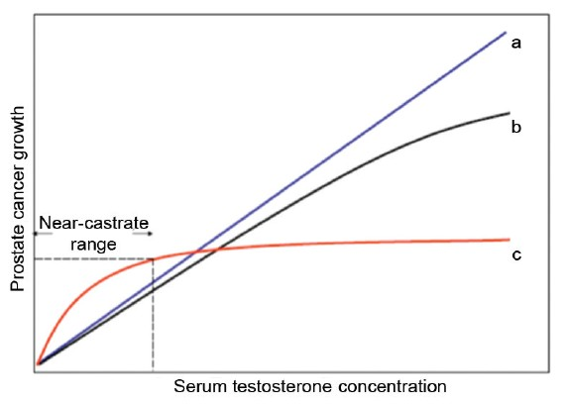
Testosterone Replacement After Prostate Cancer
Talk to your doctor
Injections, patches (Androderm®), gel (Androgel®), topical underarm solution (Axiron®)
Khera. 2014. European Urology, 65(1): 115-123 Morgentaler et al. 2015. Asian Journal of Andrology, 17(2): 206-211.
www.harvardprostateknowledge.org/testosterone-supplementation-after-prostate-cancer
Notes:
Being studied;
Proposed saturation model for the relationship of prostate cancer (PCa) growth and serum T concentration. The traditional belief has been that higher T concentration caused increasing rates of PCa growth, as represented by curves a and b. All available evidence demonstrates a powerful effect of T on PCa growth at low T concentration, yet little or no effect above the near-castrate range. The proposed model for the relationship between T and PCa is thus shown as curve c and is consistent with a saturation model, as seen in many other biologic systems. From Morgentaler.13
Whereas it had been assumed for decades that increasing serum androgen concentrations would increase PCa growth, it is now appreciated that PCa is exquisitely sensitive to changes in serum androgens at very low concentrations, yet behaves in indifferent fashion with changes in concentration above a saturation point, the concentration of maximal androgen stimulation. ^{[13],[14]} In other words, there is a limit to the ability of androgens to stimulate prostate growth, whether benign or malignant.
Does not seem to be as simple as dose-response/dose-risk; may have to do with saturation of receptors, etc. There may be a safe amount of T after prostate cancer BUT we do not know in what context (ie…only in early stage disease?? Vs late/metastatic disease) or what dose
Interesting as we know that prostate cancer risk increases as we age….T levels decline as we age; if it were as simple as amount of T in the body, young men, who have high T levels (comparatively) would be at higher risk and that is not the case
Not as simple as once thought….not merely related to absolute amount of T
Although it is clear that prostate cancer is exquisitely sensitive to changes in serum testosterone at low concentrations, there is considerable evidence that prostate cancer growth becomes androgen indifferent at higher concentrations. The most likely mechanism for this loss of androgen sensitivity at higher testosterone concentrations is the finite capacity of the androgen receptor to bind androgen. This saturation model explains why serum testosterone appears unrelated to prostate cancer risk in the general population and why testosterone administration in men with metastatic prostate cancer causes rapid progression in castrated but not hormonally intact men. Worrisome features of prostate cancer such as high Gleason score, extracapsular disease and biochemical recurrence after surgery have been reported in association with low but not high testosterone. In 6 uncontrolled studies results of testosterone therapy have been reported after radical prostatectomy, external beam radiation therapy or brachytherapy. In a total of 111 men 2 (1.8%) biochemical recurrences were observed. Anecdotal evidence suggests that testosterone therapy does not necessarily cause increased prostate specific antigen even in men with untreated prostate cancer.
Given the uncertainty of risks, we recommend limiting treatment with T to those with clear potential for benefits, namely those who are symptomatic.The safest group to offer T therapy consists of men with undetectable PSA 1-2 years following RP for Gleason 6 disease or lower. These men are at low risk for developing PCa recurrence.Somewhat more risky are men following XRT or brachytherapy, since the possibility exists of residual in situ PCa. These men often have low but detectable PSA levels, and PSA concentrations may fluctuate from time to time. If PSA rises, it may well be assumed by patient and healthcare providers that increased T was responsible.The most risky group is men with advanced, recurrent, or metastatic disease. It is to be expected that PSA will rise in these men over time, regardless of whether they receive T therapy. Many will eventually die from PCa. Any evidence for disease progression in the setting of T therapy will be attributed by others to higher T. We strongly caution against the use of T therapy in these populations, except in an investigational setting.Men on active surveillance also represent a high risk group. Published reports indicate that approximately 25%-30% of men on active surveillance protocols will demonstrate disease progression over 3-5 years, even without T therapy. Those prescribing T therapy may be held responsible for disease progression even if this would have occurred without treatment.Men with serum T concentrations below the saturation point (approximately 250 ng dl⁻¹ or 8 nmol l⁻¹ ) are likely to demonstrate a rise in PSA with T therapy. This occurs because serum PSA in a T-deficient man is falsely depressed. The magnitude of the PSA increase will be greater for men substantially below the saturation point than for men with serum T only slightly below it. PSA will usually stabilize after 3-6 months of T therapy. A continued rise beyond 6 months is worrisome for advancing disease.Use extreme caution in men currently on ADT, particularly if ADT had been instituted to treat metastatic disease. The likelihood is that whatever initial clinical benefits had accrued from ADT will be reversed with T therapy, with the possibility of even greater disease progression. This is the population that demonstrated a high rate of disease progression, usually within 30 days, in older studies leading to the subsequent prohibition against T therapy in all men with PCa. For men on ADT for minimal or localized disease (e.g. no metastases or nodal disease, low Gleason score), consideration should first be given to a trial off ADT, as this will adequately resolve symptoms of T deficiency in many men without resorting to exogenous T treatments.Patients must be advised that T therapy in men with PCa has not been adequately studied to provide any assurances of safety, and that treatment involves risk of PCa progression or recurrence, and death.We recommend a signed informed consent from all individuals who wish to undergo T therapy after a diagnosis of PCa, regardless of prior treatment or likelihood of cure.

Slide 48
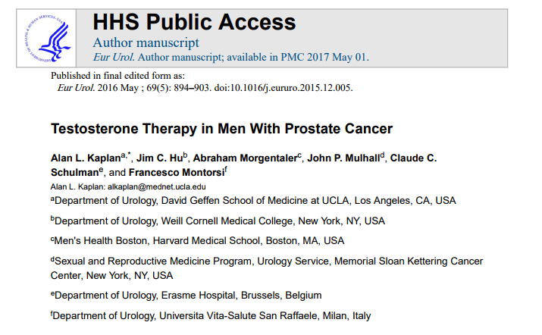

Slide 49
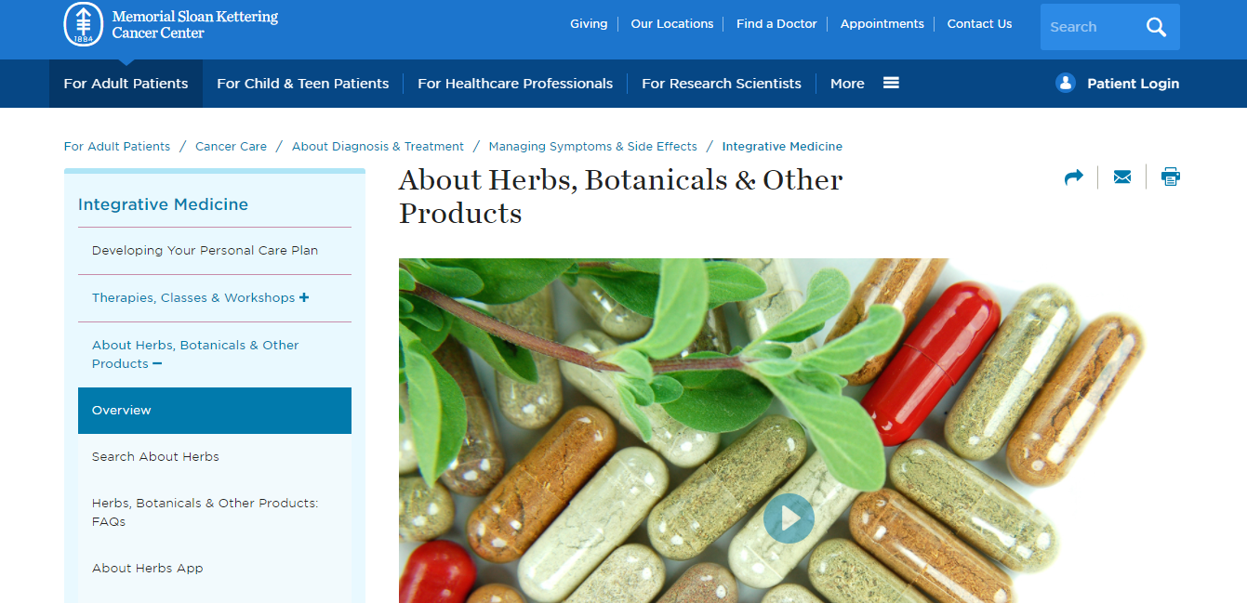
Herbal or ‘natural’ products
www.mskcc.org/cancer-care/diagnosis-treatment/symptom-management/integrative-medicine/herbs
Notes:
Be cautious about the use of herbal or ‘natural’ products…always check with your doctor as there may be interactions between the herbal product and other medications you are taking.
Presentation at the World Meeting on Sexual Medicine in Chicago in 2012:
Researchers tested ‘herbal and natural’ performance enhancement dietary supplements purporting to have PDE5i; purchased online
74/91 (81%) samples contained an active pharm ingredient (18 (20%) were overpotent)
35 (38%) actually contained tadalafil or sildenafil; 8 contained both
Labeling inadequacies: no expiration date or lot numbers included
Other analyses have revealed fillers such as brick dust, ink toner, etc.

Slide 50
Sexual enhancers

Slide 51
Lubricants
Lubricants
Available in gels or liquids
Applied in/around the genitals (partner too) prior to sexual activity. May need to be replaced during sexual activity.
Used to minimize dryness and pain during sexual activity and pelvic exams
Water and silicone based recommended; water based wash away more easily
Used immediately before and during sexual activity
Examples: Good Clean Love®, Liquid Silk®, KY®, Gun Oil®, O’My™
Carter et al. 2011. Journal of Sexual Medicine. 8: 549-559.
Notes:
Moisturizers and lubricants are different products with different intended uses.
Moisturizers: should be used 2-3 times/week for at least 2-3 months for optimal benefit
Moisturizers: best absorption when used before bedtime
Ex: vit E oil, Replens, coconut oil, Mae
Lubricants (to be used for sexual activity):
Avoid petroleum based lubricants as they do not wash away easily and can increase the risk of infection
Perfumed or flavored lubricants can cause irritation
Avoid glycerin (can cause yeast infections), propylene glycol (irritant) Some pts prefer paraben-free products
Vaginal Moisturizers
Available in gels, tablets or liquid bead
Administered in a tampon-shaped application or as a vaginal suppository
Used to hydrate the vaginal tissues and improve vaginal pH
Non-hormonal, over-the-counter
Last for up to 2-3 days then need to be reapplied (use 2-3 times/week)
Examples: Replens®, vitamin E capsules (need to be punctured prior to insertion), Mae, Me Again®, Hyalo-Gyn®, Luvena®

Slide 52
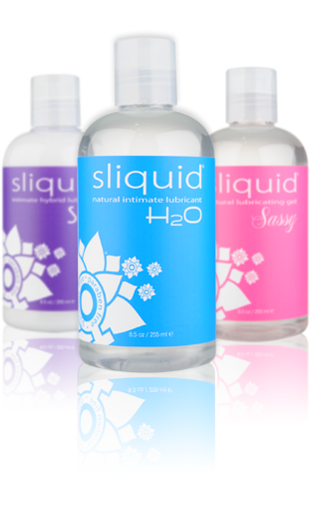
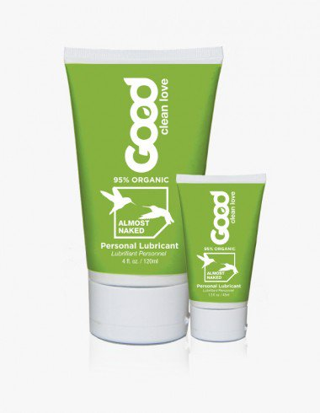
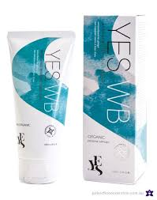
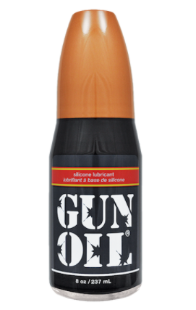
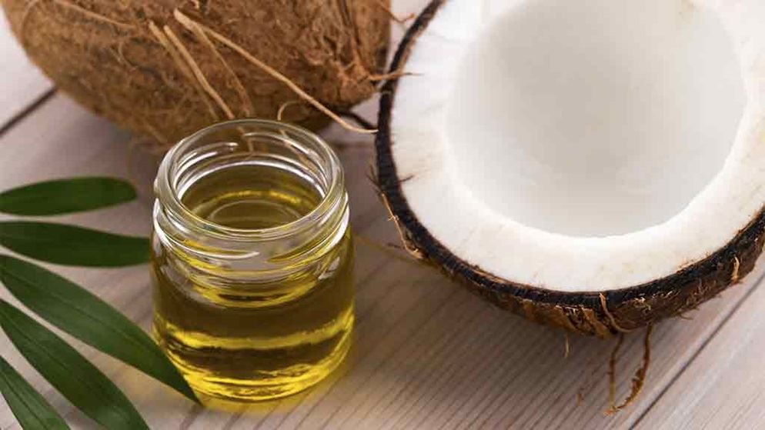
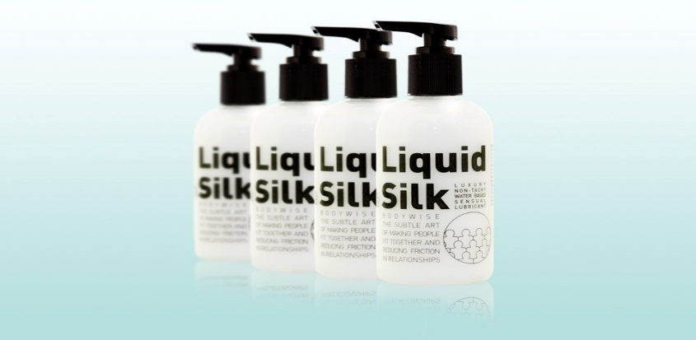
Lubricants: Examples
https://goodcleanlove.com/product-category/personal-lubricants/
liquidsilk.com
http://sliquid.com/
www.yesyesyes.org/
www.gunoil.com
Notes:
liquidsilk.com
http://sliquid.com/
https://www.yesyesyes.org/
OTC in drug stores, sex stores

Slide 53
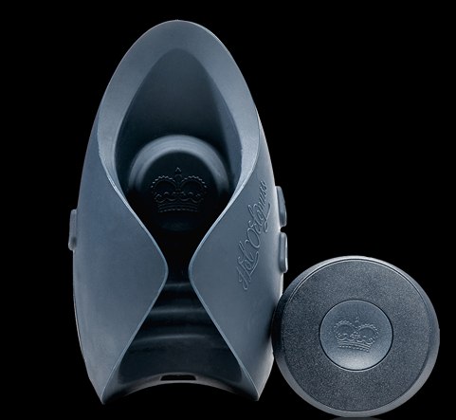
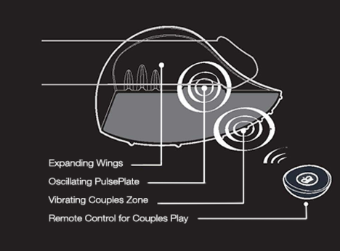
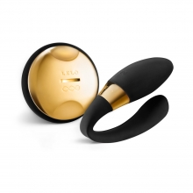
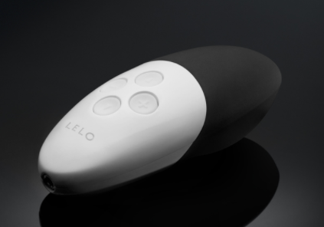
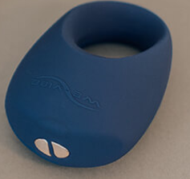
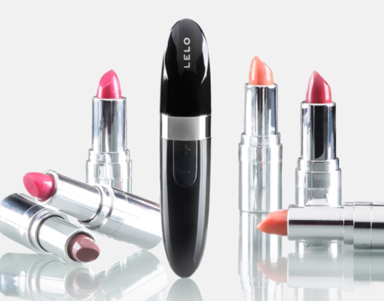
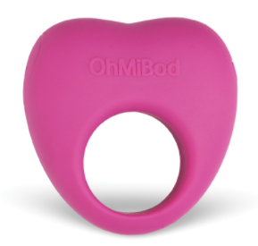
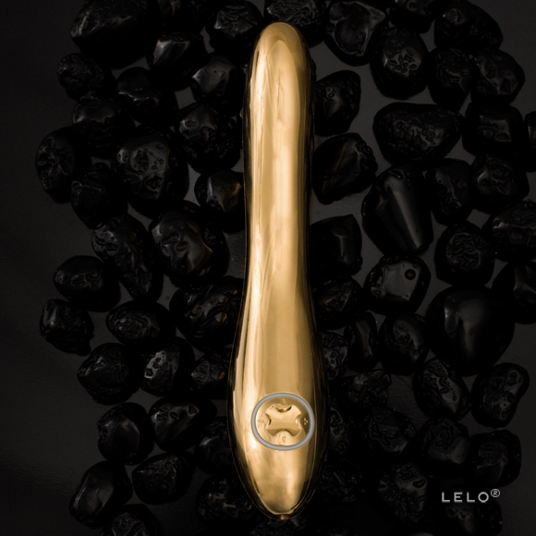
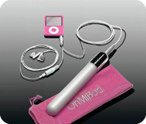
Vibrators
www.lelo.com we-vibe.com www.ohmibod.com www.hotoctopuss.com/pulse-iii/
Notes:
No research on vibrators for PVS
Pulse Duo → (hot octopuss); can be used flaccid or erect, solo or with partner. Adjustable. Can act as a masturbator (when used with lubricant).

Slide 54
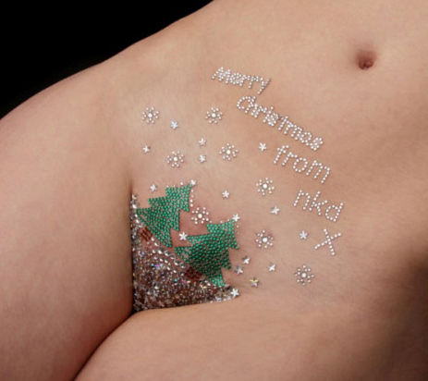
www.nkdwaxing.com/wp-content/uploads/2014/11/nkd-waxing-nottingham-festive-vajazzle-01-e1417276566432.jpg
www.morandinipeople.com/lepilation-integrale-gagne-du-terrain-chez-les-hommes/news/53639/attachment/pejazzle
Notes:
https://www.nkdwaxing.com/wp-content/uploads/2014/11/nkd-waxing-nottingham-festive-vajazzle-01-e1417276566432.jpg
http://www.morandinipeople.com/lepilation-integrale-gagne-du-terrain-chez-les-hommes/news/53639/attachment/pejazzle
Vajazzle
Pejazzle
‘Dickorating’
https://www.thesun.co.uk/living/1811856/x-factor-wannabe-ottavio-just-got-a-genital-wax-and-pejazzle-on-body-fixers/
If it suits you, Try to have fun with it!

Slide 55
Preserving Intimacy – Physical and Beyond
Walker et al. 2015. Nat Rev Urol,12(3):167-76.
Notes:
Adaptability Reframe sexual practices
Oral, manual stimulation, mutual masturbation, kissing, etc.
Changing positions (standing --- not flat on back, might help)
Cuddling

Slide 56
Resources
OASIS Clinic at TBCC
PCCN, Prostaid
Prostate Cancer Centre Calgary
→ Workshops on ADT, Intimacy
Books
Websites
Brochures
Notes:
Websites --- use direct website addresses (don’t type ‘sex’ into a Google search!)
Fertile Future, Fertile Hope
Counselors, psychologists

Slide 58
Websites
www.pccncalgary.org/
www.prostatecancer.ca/
www.prostate.org.au/
https://prostatecanceruk.org/
www.cancer.ca/en/cancer-information/cancer-type/prostate/prostate-cancer/
www.cancer.org/cancer/prostate-cancer.html
www.cancer.gov/types/prostate
www.mayoclinic.org/diseases-conditions/prostate-cancer/home/ovc-20317957
www.harvardprostateknowledge.org/
http://urology.ucla.edu/body.cfm?id=526

Slide 59
https://prostatecanceruk.org/prostate-information/living-with-prostate-cancer/gay-and-bisexual-men
www.prostatecancer.ca/Prostate-Cancer/Facing-Prostate-Cancer/Gay-and-Bisexual-Men-Prostate-Cancer
www.prostate.org.au/awareness/for-recently-diagnosed-men-and-their-families/gay-and-bisexual-men/
www.prostate.org.au/support/find-a-support-group/gay-mens-pcsg/
http://malecare.org/gay-prostate-cancer-and-doctors/
http://lgbtcancer.org/
http://lgbt.foundation/get-support/Groups/other-groups-we-support/out-with-prostate-cancer/

Slide 60
https://www.cancer.ca/~/media/cancer.ca/CW/publications/Sexuality%20and%20cancer/Sexuality-and-cancer-2012-EN.pdf

Slide 61
http://femaniwellness.com/ www.hotoctopuss.com
www.comeasyouare.com/
www.alittlemoreinteresting.com/
Notes:
pink cherry
A little more interesting
http://femaniwellness.com/
http://www.alittlemoreinteresting.com/

Slide 62
Take home messages
It is common for changes in sexuality to occur after a diagnosis of prostate cancer….for both the patient and the partner
There are a number of non-medical and medical interventions that may help to improve sexual function after prostate cancer
Try to let go of assumptions and expectations about sexual function. There is no ‘right’ amount of desire, no ‘perfect’ relationship and no such thing as a ‘normal’ sex life!
Notes:
What matters is how the changes affect the individual person and his partner (if he has a partner)

Slide 63
Take home messages
Talk to your healthcare provider to find out what option(s) is(are) best for you
If something isn’t working, try something else!
Keep talking…to your partner and to your healthcare provider. Don’t give up!
Notes:
Don’t be discouraged if something doesn’t work…it may need more time to ‘kick in’ or you may need to try something else…or a combination of a few things
Things may be different but that doesn’t mean that you cannot have a good quality, satisfying sexual relationship

Slide 64
Thank you!

